Slide 1
Are all CDK 4/6 inhibitors the same? NO
Manali Bhave, MD
Assistant Professor of Medicine
Phase I Medical Director
Winship Cancer Center
Emory University
Notes:
30 slides

Slide 2
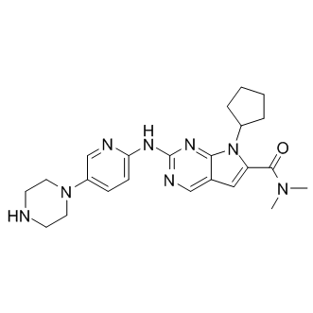
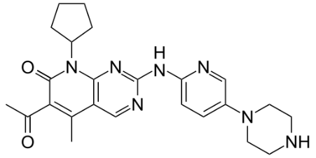
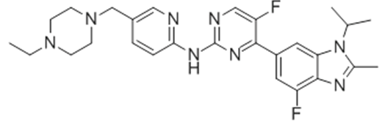
Approved CDK4/6 Inhibitors in Clinical Use
FDA Approved
(March 13, 2017)
Ribociclib
LEE011
FDA Approved
(September 27, 2017)
FDA Approved
(February 4, 2015)
Abemaciclib
LY2835219
Palbociclib
PD 0332991
Approved for HR+HER2- mBC….?adjuvant setting
Approved for HR+HER2- mBC with ET or monotherapy AND in adjuvant LN+ HR+HER2- EBC
Approved for HR+HER2- mBC
Notes:
Let’s begin with a look at the approved CDK 4/6 inhibitors.
Beginning in 2015, there are now 3 CDK 4/6 inhibitors approved for the treatment of metastatic HR+ HER2- breast cancer beginning with Palbociclib in 2015, followed by Ribociclib and Abemaciclib in 2017
Besides the overall similarities associated with CDK4/6 inhibition, there are unique differences between these agents in their pharmacology, kinase targets, central nervous system (CNS) penetration and clinical activity as single agents. These differences may explain the differences noted in their use in unique clinical scenarios- monotherapy, patients with brain metastases or use in the adjuvant setting.

Slide 3
CDK4/6 Inhibitors: Dosing Considerations
 | Palbociclib¹ | Ribociclib² | Abemaciclib³
Dosage Form | Capsule | Film-coated tablets | Tablets
Recommended Dose | 125 mg D 1-21 of 28 day cycle | 600 mg (3x200 mg) D 1-21 of 28 day cycle | 150 mg (when used as combination therapy) BID Daily | 200 mg (when used as monotherapy) BID Daily
Half Life | 29 (+/- 5) hours | 32 hours | 18.3 hours
Kinase Activity | Similar potency against CDK4 and CDK6 | CDK 4 > CDK 6 | CDK 4 > CDK 6, inhibits multiple kinases
Administration Considerations | Should be taken with food | May be taken with or without food | May be taken with or without food
Palbociclib Product Monograph. June 5, 2018
Ribociclib Product Monograph. March 19, 2018
Abemaciclib Product Monograph. August 2018
Notes:
Let’s start by looking at differences in dosing
As we know, palbociclib is dosed once days on days 1-21 of a 28 day cycle starting at a dose of 125mg
Ribociclib is dosed once daily on days 1-21 of a 28 day cycle starting at a dose of 600mg
Abemciclib is dosed on a continuous dosing schedule TWICE per day at 150mg BID if given in combination therapy or 200mg BID when used as monotherapy
The mean half-life of palbociclib is 29 (+/- 5) hours (30), ribociclib is 32 hours (31) and abemaciclib is18.3 hours (32). Palbociclib and ribociclib have a longer half-life than abemaciclib and hence are administered once a day. Abemaciclib needs twice daily administration. (See Table 1 ) The difference in dosing schedules affect the serum plasma concentrations of the drugs. The longer, > 24-hour half-lives of palbociclib and ribociclib in conjunction with daily dosing may result in drug accumulation. As a result, palbociclib and ribociclib have non-continuous dosing requiring a one week break between cycles.
In a phase 1 study of the bioavailability of palbociclib, food intake modestly increased drug absorption and decreased variability in serum drug concentration over time, as determined by the area under the curve. Food has not been shown to affect the bioavailability of either ribociclib or abemaciclib
All three drugs inhibit CDK 4 and CDK 6 kinase activity, however abemeciclib inhibits multiple other kinases as well (35). Palbociclib has similar potency against cyclin D1/CDK4 and cyclin D2/CDK6 (36). Abemaciclib and ribociclib were noted to have greater potency against CDK4 than CDK 6 (35, 37). Abemaciclib is 14 times more potent against CDK4 than it is against CDK6 (38). Abemaciclib has five-fold more potency for CDK4 than palbociclib or ribociclib (16, 35). Unlike palbociclib and ribociclib, abemaciclib has been shown to have in-vivo inhibition of CDK1, CDK2, CDK5, CDK9, CDK14, CDKs16-18, GSK3α/β, CAMKIIγ/δ and PIM1 kinases (35, 39). Abemaciclib is 10- to 100-fold less potent against CDK2 and CDK1 than CDK4/6 (40).
CDK4/6 inhibitors induce cytostasis through cell-cycle arrest in the G1 phase, resulting in growth inhibition. However, pre-clinical models of abemaciclib demonstrated that it can induce tumor cell death and regression, rather than cell cycle arrest alone. This is evidenced by the fact that monotherapy with abemaciclib in a Phase I study was shown to decrease tumor size, rather than simply inhibit growth in solid tumors including breast cancer (41). Based on these results, abemaciclib was thought to have additional mechanisms of action outside of just inducing G1-cell cycle arrest.

Slide 4
Safety Profiles Vary Across CDK4/6 Inhibitors: First Line
AEs (≥ 20% All grades and of special interest) | PALOMA-2¹⁻³ PAL + LET (n = 444) |  |  | MONALEESA-2^{4,5} RIB + LET (n = 334) |  |  | MONALEESA-7^{5,6} RIB + TAM/NSAI (n = 335) |  |  |  |  | MONARCH 3^{7,8} ABE + NSAI (n = 327)
 | Total | Grade 3 | Grade 4 | Total | Grade 3 | Grade 4 | Total | Grade 3 |  | Grade 4 |  | Total | Grade 3 | Grade 4
Haematological AEs
Neutropenia | 80 | 56 | 10 | 74 | 50 | 10 | 76 |  | 51 |  | 10 | 41 | 20 | 2
Febrile neutropenia | 1.8 |  |  | 1.5 |  |  | 2 |  |  |  |  | 0.3
Infections | 60 | 6 | 1 | 50 | 4 | <1 | NR |  |  |  |  | 39 | 4 | <1
Leukopenia | 39 | 24 | 1 | 33 | 20 | 1 | 31 |  | 13 |  | 1 | 21 | 7 | <1
Anaemia | 24 | 5 | <1 | 18 | 1 | <1 | 21 |  | 10 |  | 0 | 28 | 6 | 0
Gastrointestinal AEs
Nausea | 35 | <1 | 0 | 52 | 2 | 0 | 32 |  | 1 |  | 0 | 39 | <1 | 0
Stomatitis | 30 | 1 | 0 | 12 | <1 | 0 | 10 |  | 1 |  | 0 | NR
Diarrhea | 26 | 1 | 0 | 35 | 1 | 0 | 20 |  | 1 |  | 0 | 81 | 9 | 0
Vomiting | 16 | 1 | 0 | 29 | 4 | 0 | 19 |  | 1 |  | 0 | 28 | 1 | 0
Constipation | 19 | <1 | 0 | 25 | 1 | 0 | 16 |  | 0 |  | 0 | 16 | <1 | 0
Abdominal pain | 11 | 1 | 0 | 11 | 1 | 0 | 10 |  | 1 |  | 0 | 28 | 1 | 0
Other
ALT Increased | 10 | NR | NR | 16 | 7 | 2 | 12 |  | 4 |  | 0 | 16 | 6 | <1
AST Increased | 10 | NR | NR | 15 | 5 | 1 | 13 |  | 5 |  | 0 | 15 | 3 | 0
Post-baseline QTcF >480/500 ms | 1.6/0.2 |  |  | 3.3/NR |  |  | 7/1 |  |  |  |  | NR
Thromboembolic events | NR |  |  | NR |  |  | NR |  |  |  |  | 5
Alopecia | 33 | NA | NA | 33 | NA | NA | 19 |  | NA |  | NA | 27 | NA | NA
Fatigue | 37 | 2 | 0 | 37 | 2 | <1 | 24 |  | 1 |  | 0 | 40 | 2 | 0
Discontinuation due to AEs vs PBO (%) | 9.7 vs. 5.9 |  |  | 7.5 vs 2.1 |  |  | 4 vs 3 |  |  |  |  | 19.6 vs 2.5
Dose Reduction due to AEs vs PBO (%) | 36 vs 1.4 |  |  | 50.6 vs 4.2 |  |  | 31 vs 5 |  |  |  |  | 43.4 vs 6.2
Any SAEs vs PBO (%) | 19.6 vs 12.6 |  |  | 21.3 vs 11.8 |  |  | 18 vs 12 |  |  |  |  | 27.5 vs 14.9
Cross-trial comparisons need to be taken with caution. ABE, abemaciclib; AE, adverse events; ALT, alanine aminotransferase; AST, aspartate aminotransferase; LET, letrozole; NR, not reported; NSAI, non-steroidal anti-inflammatory drug; PAL, palbociclib; PBO, placebo; RIBO, ribociclib; SAE, serious adverse events; TAM, tamoxifen; 1L, first-line. 1. Finn RS et al. N Engl J Med. 2016;375:1925‒36; 2. Palbociclib prescribing Information. Pfizer Inc; 2019; 3. Durairaj et al. Anticancer Drugs. 2018;29:271-280; 4. Hortobagyi G, et al. N Engl J Med. 2016;375:1738-1748; 5. Ribociclib prescribing Information. Novartis; 2020; 6. Tripathy D, et al. Lancet Oncol. 2018;19:904-915; 7. Goetz MP, et al. J Clin Oncol. 2017;35:3638-3646; 8. Abemaciclib prescribing information. Lilly; 2020.
Notes:
Here is a bit of a busy slide listing the most common Aes and Aes of special interest seen in the PALOMA, MONALEESA and MONARCH clinical trials for palbociclib, ribociclib and abemaciclib, respectively
The differential targets of these drugs, especially the relative potency of CDK4 vs CDK6 and are most likely responsible for the different dose limiting toxicities.
Some of the pertinent side effects for each of the drugs are as follows: Neutropenia, leukopenia and fatigue for palbociclib; neutropenia, increased creatinine, hyponatremia, QTc prolongation for ribociclib; diarrhea, fatigue and a rarer but drug-specific side effect of thromboembolic events for abemaciclib.
We also see differences in discontinuation rates related to Aes compared to placebo in each of these studies with significant higher rate of discontinuation and dose reductions with abemaciclib compared to ribociclib and palbociclib

Slide 5
Differences in Toxicity Profiles Require Different Monitoring Schedules
Palbociclib | CYCLE 1 |  | CYCLE 2 |  | CYCLES 3–6 | CYCLES 6+
 | Day 1† | Day 15 | Day 1 | Day 15 | Day 1 | Day 1 | As clinically indicated
CBC | ✓ | ✓ | ✓ | ✓ | ✓ | ✓‡ | ✓
Pulmonary symptoms indicative of ILD/pneumonitis |  |  |  |  |  |  | ✓
Ribociclib | CYCLE 1 |  | CYCLE 2 |  | CYCLES 3–6 | CYCLES 6+
 | Day 1† | Day 14 | Day 1 | Day 14 | Day 1 | Day 1 | As clinically indicated
CBC | ✓ | ✓ | ✓ | ✓ | ✓ |  | ✓
LFT | ✓ | ✓ | ✓ | ✓ | ✓ |  | ✓
Serum electrolytes | ✓ |  | ✓ |  | ✓ |  | ✓
ECG | ✓ | ✓ | ✓ |  |  |  | ✓
Pulmonary symptoms indicative of ILD/pneumonitis⁴ |  |  |  |  |  |  | ✓
Abemaciclib | MONTH 1 |  |  | MONTH 2 |  | MONTH 3 | MONTH 4
 | Day 1† | Week 2 | Week 4 | Week 6 | Week 8 | Week 12 | Week 16 | As clinically indicated
CBC | ✓ | ✓ | ✓ | ✓ | ✓ | ✓ | ✓ | ✓
LFT | ✓ | ✓ | ✓ | ✓ | ✓ | ✓ | ✓ | ✓
Pulmonary symptoms indicative of ILD/pneumonitis |  |  |  |  |  |  |  | ✓
Notes:
Differences in toxicities between the different drugs requires different monitoring schedules as outlined here, though in the interest of time and if I haven’t convinced you yet, let’s move on to key differences in the pivotal clinical trials leading to the approval of these agents

Slide 6
Results for Pivotal CDK 4/6 Inhibitor Trials
Trial | CDK Inhibitor | Line of Therapy (Endocrine Rx) | Menopausal Status | PFS HR | Statistical Significance | OS HR | Statistical Significance
PALOMA-2^{[1]} | Palbociclib | 1st Line/AI | Post | 0.56 | Yes | 0.96 | No
MONALEESA-2^{[2]} | Ribociclib | 1st Line/AI | Post | 0.57 | Yes | 0.76 | Yes
MONALEESA-7^{[3a]} | Ribociclib | 1st Line/AI or Tam | Pre/Peri | 0.55 | Yes | 0.70 | Yes
MONARCH-3^{[4]} | Abemaciclib | 1st Line/AI | Post | 0.54 | Yes | 0.75 | No (@IA2)
PALOMA-3^{[5]} | Palbociclib | 2nd Line/Fulv | Pre/Post | 0.46 | Yes | 0.81 | No
MONARCH-2^{[6]} | Abemaciclib | 2nd Line/Fulv | Pre/Post | 0.55 | Yes | 0.78 | Yes
MONALEESA-3^{[7]} | Ribociclib | 1st /2nd Line/Fulv | Pre/Post | 0.59 | Yes | 0.72 | Yes
a. Missing survival data (ie, pts who withdrew consent or were lost to follow-up) and were censored (assumed to be alive) at time of analysis: 13% in palbo+AI arm vs 21% in control arm.
b. 27% of patients in control arm went on to receive a CDK4/6i (24% received palbociclib).
c. PFS/OS data reported for approved AI subset.
AI indicates aromatase inhibitor; Fulv, fulvestrant; IA2, interim analysis 2; NR, not reported; Rx, therapy.
1. PALOMA-2: Finn R, et al. N Engl J Med. 2016;375:1925-1936; Rugo H, et al. Breast Cancer Res Treat. 2019;174:719-729. Finn R, et al. ASCO 2022. LBA1003. 2. MONALEESA-2: Hortobagyi G, et al. N Engl J Med. 2016;375:1738-1748; Hortobagyi G, et al. Ann Oncol. 2018;29:1541-1547; Hortobagyi G. et al. ESMO 2021. Abstract LBA17_PR. 3. MONALEESA-7: Tripathy D, et al. Lancet Oncol. 2018;19:904-915; Im S-A, et al. New Engl J Med. 2019;381:307-316. 4. MONARCH-3: Goetz M, et al. J Clin Oncol. 2017;35:3638-3646; Johnson S, et al. NPJ Breast Cancer. 2019;5:5. Goetz MP, et al. ESMO 2022. Abstract LBA 15. 5. PALOMA-3: Turner NC, et al. New Engl J Med. 2015;373:209-219; Cristofanilli M, et al. Lancet Oncol. 2016;17:425-439; Turner NC, et al. New Engl J Med. 2015;373:1672-1673. 6. MONARCH-2: Sledge G, et al. J Clin Oncol. 2017;35:2875-2884; Sledge G, et al. JAMA Oncol. 2020;6:116-124. 7. MONALEESA-3: Slamon D, et al. J Clin Oncol. 2018;36:2465-2472; Slamon D, et al. New Engl J Med. 2020;382:514-524.
Notes:
While the PALOMA, MONALEESA and MONARCH studies showed statistically significant improvements in PFS across all 3 CDK 4/6 inhibitors, we saw differences in OS benefit with ribociclib reaching statistically significant OS benefit in MONALEESA 2, 7 and 3 and abemaciclib reaching OS benefit in monarch-2 with a numerical trend favoring OS benefit in monarch 3 though data is immature. We unfortunately did not see a statistically significant improvement in OS with PALOMA-2 or 3.

Slide 7
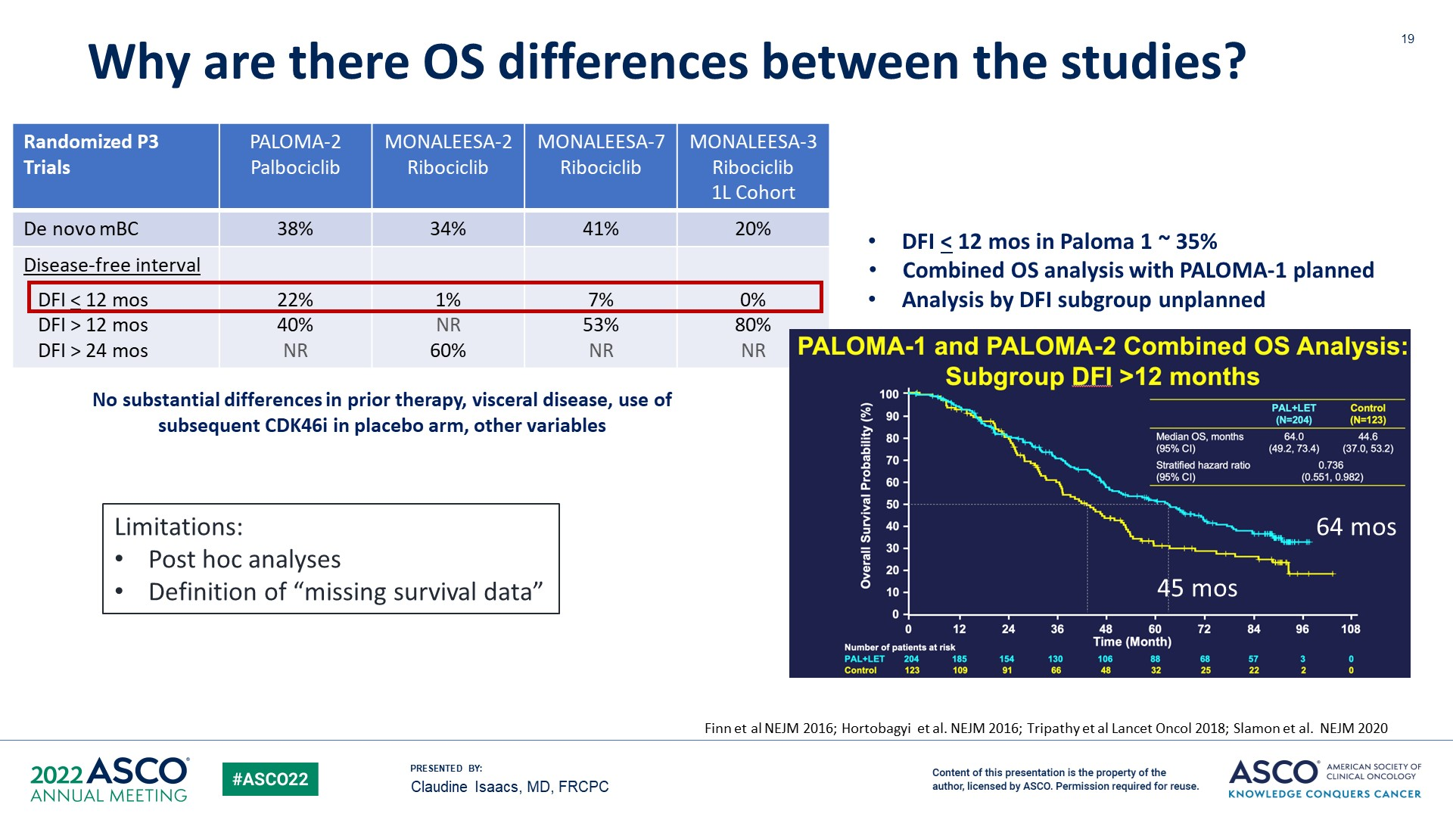
Why are there OS differences between the studies?
*
Paloma-2: Missing survival data and were censored at time of analysis: 13% in palbo+AI arm vs 21% in control arm. 27% of pts in control arm went on to receive a CDK4/6i (24% received palbo).
Adopted from Claudine Isaacs
Notes:
Why are there OS differences between the studies?
There are likely a number of factors contributing to OS differences between these CDK 4/6 inhibitors including the fact that these drugs are simply different, however, it is important to note that differences in trial design/eligibility and missing survival data may also have contributed to these differences.
As we can see, PALOMA-2 included a greater number of patients with higher risk disease with a DFI of <12 months compared to the other studies (22% versus 0-7% across the MONALEESA studies) and had significant missing survival data 13% in the palbo arm versus 21% in the control arm.
In a combined posthoc analysis of OS in PALOMA 1 and 2 in the subgroup of patients with DFI >12, we do see a widening of the KM curves with a numerically improved OS benefit with palbociclib + ET compared to the control arm; however, once again PALOMA-2 did not show a statistically significant OS benefit.

Slide 8
MAINTAIN Trial: Schema
Key Entry Criteria
Men or Women age > 18 yrs
ER and/or PR > 1%, HER2- MBC
Progression on ET + any CDK 4/6 inhibitor
< 1 line of chemotherapy for MBC
Measurable or non-measurable
PS 0 or 1
Postmenopausal
  GnRH agonist allowed if premenopausal
Stable brain metastases allowed
Primary Endpoint
Progression free survival
  Locally assessed per RECIST 1.1
Secondary Endpoints
Overall response rate
Clinical benefit rate
Safety
Tumor and blood markers, including circulating tumor DNA
Arm 1
Ribociclib + Switch Endocrine Therapy*
1:1
Arm 2
Placebo + Switch
Endocrine Therapy*
N=120
  Fulvestrant as endocrine therapy in pts with progression on a prior aromatase inhibitor for MBC and no prior fulvestrant; Protocol amended to allow exemestane as endocrine therapy if progression on prior fulvestrant (September 2018); Ribociclib 600 mg administered 3 weeks on/1 week off
Kevin Kalinsky, MD, MS
Notes:
Now let’s look at use of CDK 4/6 inhibitors after progression on CDK 4/6 inhibitor
The MAINTAIN study is a phase II study evaluating the use of ribociclib + switch in ET versus placebo + switch in ET in patients with mHR+ HER2- breast cancer with progression on ET + any CDK 4/6 inhibitor
The primary endpoint was PFS per RECIST 1.1 criteria, with secondary endpoints including ORR, CBR, safety and tumor and blood markers

Slide 9
Patient Characteristics and Prior Treatment
 | Placebo (n=59) | Ribociclib (n=60)
Female - no. (%) | 58 (99%) | 60 (100%)
Median age – years (IQR) | 59 (52-65) | 55 (48-67)
Race or ethnic group – no. (%)
White | 42 (71%) | 46 (77%)
Black | 8 (14%) | 5 (8%)
Asian | 2 (3%) | 5 (8%)
Other or not specified | 7 (12%) | 4 (7%)
ECOG PS – no. (%)
0 | 38 (64%) | 40 (67%)
1 | 21 (36%) | 20 (33%)
De Novo Metastasis at Dx - no. (%)*** | 32 (54%) | 21 (35%)
Visceral Metastasis – no. (%) | 35 (59%) | 36 (60%)
Bone-Only Disease – no. (%) | 9 (15%) | 13 (22%)
> 2 prior ET for MBC – no. (%) | 11 (19%) | 11 (18%)
Chemotherapy for MBC – no. (%) | 7 (12%) | 4 (7%)
 | Placebo (n=59) | Ribociclib (n=60)
Prior CDK 4/6 inhibitor – no. (%)
Palbociclib* | 51 (86%) | 52 (87%)
Ribociclib** | 8 (14%) | 6 (10%)
Abemaciclib | 0 (0%) | 2 (3%)
Median duration of prior CDK 4/6 inhibitor - months (IQR) | 17 (11-23.5) | 15.5 (12-21)
Prior CDK 4/6 inhibitor duration– no. (%)****
< 12 months | 21 (36%) | 18 (30%)
> 12 months | 38 (64%) | 42 (70%)
Prior CDK 4/6 inhibitor in metastatic setting - no. (%) | 59 (100%) | 60 (100%)
Intervening treatment after progression on prior CDK 4/6 inhibitor - no. (%) | 6 (10%) | 1 (2%)
* Includes 1 pt who did not tolerate prior abemaciclib and 2 pts with insurance issues with ribociclib; ** Includes 1 pt who did not tolerate prior palbociclib;
***p=0.035; **** 10 pts (17%) in placebo arm and 7 pts (12%) pts in ribociclib arm on prior CDK4/6 inhibitor < 6 months; IQR = interquartile range
Kevin Kalinsky, MD, MS
Notes:
Patient characteristics were well balanced between the two arms with the majority of patients having visceral disease, a small minority receiving chemotherapy prior to study enrollment (slightly higher in the placebo arm) and the majority having received palbociclib as prior CDK 4/6 inhibitor for at least 15 months

Slide 10
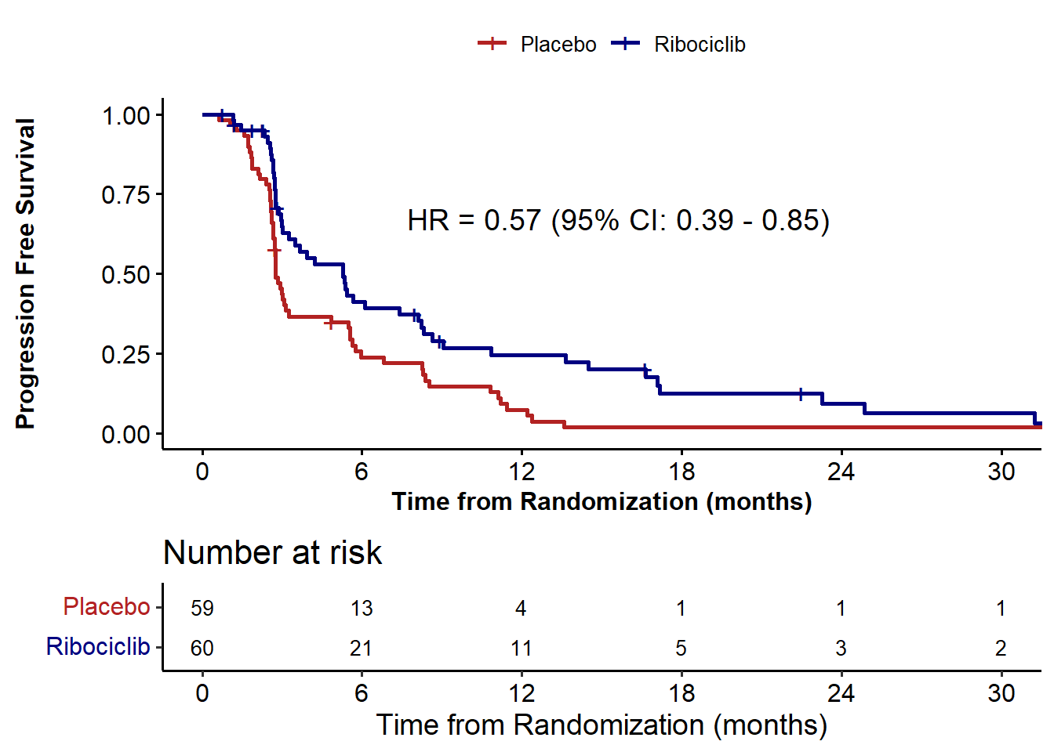
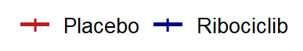
Progression Free Survival
 | Placebo + ET (n=59) | Ribociclib + ET (n=60)
Median: 95% CI (months) | 2.76 (2.66-3.25) | 5.29 (3.02-8.12)
PFS rate at 6 months (95% CI) | 23.9% (12.8%-35%) | 41.2% (27.8%-54.6%)
PFS rate at 12 months (95% CI) | 7.4% (0.4%-14.3%) | 24.6% (12.5%-36.7%)
Median PFS:
HR=0.57 (95% CI: 0.39-0.95), p=0.006
Kevin Kalinsky, MD, MS
Notes:
The study showed a statistically significant improvement in PFS of 5.3 mos with ribociclib + ET compared to 2.7 mos with ET alone with clinically meaningful improvement in PFS at 6 and 12 months with ribociclib
This study was hypothesis generating and supports further investigation of ribociclib + ET after progression on prior CDK 4/6 inhibition

Slide 11
PACE Trial: Schema
RANDOMI
Z
E
Eligibility Criteria
HR+/HER2- MBC
Progression on CDK4/6i and ET, with >6mo SD on prior regimen
<2 prior lines ET for MBC
No prior fulvestrant
0-1 prior chemo for MBC
Fulvestrant: 500 mg IM C1D1,15, then q28d
1:2:1 randomization; stratified by exposure to chemo between CDK4/6i and entry onto trial
Fulvestrant: 500 mg IM C1D1,15, then q28d
Palbociclib: 125 mg PO qd 1-21d in a 28d cycle (or lower starting dose to match prior treatment)
Fulvestrant: 500 mg IM C1D1,15, then q28d
Palbociclib: 125 mg PO qd 1-21d in a 28d cycle
Avelumab: 10 mg/kg IV q14d
N=220
Baseline archival tissue
Baseline ctDNA, CTC
ctDNA
ctDNA, CTC
ctDNA
ctDNA
Primary objective: To compare PFS (RECIST-confirmed) for fulvestrant+palbociclib vs. fulvestrant alone
Secondary objectives: To compare PFS for fulvestrant+palbociclib+avelumab vs fulvestrant alone, response endpoints, safety, outcomes in predefined molecular subgroups including ESR1, PIK3CA, and Rb.
Notes:
Unfortunately, we did not see the same result with the PACE clinical trial. PACE was a phase II clinical trial evaluating the combination of palbociclib (Ibrance) plus fulvestrant (Faslodex) vs fulvestrant alone in pateints with mHR+ HER2- breast cancer who progressed on CDK 4/6 inhibtior and ET with at least 6 months of SD on prior CDK 4/6 inhibitor. No prior fulvestrant was allowed.
Patients were randomized in in a 1:2:1 fashion to SOC fulvestrant alone, palbociclib plus fulvestrant, or palbociclib plus fulvestrant and avelumab.
The primary endpoint was PFS for fulvestrant + palbociclib versus fulvestrant alone with secondary objectives inlcuding PFS for the triplet arm with avelumab versus fulvestrant alone, response endpoints, safety and outcomes in predefined molecular subgroups

Slide 12
PACE Trial: Patient Demographics
 | Fulvestrant (n=55) |  | Fulvestrant + Palbociclib (N=111) |  | Fulvestrant + Palbociclib + Avelumab (N=54) |  | Overall (n = 220)
 | N | % | N | % | N | % | N | %
Female | 55 | 100.0 | 109 | 98.2 | 54 | 100.0 | 218 | 99.0
Age (median, range) | 58 (36-77) |  | 55 (28-77) |  | 58 (25-83) |  | 57 (25-83)
Race White Black Asian Other | 47 3 0 5 | 85.5 5.5 0 9.1 | 88 13 4 6 | 79.3 11.7 3.6 5.4 | 44 4 3 3 | 81.5 7.4 5.6 5.6 | 179 20 7 14 | 81.4 9.1 3.2 6.4
Post-menopausal | 47 | 85.5 | 87 | 78.4 | 44 | 81.5 | 178 | 80.9
De novo MBC | 28 | 50.9 | 40 | 36.0 | 20 | 37.0 | 88 | 40.0
Visceral disease | 29 | 52.7 | 70 | 63.1 | 33 | 61.1 | 132 | 60.0
Bone only disease | 4 | 7.3 | 18 | 16.2 | 8 | 14.8 | 30 | 13.6
Measurable disease | 37 | 67.3 | 73 | 65.8 | 39 | 72.2 | 149 | 67.7
Unknown values are omitted from the table.
Notes:
The majority of patients were postmenopausal with visceral disease

Slide 13
PACE: Prior Treatment Characteristics
 | Fulvestrant (n=55) |  | Fulvestrant + Palbociclib (N=111) |  | Fulvestrant + Palbociclib + Avelumab (N=54) |  | Overall (n = 220)
 | N | % | N | % | N | % | N | %
Prior adjuvant endocrine exposure* Endocrine resistant Endocrine sensitive | 10 45 | 18.2 81.8 | 32 78 | 28.8 70.3 | 16 37 | 29.6 68.5 | 58 160 | 26.4 72.7
Prior CDK4/6i Palbociclib Ribociclib Abemaciclib | 52 1 2 | 94.5 1.8 3.6 | 102 5 3 | 91.9 4.5 2.7 | 46 4 4 | 85.2 7.4 7.4 | 200 10 9 | 90.9 4.5 4.1
Duration of prior CDK4/6i + ET 6-12 months > 12 months | 10 45 | 18.2 81.8 | 26 84 | 23.4 75.7 | 16 38 | 29.6 70.4 | 52 167 | 23.6 75.9
Prior chemotherapy for MBC | 11 | 20.0 | 16 | 14.4 | 9 | 16.7 | 36 | 16.4
Line of MBC therapy initiated in PACE First line Second Line > Second Line | 3 42 10 | 5.5 76.4 18.2 | 5 83 21 | 4.5 74.8 18.9 | 2 44 7 | 3.7 81.5 13.0 | 10 169 38 | 4.5 76.8 17.3
Any systemic therapy between prior CDK4/6i and randomization | 5 | 9.1 | 16 | 14.4 | 5 | 9.3 | 26 | 11.8
Unknown values are omitted from the table.
*Endocrine resistant: recur <1y of adj ET. Endocrine sensitive: de novo MBC, or no adj ET, or recur >1y after adj ET. Adapted from ESO-ESMO guidelines, Ann Oncol 2020
Notes:
The majority of patients had received prior palbociclb with >12 months of duration of prior CDK 4/6 inhibitor + ET use
A slightly higher percentage of patients received chemotherapy prior to enrollment compared to MAINTAIN though overall was a minority of patients

Slide 14
PACE: Progression Free Survival ITT
 | Pts | PFS Events | Median PFS, mo (90% CI) | HR vs F (90% CI) | P-value
F | 55 | 34 | 4.8 (2.1, 8.2) | -- | --
F+P | 111 | 79 | 4.6 (3.6, 5.9) | 1.11 (0.74-1.66) | P=0.62
F+P+A | 54 | 35 | 8.1 (3.2, 10.7) | 0.75 (0.47-1.20) | P=0.23
6-month PFS:
F: 42.9%
F+P: 40.0%
F+P+A: 50.8%
12-month PFS:
F: 17.5%
F+P: 13.1%
F+P+A: 35.6%
Numbers at risk:
F | 55 | 31 | 20 | 14 | 12 | 9 | 4 | 3 | 3 | 3
F+P | 111 | 73 | 48 | 32 | 28 | 16 | 7 | 5 | 4 | 4
F+P+A | 54 | 38 | 25 | 20 | 20 | 15 | 12 | 10 | 9 | 7
Notes:
The study unfortunately did not meet its primary endpoint - palbociclib plus fulvestrant beyond progression on a prior CDK4/6 inhibitor did not significantly improve progression-free survival (PFS) compared with fulvestrant alone at a median follow-up of 24 mos.
Interestingly although the primary end point for the superiority of palbociclib plus fulvestrant vs fulvestrant alone was negative, we did see numeric superiority of the triplet combination of fulvestrant + palbo + avelumab compared to fulvestrant alone (close to 8.1) and is hypothesis generating

Slide 15
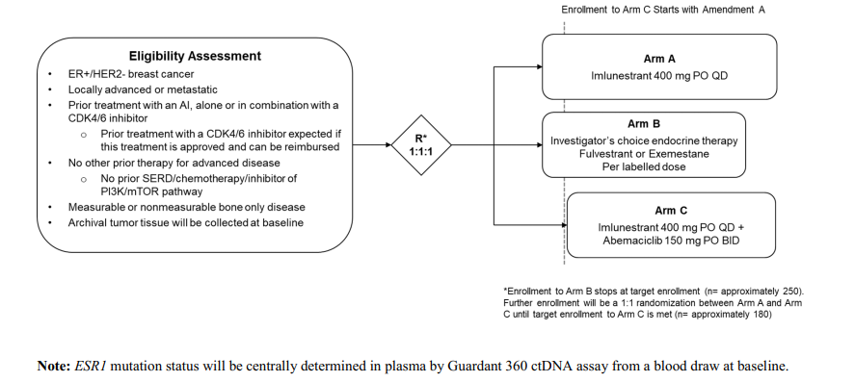
Ongoing Trials
Await data from larger randomized phase 3trials postMONARCH: Fulvestrant + Abemaciclib vs Fulvestrant
Ember-3
N= 860
Notes:
We are awaiting data on the larger randomized phase 3 trials inclduing postMONARCH evaluating abemaciclib + fulvestrant versus fulvestrant alone after prior CDK 4/6 inhibitor and the EMBER-3 study evaluating the use of a novel oral SERD imlunestrant as monotherapy, investigators hoice of SOC ET (fulvestrant or exemestane) versus imlunestrant and abemaciclib after progression on prior CDK 4/6 inhibitor.

Slide 16
CDK4/6 INHIBITOR STUDIES IN EARLY-STAGE
HR+/HER2- BREAST CANCER
Study | Description | Population* | IDFS (%) | median f/u (mos)
PALLAS | PALBO x 2 years + ET | Stage II/III | 3y: 88.2 vs 88.5 | 23.7
PENELOPE-B | PALBO x 13 cycles + ET | All received preop chemo CPS-EG score ≥ 3 or CPS-EG score 2 with ypN+ | 4y: 73 vs 72.4 | 42.8
monarchE | ABEMA x 2 years + ET | 1-3LN + high-risk (T≥ 5cm, Gr 3, or Ki67 ≥ 20%) or ≥4 LN | 4y: 85.8 vs 79.4# | 42
NATALEE‡ | RIBO x 3 years + ET | Stage II (N1 or T2-T3N0 + Gr 2-3, or Ki67 ≥ 20%) or Stage III | 3y: 90.4 vs 87.1# | 27.7
*All studies included pre & post menopausal; #Statistically significant; ‡amended to include more high-risk patients after PALLAS & monarchE
O’Shaughnessy Annals of Oncology 2021
Notes:
Now let’s move on to the adjuvant setting and use of adjuvant CDK 4/6 inhibitors + ET in patients with moderate to high risk EBC
PALLAS and PENELOPE=B evaluated the use of Palbociclib with ET in the adjuvant setting
MONARCHE evaluated amebacilicb with ET in the adjuvant setting
NATALEE, which was recently presented at ASCO 2023, evaluated the efficacy of Ribociclib plus ET in the adjuvant setting
As noted on this slide, two studies reached their primary endpoints - monarchE with adjuvant abemaciclib was a positive study reaching its primary endpoint of improvement in IDFS with a 4 year IDFS of 85.8% with the addition of abemaciclib x 2 years + ET compared to 79.4% in patients on ET alone and NATALEE with ribociclib showed a 3 year IDFS benefit of 3.3% from 87.1% with adjvuant ET alone compared to 90.4% with 3 years of adjuvant ribociclib + ET. It is important to note that at time of data cutoff, only 20% of patients had completed 3 years of ribociclib.

Slide 17
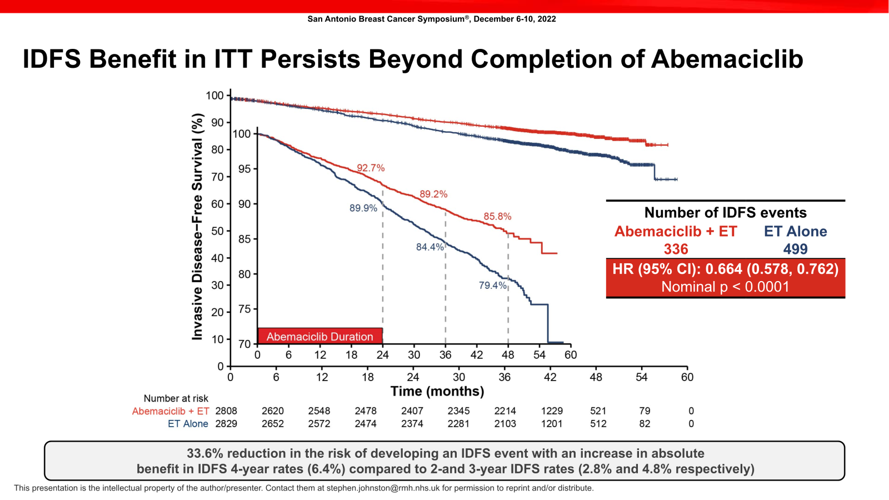
monarchE: ET +/- Adjuvant Abemaciclib - IDFS
Johnston et al SABCS 2022

Slide 18
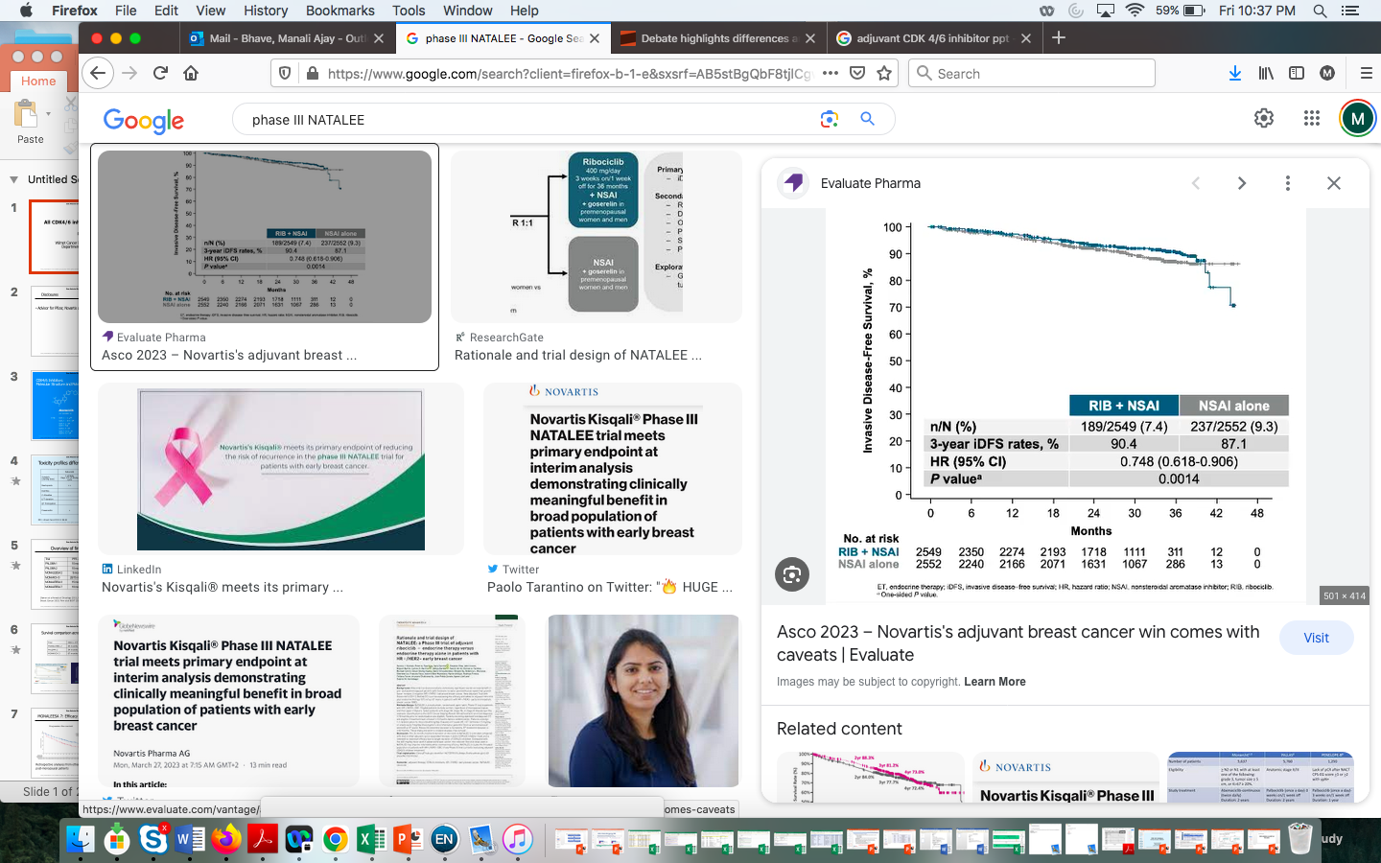
NATALEE: ET +/- Adjuvant Ribociclib - IDFS

Slide 19
PALLAS: ET +/- Adjuvant Palbociclib - IDFS
Mayer et al. Lancet Oncol
Notes:
While some of these differences are likely due to variations in the patient population with monarchE and NATALEE enrolling higher risk patients or the administration of CDK 4/6 inhibitors for different lengths of time, the differences in clinical outcome seen between the CDK 4/6 inhibitors in the metastatic setting and early-stage setting support the fact that the CDK 4/6 inhibitors are NOT the same.

Slide 20
CDK inhibitors (indirect comparisons)
 | PALBOCICLIB | RIBOCICLIB | ABEMACICLIB
Schedule | 3 on 1 off | 3 on 1 off | Continuous
Dose | Once daily | Once daily | Twice daily
Commonest AE | Neutropenia | Neutropenia | Neutropenia/Diarrhea
First-line with ET | Yes# | Yes | Yes#
Second line with ET | Yes | Yes | Yes
Premenopausal | Yes | Yes* | Yes
Impending visceral crisis | ? | Yes | ?
Proven single agent activity | ? | ? | Yes
Brain mets | ? | ? | Yes
Efficacy through progression | No | Yes* | Possible
# No significant OS benefit reported to date, *data from randomized trial
Notes:
I’ll end with an overview slide by Dr. O’Regan presented at SABCS that summarizes the differences amongst the 3 CDK 4/6 inhibitors namely in dosing schedules, toxicity profiles, activity for CNS disease which we have only seen with abemaiclib, and differences in activity/benefit in different clinical scenarios as I reviewed in my presentation.

Slide 21
For all of these reasons…
CDK inhibitors are NOT all the same
Notes:
For all of these reasons, I feel CDK 4/6 inhibitors are NOT all the same.

