Slide 1
Optimal First Line Therapy for Newly Diagnosed Metastatic Melanoma Patients: Nivolumab and Relatlimab
Melinda Yushak, MD MPH
Winship Cancer Institute

Slide 2
Disclosure
I regularly use ipi/nivo.
It has an important place in certain populations of patients such as those with brain mets.

Slide 3
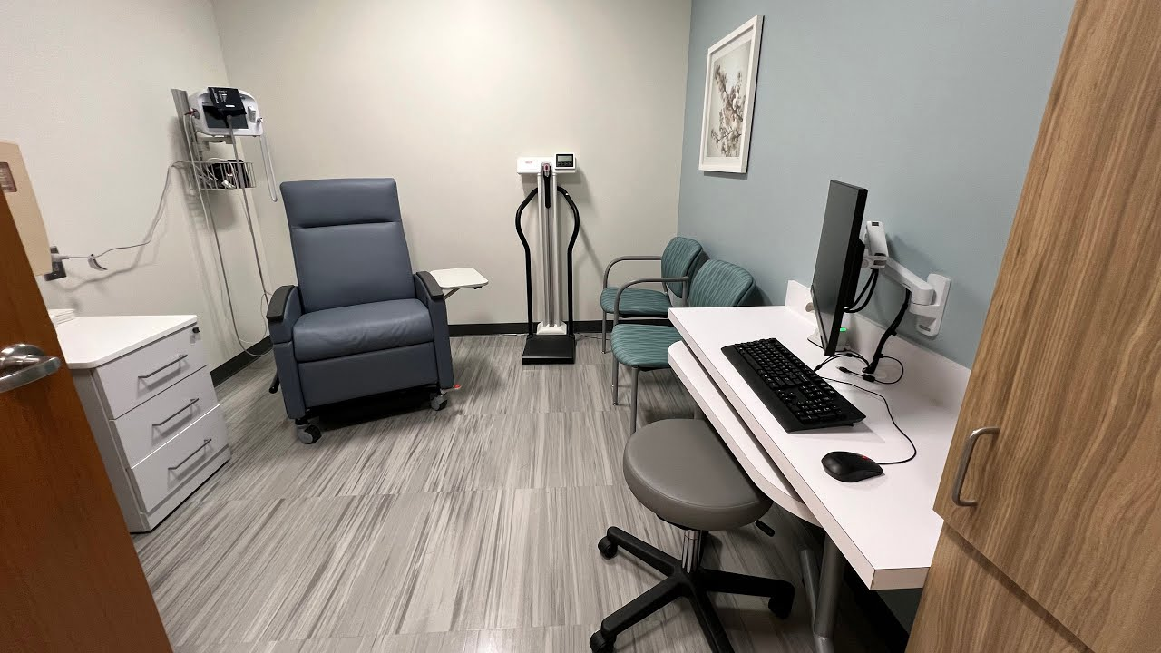
Why consider Nivolumab-relatlimab over Nivolumab and Ipilimumab?
Efficacy
Safety

Slide 4
Nivolumab/Relatlimab is superior to Nivolumab
Tawbi et al. Oral Presentation at ASCO Annual Meeting; June 2-6, 2023; Chicago, IL. Abstract 9502.
Notes:
Median f/u: 25.3 months

Slide 5
Sub group analysis

Slide 6
If we looked at everything on a single page…**
Endpoints | Rela/Nivo Relativity-047 | Nivolumab Relativity-047 | Ipi/Nivo Checkmate 067 | Nivolumab CheckMate 067 | Flipped Ipi/Nivo CheckMate 511 | Ipi/Nivo CheckMate 511
Median follow-up (months) | 25.3 | 25.3 | 77 | 77 | 18.8 | 18.6
ORR (95% CI) | 44% | 34% | 58% | 45% | 46% | 51%
CR rates | 18% | 18% | 22% | 19% | 15% | 13.5%
PD rates | 31% | 42% | 24% | 38% | 34% | 26%
Median PFS (months) | 10.2 | 4.6 | 11.5 | 6.9 | 9.9 | 8.9
Median OS | NR | 33.2 | 72.1 | 36.9 | NR | NR
Median DOR | NR | NR | NR | NR | NR | NR
G3-4 TRAE | 22% | 12% | 59% | 24% | 33% | 48%
**Cross-trial comparisons should be interpreted with caution
Tawbi et al. Oral Presentation at ASCO Annual Meeting; June 2-6, 2023; Chicago, IL. Abstract 9502.
Wolchok et al. JCO. 2022 40(2):127-137
Lebbe et al. JCO. 2019; 37:867-875

Slide 7
Nivolumab and Relatlimab is better tolerated
Tawbi et al. Oral Presentation at ASCO Annual Meeting; June 2-6, 2023; Chicago, IL. Abstract 9502.
CheckMate-067
Ipilimumab-Nivolumab
Nivolumab
 | Any grade | Grade 3 or 4 | Any grade | Grade 3 or 4
Treatment-related adverse event | 300 (96) | 186 (59) | 271 (87) | 74 (24)
Led to discontinuation of treatment | 131 (42) | 96 (31) | 43 (14) | 25 (8)
Wolchok et al. JCO. 2022 40(2):127-137

Slide 8
Nivolumab and Relatlimab should be used in the first line setting
Improved PFS over nivolumab
Tolerable safety profile

