Slide 1
Patient-Based Panel Discussion Genitourinary Malignancies
All Speakers: Drs. Brown, Nazha, Master, Carthon, Atkins, & Bilen
Case presented by Emory University Heme-Onc fellow: Sarah J. Wood, MD
July 20th, 2023

Slide 2
Hospital Course
A 66-yo M with PMHx of HTN, HLD, and T2DM presents to the ED with complaints of back pain. There, cross-sectional imaging revealed multiple sclerotic lesions throughout the axial and appendicular skeleton, along with multiple enlarged RP lymph nodes. He was admitted to HSM for further work-up.
His physical examination on admission revealed normal lower extremity strength and sensation. The patient denied any bowel / bladder dysfunction.
Labs on initial presentation to the hospital notable for Hgb 11 g /dL, Calcium 11 prompting HSM to pursue myeloma work-up, which resulted as normal. Other organ function within normal limit.
Oncology was consulted for further evaluation. We recommended dedicated spine imaging, PSA, and lymph node biopsy. PSA resulted at 76 ng/mL. Subseuqently, NM Bone Scan was recommended to complete staging.

Slide 3
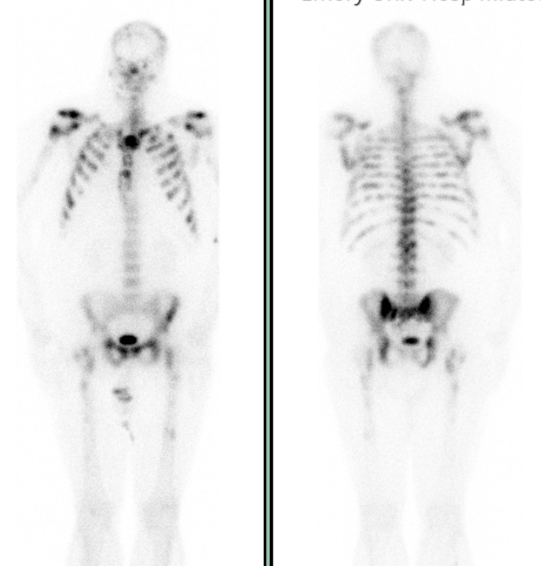
Hospital Course
MRI T & L spine w/and w/o contrast demonstrated extensive bony changes with multiple sclerotic bone lesions throughout vertebral bodies and redemonstration of RP LAD.
Bone scan with diffusely distributed foci of radiotracer uptake throughout calvarium, spine, sacrum, bilateral proximal femurs, proximal humeri and bilateral ribs.
LN biopsy was obtained by IR, which confirmed metastatic prostate adenocarcinoma.
The patient’s pain was controlled with oral analgesia and was discharged with bicalutamide and clinic follow up.

Slide 4
Clinic follow-up
He then presents to your office for NPV where you begin androgen deprivation therapy with six cycles of docetaxel chemotherapy. You also refer to rad-onc where he receives palliative radiation to spine.
He tolerates chemotherapy well. Following completion, PSA nadir is 3.0 ng/mL. Over the next four months, PSA level begins to rise to 7.4 ng / mL, then to 13 ng / mL.
PSMA PET shows multiple intensely PSMA avid osseous lesions involving the axial and appendicular skeleton, compatible with osseous metastasis. No visceral organ involvement.
You order NGS on prior tissue biopsy and refer to genetic counseling for germline testing.
Subsequent germline testing revealed a PALB2 mutation. At time of progression, he maintains excellent PS and normal CBC parameters.

Slide 5
Panel Discussion
In this patient - a 66 yo M w/ few medical comorbidities and significant osseous disease with symptoms - would you have considered triplet therapy up-front? If so, can you walk us through your decision when choosing between PEACE-1 (abi/pred, docetaxel, ADT) versus ARASENs (darolutamide, docetaxel, ADT)?
At time of PD, with germline testing revealing a PALB2 mutation, a known mutation resulting in homolougous repair deficiency (HRD), what would you implement as second line therapy given recent TALO-2 (talazoparib plus enzalutamide) and PROPEL (abiraterone plus olaparib) data?
Thank you

