Slide 1
Adjuvant immunotherapy for resectable NSCLC
Conor E. Steuer, MD
Associate Professor
The Winship Cancer Institute of Emory University
July 22, 2023

Slide 2
Disclosures
Received honoraria for ABBvie, Merck, Bergen Bio, Armo, Mirati, Caris, Sanofi/Regeron, Daiichi

Slide 3
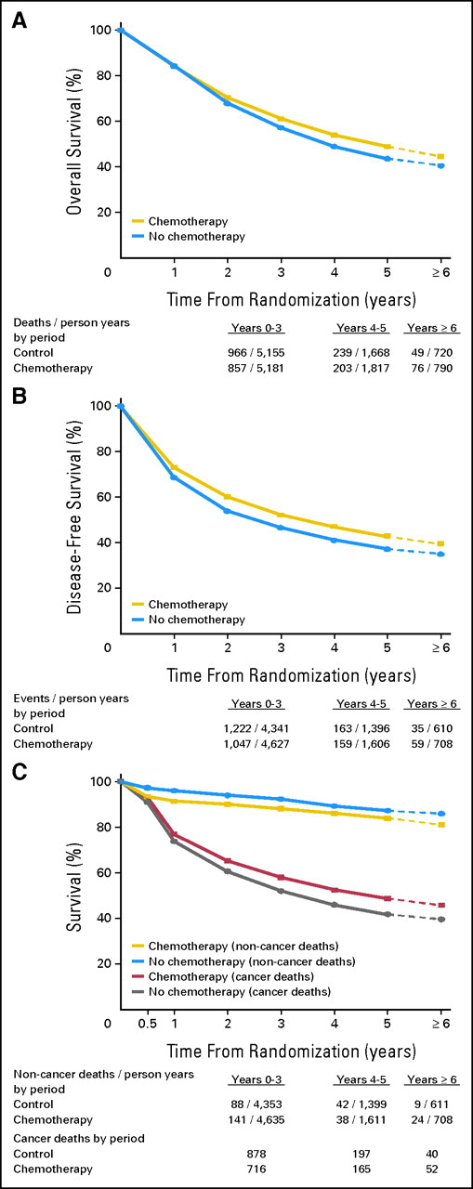
LACE Meta-Analysis
Individual patient pooled analysis showing a 5.4% OS benefit of adjuvant cisplatin based chemotherapy, stronger for more advanced disease.
Pignon et al. JCO 2016

Slide 4
Which is Better, a Neoadjuvant or Adjuvant Approach?
First, important to define the boundaries of this debate. This is a new world, and it is not a rehashing of neoadjuvant chemotherapy vs adjuvant chemotherapy.
Prior to the new IO data, most would consider the SOC for stage 1-2 NSCLC upfront surgical resection with adjuvant chemotherapy as indicated.
Stage 3 generally, “single station”, neoadjuvant chemo followed by surgery vs CRT but varies more.

Slide 5
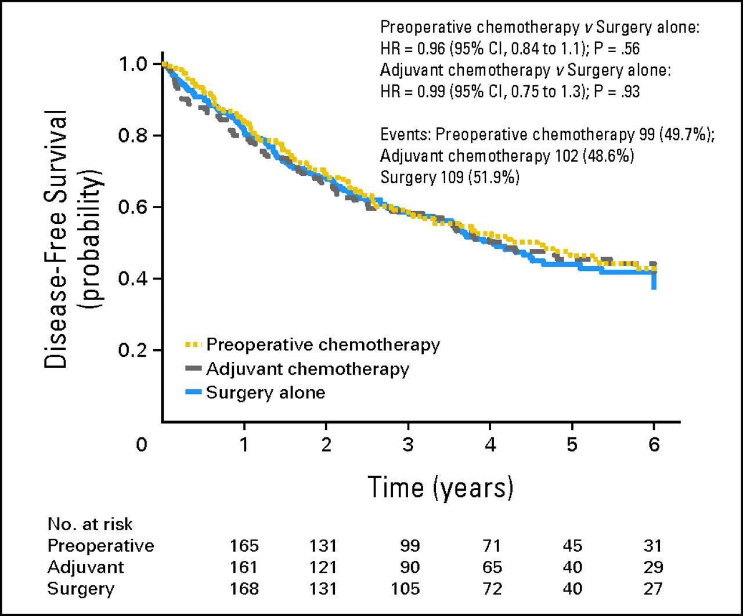
Neoadjuvant vs Adjuvant Chemotherapy
NATCH study-624 patients with stage IA (tumor size > 2 cm), IB, II, or T3N1 were randomly assigned to surgery alone, three cycles of preoperative paclitaxel-carboplatin followed by surgery, or surgery followed by three cycles of adjuvant paclitaxel-carboplatin
Felip et al. J Clin Oncol. 2010

Slide 6
Despite many strong opinions you will see in conferences, or on twitter, there are NO studies comparing adjuvant IO to neoadjuvant IO combinations.

Slide 7
The game changer…IMpower 010
Wakelee ASCO 2021

Slide 8
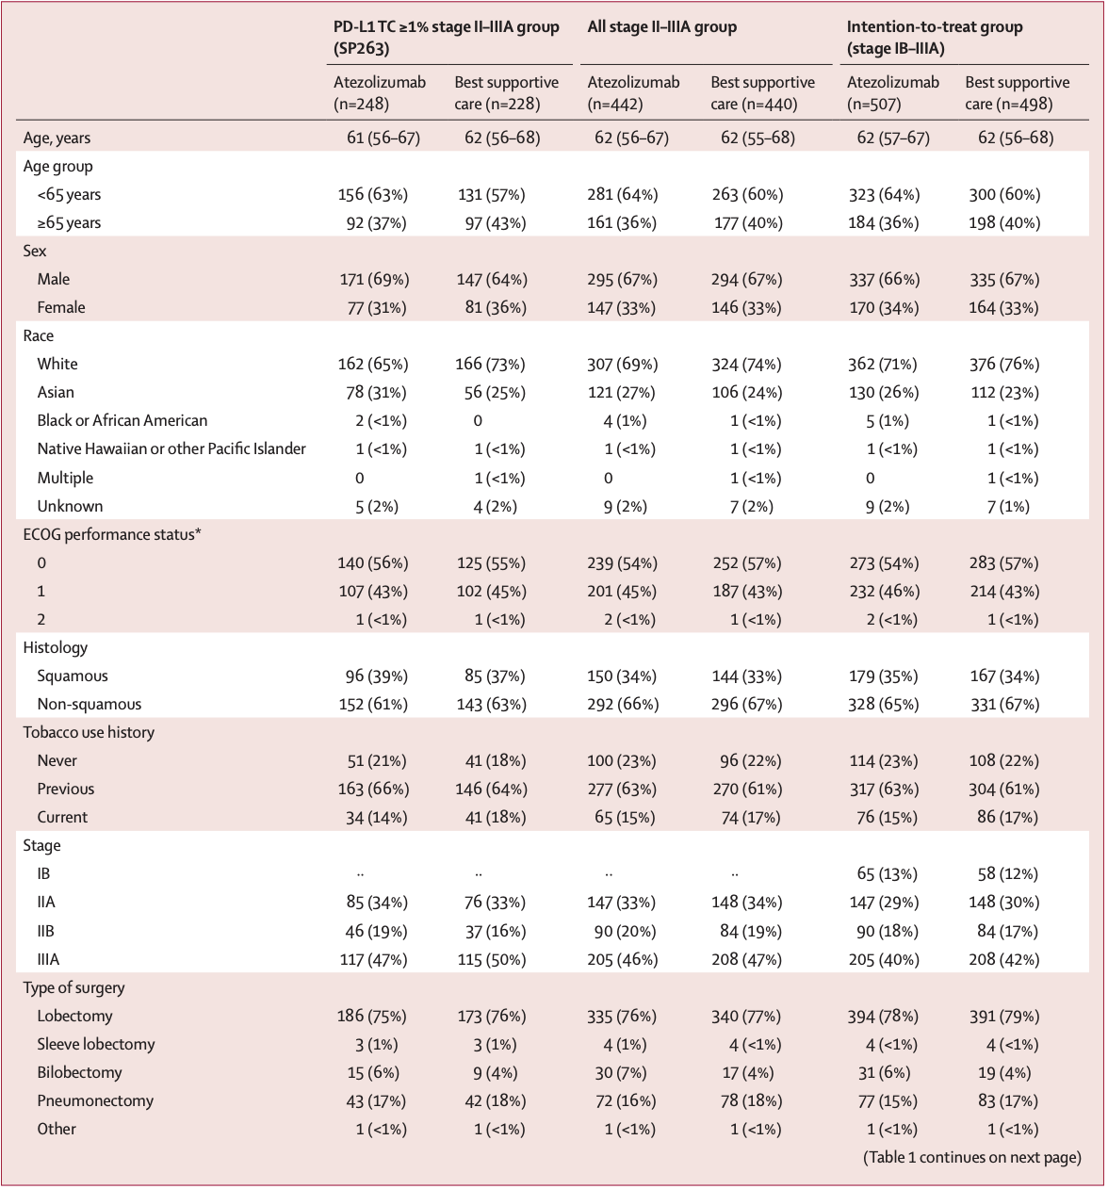
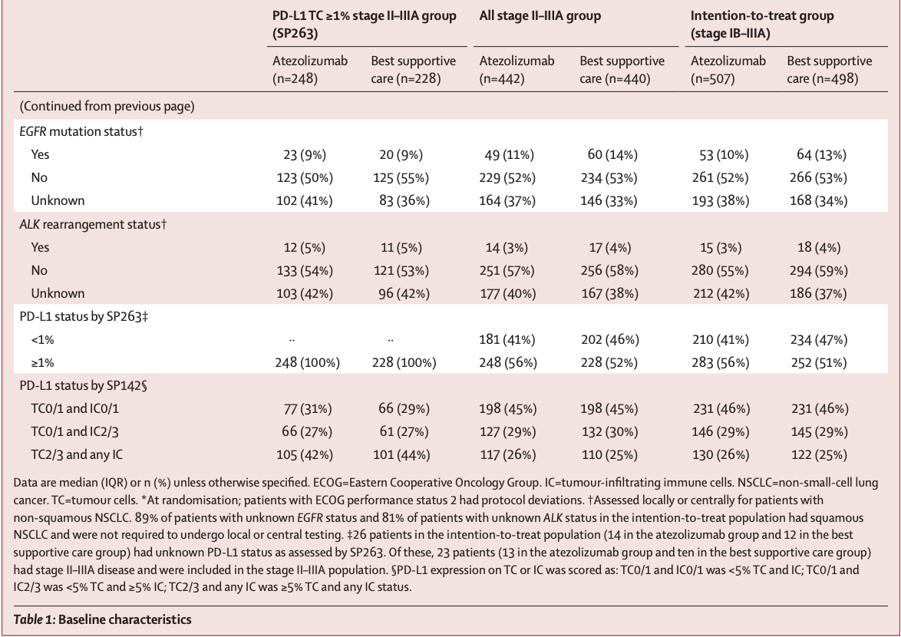
IMpower 010
Overall, 1280 patients enrolled
Felip et al. Lancet 2021

Slide 9
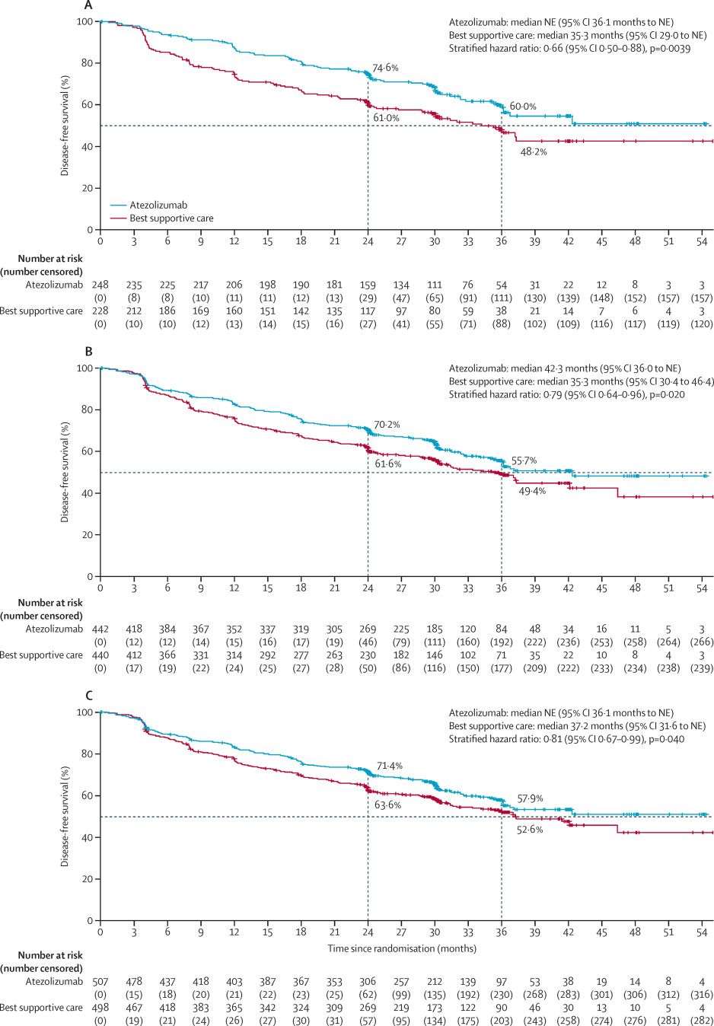
Figure 2. Disease-free survival in the atezolizumab and best supportive care groups
Kaplan-Meier estimates of disease-free survival are shown:
patients whose tumours expressed PD-L1 on 1% or more of tumour cells (per the SP263 assay) in the stage II–IIIA population (A),
all patients in the stage II–IIIA population (B),
the intention-to-treat population (C).(1b-3a)
Felip et al. Lancet 2021

Slide 10
IMPOWER 010
Felip WCLC 2022

Slide 11
IMPOWER 010

Slide 12
IMPOWER 010

Slide 13
Atezolizumab approved in US as adjuvant treatment following resection and platinum-based chemotherapy in patients with stage II to IIIA non-small cell lung cancer (NSCLC) whose tumors have PD-L1 expression on ≥ 1% of tumor cells, as determined by an FDA-approved test.
Atezolizumab approved in Europe as adjuvant treatment following complete resection and platinum-based chemotherapy for adult patients with NSCLC with a high risk of recurrence whose tumors have PD-L1 expression ≥50% and who do not have EGFR mutant or ALK-positive NSCLC

Slide 14
PEARLS/KEYNOTE-091
Similar Schema to IMpower010, stage 1b-3a, all PDL1

Slide 15
Checkmate 816
Open-label, phase 3 trial, for patients with stage IB to IIIA resectable NSCLC to receive nivolumab plus platinum-based chemotherapy or platinum-based chemotherapy alone, followed by resection. The primary end points were event-free survival and pathological complete response
From March 2017 through November 2019, a total of 773 patients were enrolled, 505 underwent randomization, and 358 were concurrently assigned to receive neoadjuvant nivolumab plus chemotherapy (179 patients) or chemotherapy alone (179 patients)
Forde et al. NEJM 2022

Slide 16
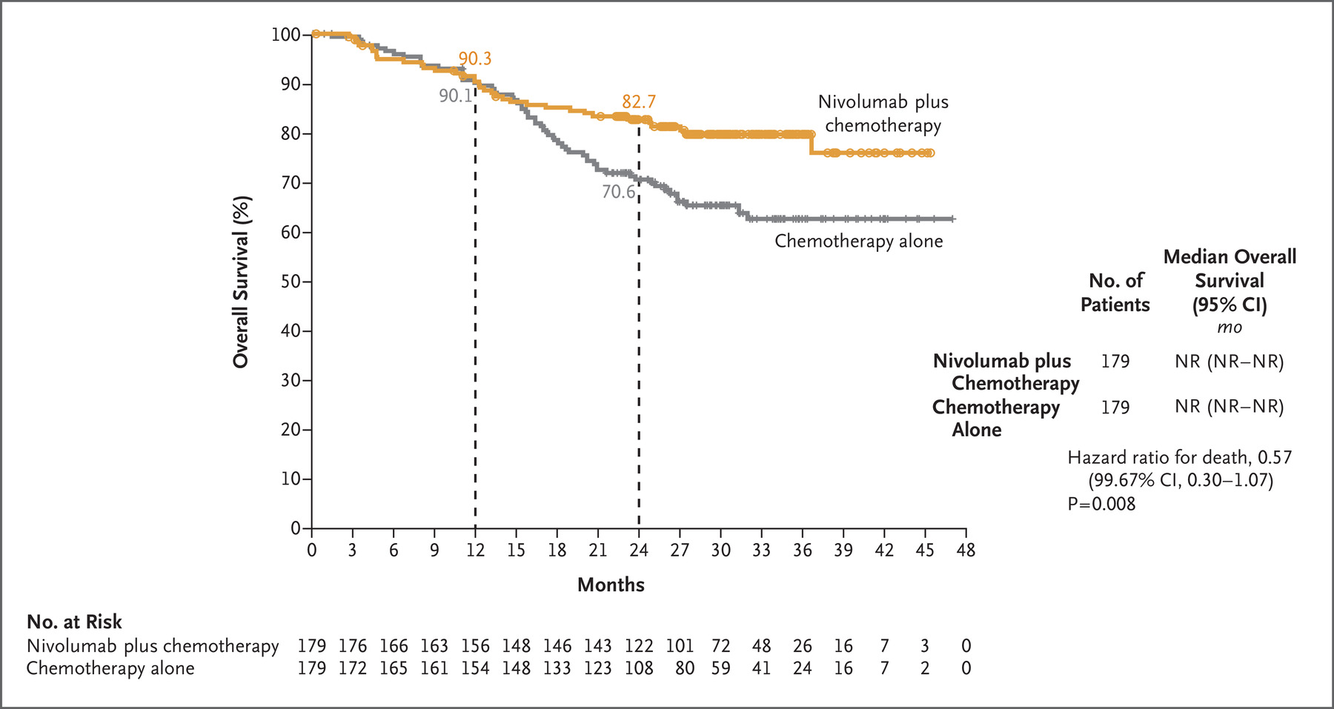
Checkmate 816
Forde et al. NEJM 2022

Slide 17
Slide 4

Slide 18
Overall survival at 24 months was 85.3% (95%CI: 75.7-96.1) with nivolumab plus chemotherapy versus 64.8% (95%CI: 47.4-86.4) with chemotherapy (hazard ratio, 0.37; 95%CI, 0.14-0.93; P=0.003).
Provencio WCLC 2022

Slide 19
Best attempt at a cross trial comparison
Probably not much yet to talk about in terms of efficacy between neoadjuvant and adjuvant

Slide 21
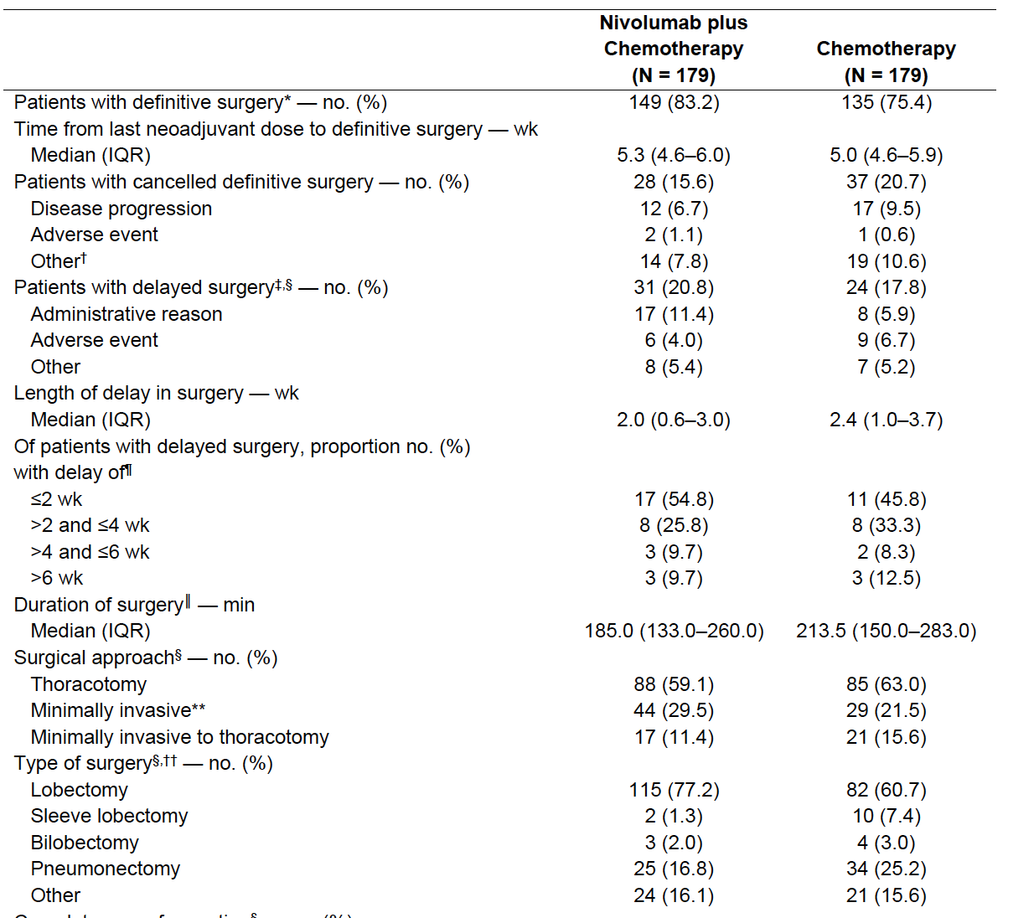
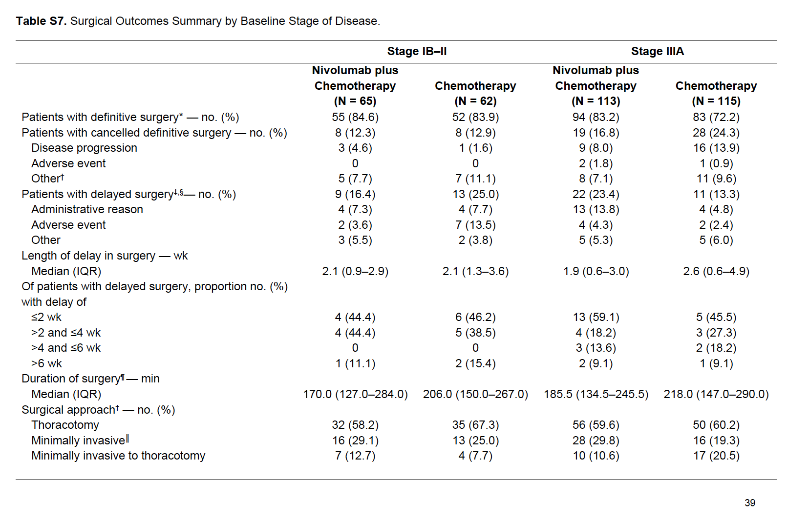
So many thoracotomies on 816…and non-surgeries
What would have happened if these patients went straight to surgery?
Forde et al. NEJM 2022

Slide 22
Concerns for Neoadjuvant Therapy
Checkmate 816 “Adverse events of any grade led to delayed surgery in 3.4% of the patients receiving nivolumab plus chemotherapy”
Not a large number, in the context of clinical trial, but I think its reasonable to assume that the number will wind up being higher (hepatitis, pneumonitis, etc)
SURGERY is the curative modality. No patient will be cured with IO or chemo-IO
20% of patients still got adjuvant treatment, most with chemotherapy. How to interpret path responses?

Slide 23
Path CR? Not established in NSCLC!
“Trial-level association of pathological complete response with survival among patients with NSCLC has not been shown prospectively to date” as per authors of Checkmate 816
Not sure how to compare path CR vs tumor cleanly resected upfront, so the interesting CR results play no role in this debate, IMO!

Slide 24
A concession…
I concede that for stage 3 resectable lung cancer, the standard of care if known at diagnosis, the treatment paradigm should be neoadjuvant chemo-IO followed by resection.
Chemo/IO>>chemo alone neoadjuvant
But how much should we be resecting stage 3, especially vs CRT (whole other debate)
I suspect the stage 3 cancers on IMpower 010 were upstaged after surgery
NCCN

Slide 25
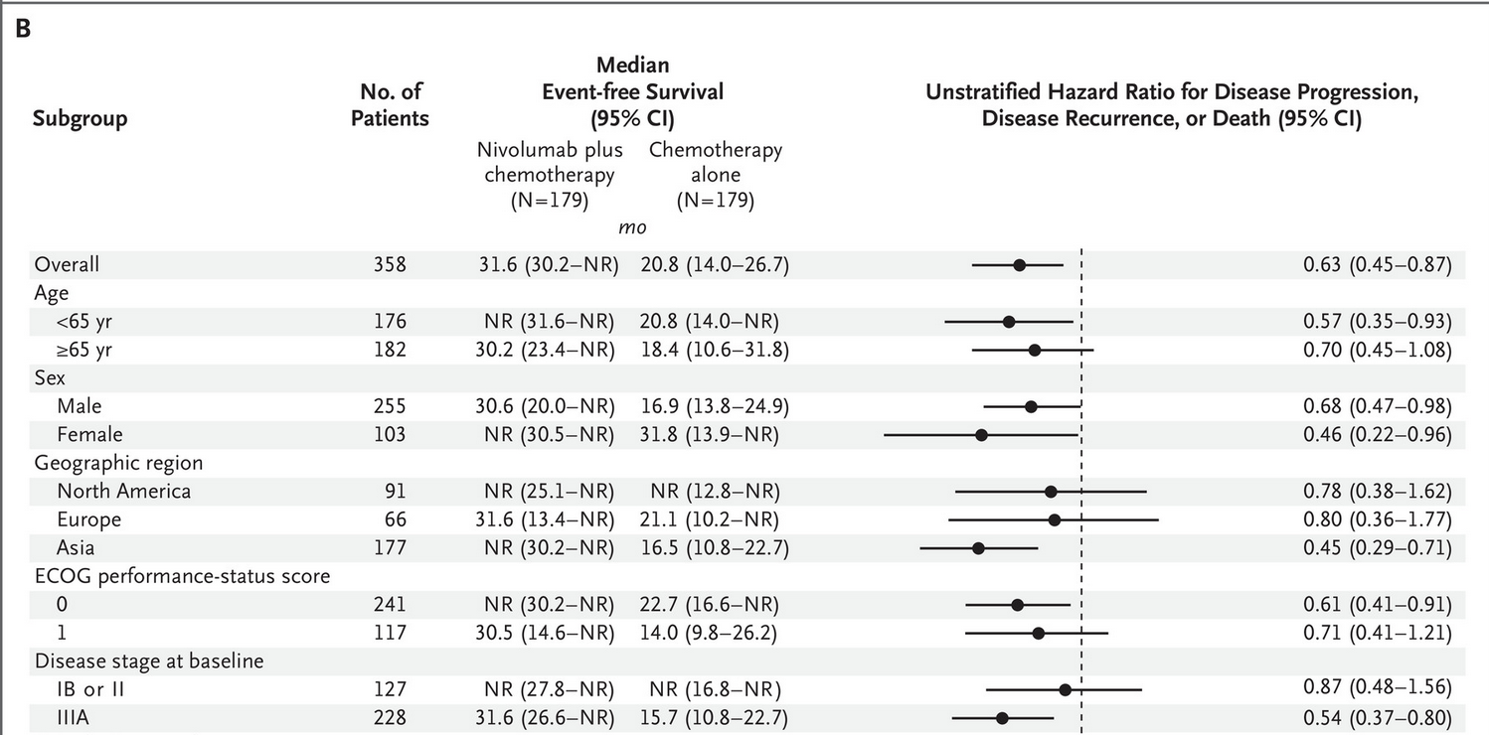
But Stage 1B/2 NSCLC?
Prior to IO, no one believed the SOC for resectable stage 2 would be neoadjuvant chemotherapy
The data does not support changing that decision.
Surgery upfront will also give the most accurate staging allowing for most refinement of adjuvant treatment.
In real world, surgeon, patient buy-in and collaboration is crucial.
Forde et al. NEJM 2022

Slide 26
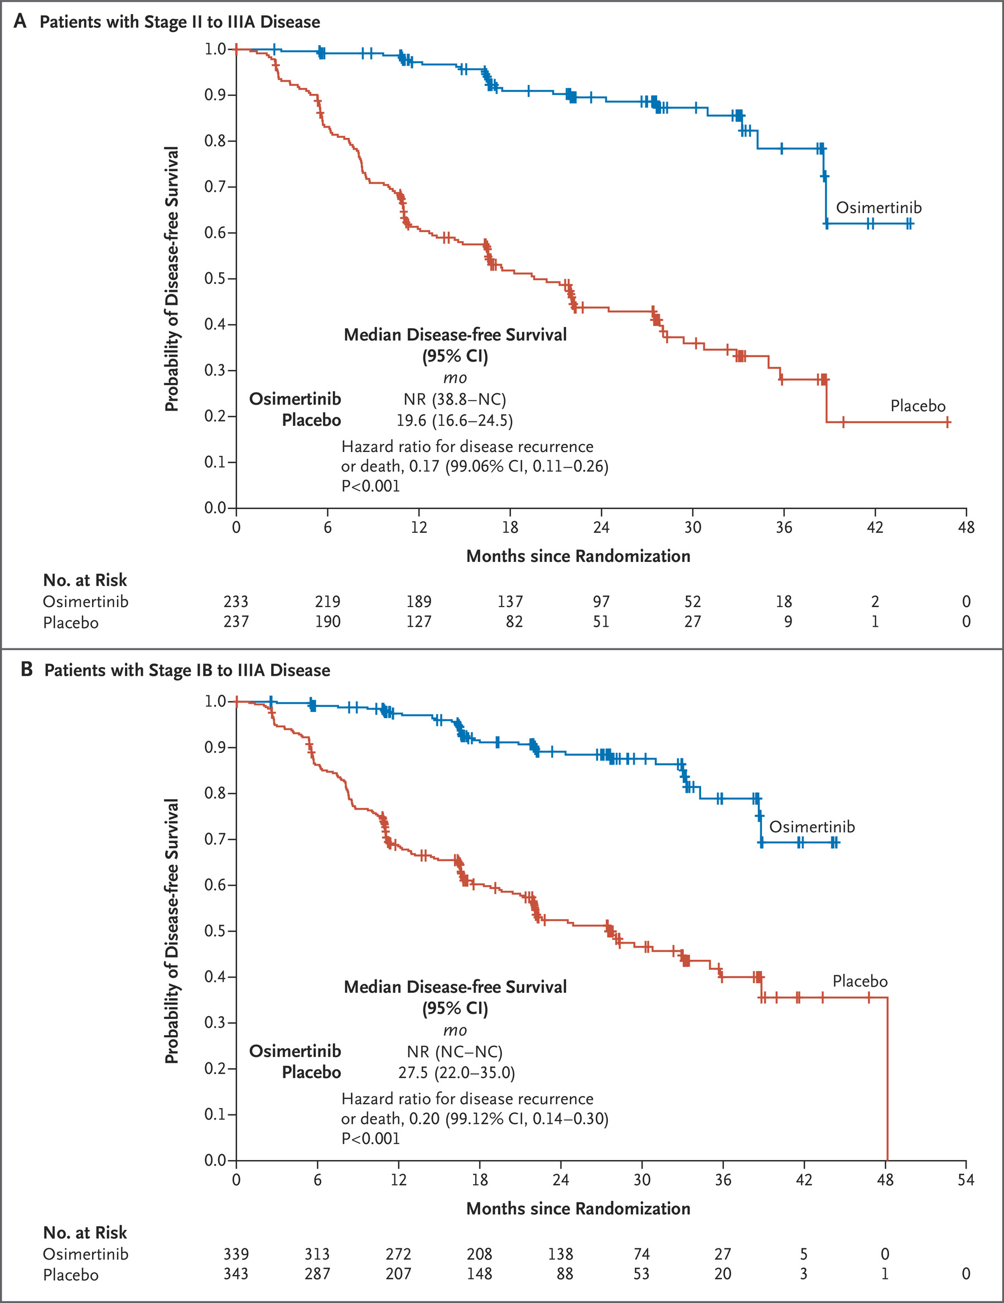
Molecular tests
As of now, there is one targeted therapy approved in the adjuvant NSCLC space, osimertinib for EGFR-mutated NSCLC based on the ADAURA trial. Positive overall survival
IO does not work well (at least in metastatic setting) for many oncogenic driven tumors
In real-world, best-case timing to receive genomic results is 2-4 weeks from date of ordering. This relies on a good enough biopsy, and a specialist ordering the test upfront. May wind up delaying treatment further or not giving the right patient the right drug.
Plenty of time and tissue after surgical resection for appropriate testing.
Wu et al. NEJM 2020

Slide 27
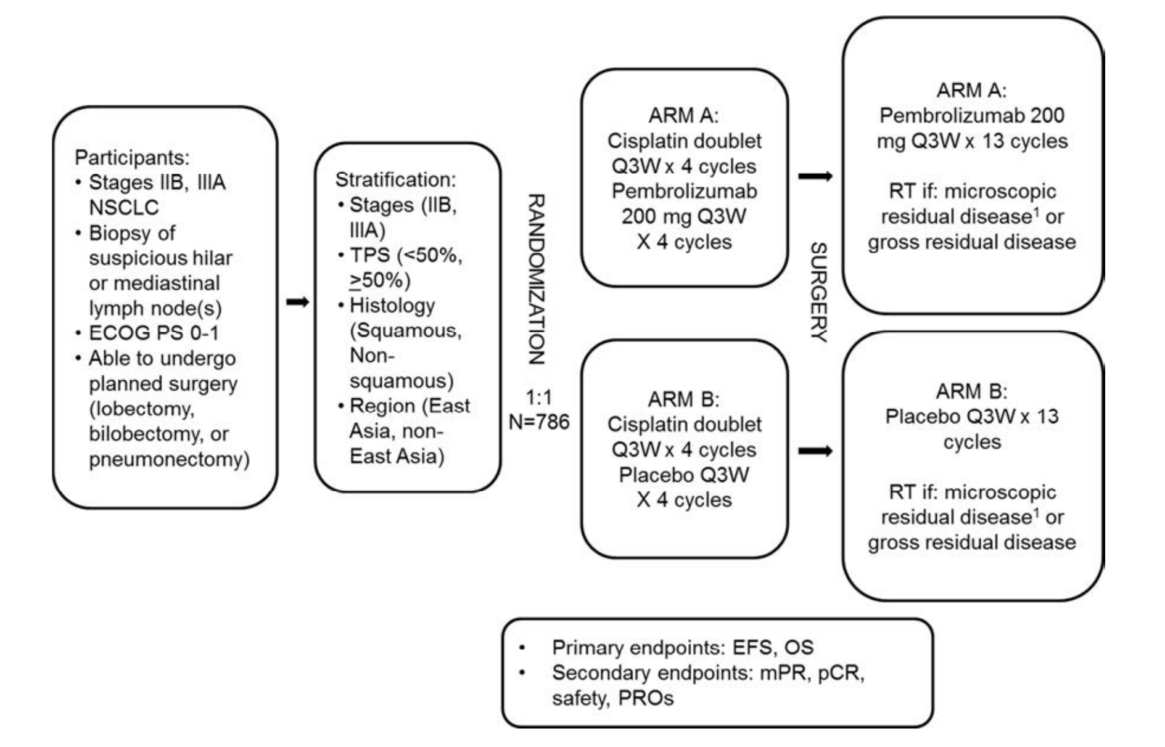
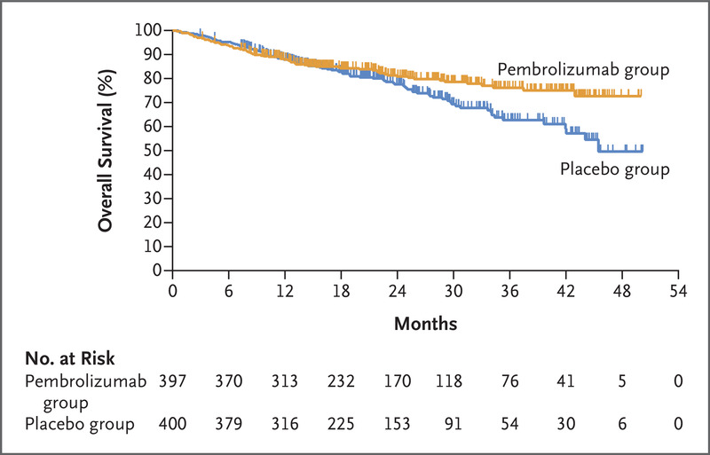
Maybe we are both wrong-Perioperative therapy
Keynote 671
Wakelee et al. NEJM 2023

Slide 28
Conclusions
Both neoadjuvant chemo IO, adjuvant IO, and perioperative are good options for patients with resectable lung cancer
All PD-L1 Levels for neoadjuvant, likely only PD-L1 high for adjuvant *depending how you feel about PEARLS data
For known stage 3 disease that is surgically resectable, neoadjuvant is the way to go (if not CRT)
For earlier stage disease, upfront surgery is still popular
In real world, need surgical buy in, quick genomic testing

