Slide 1

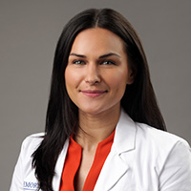

Adjuvant pembrolizumab in renal cell carcinoma: The case for immunotherapy
VS
Jacqueline T. Brown, MD
Assistant Professor, Winship Cancer Institute
Debates and Didactics in Hematology and Oncology
July 20th, 2023
Notes:
Hi everyone. My name is Jackie Brown, I’m jr faculty at Winship and a genitourinary medical oncologist. I would like to thank Ram and Sagar for inviting me back to beautiful Sea Island again this year, to Patti and the Bioascend team for organizing this wonderful event, and of course to all of you for being here at 7:30 in the morning.
I am here to make my case for the use of adjuvant pembrolizumab in high risk resected RCC and am honored to get to debate my mentor and friend, Dr. Master.

Slide 2
Disclosures
Medicenna, Surface Oncology, and Xencor
(research funding to institution)
Notes:
Here are my disclosures

Slide 3
Goals for my 10-12 minutes
Describe the landscape of adjuvant therapy in RCC
Outline the DFS benefit across risk groups
Argue that DFS is a reasonable surrogate endpoint for OS in this setting
Review the rates of irAEs with single-agent pembrolizumab
Convince you that a conversation about immunotherapy is appropriate for every eligible patient
Leave you with no choice as to who won this debate
Notes:
(and increasing degree of relative benefit with higher risk disease)
In this particular setting
And emphasize that early management = better outcomes

Slide 4
The patient
Cara is a 46-year-old female found to have a 12 cm right renal mass with prominent RP lymph nodes
Dr. Master took her for radical right nephrectomy, adrenalectomy and regional lymph node dissection
He explains her risk of recurrence is over 50%
She is tearful, says she needs to be around for her 2 teenage children
Referred to me for further discussion of adjuvant pembrolizumab
Pathology:
Clear cell renal cell carcinoma
12.6 cm
WHO/ISUP grade 4
15% sarcomatoid differentiation
Tumor thrombus extends into inferior vena cava to level above diaphragm
1/3 LN positive
pT3cN1M0 = stage III ccRCC

Slide 5
The land before immunotherapy
Trial | Therapy | Duration (y) | Eligibility | Histology | N | Endpoint | HR | P-value
ASSURE | Sunitinib or sorafenib | 1 | ≥T1bNxM0 | Any | 1943 | DFS | 1.02 (su) 0.97 (so) | 0.80 (su) 0.72 (so)
SORCE | Sorafenib | 3 | Leibovich 3-11 | Any | 1656 | DFS | 1.01 | 0.95
PROTECT | Pazopanib | 1 | pT2, pT3-4N0, N+ | ccRCC | 1583 | DFS | 0.86 | 0.17
ATLAS | Axitinib | 3 | pT2, pT3-4N0, N+ | ccRCC | 592 | DFS | 0.87 | 0.32
S-TRAC | Sunitinib | 1 | High risk per UISS | ccRCC | 674 | DFS | 0.76 | 0.03
EVEREST | Everolimus | 1 | pT1bG3-4 pT2-4 anyG N+ | Any | 1545 | DFS | 0.85 | 0.0246*
Notes:
Before we get into the data about immunotherapy, let’s review where we’ve been. Prior to the application of IO in this space, there were multiple trials investigating adjuvant targeted therapies. DFS was the primary endpoint for all and all but one failed to achieve statistical significant improvement over placebo. One trial, S-TRAC, investigating adjuvant sunitinib vs placebo, showed a significant improvement in DFS.

Slide 6
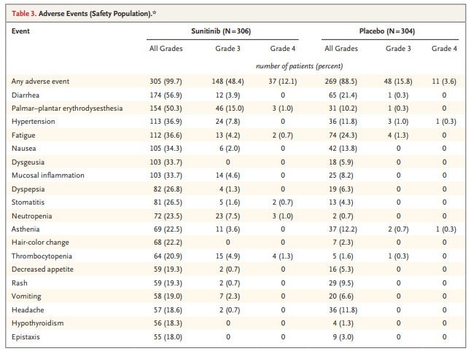
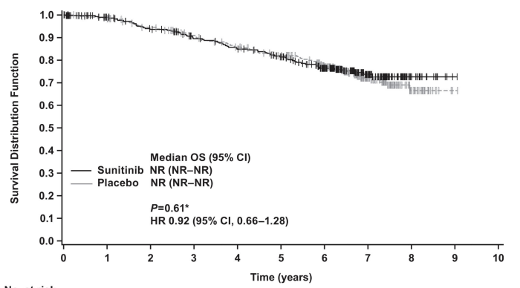
Sunitinib toxicity: not worth the hassle
No demonstrated overall survival benefit
Category 3 recommendation in NCCN
Low uptake in clinical practice
Ravaud et al. (2016). NEJM.
Motzer et al. (2018). Eur Urol.
Notes:
Not that you need reminding, but sunitinib is tough. Note the high frequency of the typical constellation of symptoms we see from antiangiogenic agents – GI upset inc diarrhea/nausea, fatigue, HTN, HFS, and more. These day to day toxicities, combined with the ultimately negative OS signal within this trial, led to only a cat 3 rec in NCCN and low uptake of adjuvant sunitinib in clinical practice.

Slide 7
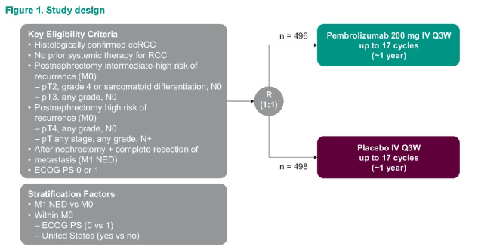
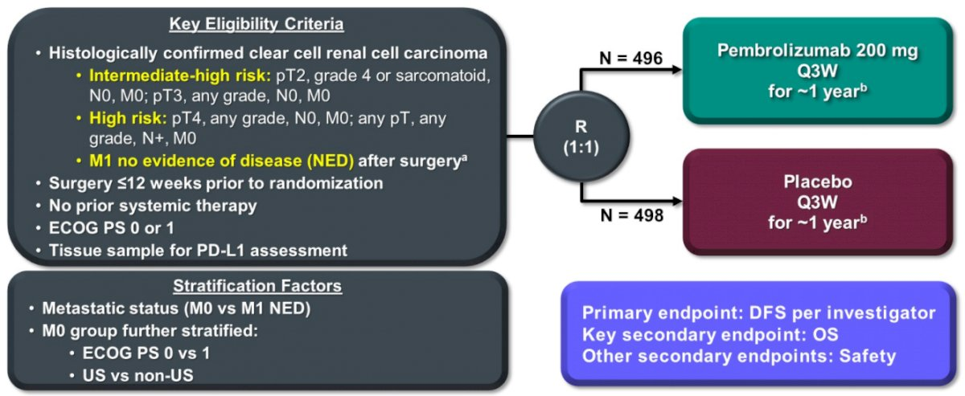
Phase III KEYNOTE-564
Choueiri, et al. ASCO 2022. (Abstract 290)
Notes:
Now, to transition to the crux of this debate – the data behind the current approval for adjuvant pembrolizumab.

Slide 8
Primary endpoint: disease-free survival in IIT population
24-mo rate
77.3%
68.1%
24-mo rate
78.3%
67.3%
HR 0.68 (95% CI 0.53−0.87)
P = 0.001*
HR 0.63 (95% CI 0.50–0.80)
Nominal P < 0.0001
 | Pts w/ Event | Median, mo (95% CI)
Pembro | 109 | NR (NR–NR)
Placebo | 151 | NR (NR–NR)
 | Pts w/ Event | Median, mo (95% CI)
Pembro | 114 | NR (NR–NR)
Placebo | 169 | NR (40.5–NR)
Choueiri et al. (2021). NEJM.
Powles et al. (2022). Lancet Oncology.
Notes:
The primary endpoint was DFS in the IIT population.
On the left is the primary analysis after 24.1 mo of f/u. The study met its primary endpoint with a HR of 0.68 and P of 0.001. The 24 month disease free survival rate in those who received pembro was 77.3% compared to 68.1% in those who received placebo.
I expect Dr. Master is going to point out how these curves cross. That’s a reasonable point and suggests the need for longer follow up to draw conclusions about efficacy. Luckily for him and for you, we have that.
On the right, you can see the updated analysis with data from 30.1 months of follow up. The HR actually decreases to 0.63 after more follow up with an undetectable P value. The 24 month rates of recurrence separate further.

Slide 9
Post-hoc analysis of DFS per subgroup
Intermediate-high risk |  | High risk |  | M1 NED
pT2 | pT3 | pT4 | Any pT | NED after resection of oligometastatic sites 1 year from nephrectomy
G4 or sarcomatoid | Any grade | Any grade | Any grade
N0 | N0 | N0 | N+
M0 | M0 | M0 | M0
Choueiri et al. GU ASCO 2022
Notes:
One thing I find helpful is to post hoc analyses of DFS per risk subgroup given that it was a somewhat heterogeneous population enrolled in the trial.
You can see three risk groups here including int-high risk, high risk, and M1 NED, with ***

Slide 10
Benefit maintained across risk groups (30-month follow-up)
Choueiri et al. GU ASCO 2022
Notes:
The improvement in DFS was seen across risk groups and actually deepened as risk of recurrence increased; the HR in those with M1 NED was as low as 0.28!

Slide 11
by the numbers: a tool for clinical conversations
Intermediate-high risk |  | High risk |  | M1 NED
pT2 | pT3 | pT4 | Any pT | NED after resection of oligometastatic sites 1 year from nephrectomy
G4 or sarcomatoid | Any grade | Any grade | Any grade
N0 | N0 | N0 | N+
M0 | M0 | M0 | M0
Risk of recurrence at 5 years | 31% | 47% | 54% | 63% | ?70%
Abs. reduction | 10% | 15% | 17% | 20% | 24%
OS at 5 years | 82% | 77% | 63% | 54% | ?
Beckermann, MedPro Master Lecture Series, Aug 2022. (adapted from Brian Rini)
Notes:
This is a really beautiful clinical tool that was presented by Katy Beckerman from Vanderbilt and I use routinely when trying to help patients understand THEIR potential benefit from pembro.
The absolute reduction in risk expected from adj pembro increases with increasingly high risk disease. Their absolute risk reduction could be as low as 10 percent and potentially as high as…25% based on what we know? Ultiamtely, we all know our patients only care about whether they recur or whether they do not – its all or none. But this helps me to counsel them on what we can realistically expect from pembrolizumab

Slide 12
Overall survival: Immature but early signal is encouraging
Powles et al. (2022). Lancet Oncology.
Notes:
In terms of OS, the number of survival events is, to date, relatively low. The signal is early but encouraging, however a conclusion cannot yet be drawn regarding an overall survival benefit with adjuvant pembrolizumab.

Slide 13
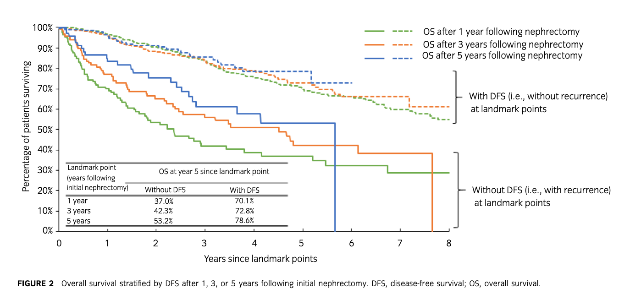
DFS is a reasonable surrogate endpoint for OS
Prospective observational study using the SEER-Medicare database 2007-2016
The Kendall’s 𝛕 rank correlation model showed correlation between DFS and OS post-nephrectomy
(Kendall’s 𝛕 = 0.70; 95% CI: 0.65-0.74; p<0.001)
Haas et al. (2023). IJU.
Notes:
Now all signs point to DFS being a reasonable surrogate endpoint for OS in this particular setting
This is a ***
The authors looked at those who had recurrence vs were recurrence at landmark time points of 1 year, 3 years, and 5 years after nephrectomy for localized disease. For patients with versus without recurrence at the landmark pointsof 1, 3, and 5 years post-nephrectomy, the 5-year OS were 37.0% versus 70.1%, 42.3%versus 72.8%, and 53.2% versus 78.6%, respectively. The Kendall’s tau coefficient between DFS andOS post-nephrectomy was 0.70 (95% CI: 0.65, 0.74;p<0.001), suggesting high correlation between DFS and OS post nephrectomy.
Objectives:This study aimed to assess whether disease-free survival (DFS) may serveas a predictor for long-term survival among patients with intermediate-high risk or highrisk renal cell carcinoma (RCC) post-nephrectomy when overall survival (OS) isunavailable.
Methods:The Surveillance, Epidemiology and End Results-Medicare database (2007–2016) was used to identify patients with non-metastatic intermediate-high risk and highrisk RCC post-nephrectomy. Landmark analysis and Kendall’sswere used to evaluate thecorrelation between DFS and OS. Multivariable regression models were used to quantifythe incremental OS post-nephrectomy associated with increased time to recurrenceamong patients with recurrence, adjusting for baseline covariates.
Results:A total of 643 patients were analyzed; mean age of 75 years;>95% ofpatients had intermediate-high risk RCC at diagnosis; 269 patients had recurrencepost-nephrectomy. For patients with versus without recurrence at the landmark pointsof 1, 3, and 5 years post-nephrectomy, the 5-year OS were 37.0% versus 70.1%, 42.3%versus 72.8%, and 53.2% versus 78.6%, respectively. The Kendall’ssbetween DFS andOS post-nephrectomy was 0.70 (95% CI: 0.65, 0.74;p<0.001). After adjusting forbaseline covariates, patients with one additional year of time to recurrence wereassociated with 0.73 years longer OS post-nephrectomy (95% CI: 0.40, 1.05;p<0.001).Conclusion:The significant positive association of DFS and OS among patients withintermediate-high risk and high risk RCC post-nephrectomy from this study supports theuse of DFS as a potential predictor of OS for these patients when OS data are immature

Slide 14
what about the negative perioperative trials?
IMmotion010¹: Adjuvant atezolizumab
PROSPER-RCC²: Neoadjuvant and adjuvant nivolumab
CHECKMATE-914³: Adjuvant nivolumab and ipilimumab/nivolumab
KEYNOTE-564⁴: Adjuvant pembrolizumab
¹Pal et al. (2022). The Lancet.
²Bex et al. ESMO Congress 2022. (Abstract LBA66)
³Motzer et al. (2023). The Lancet.
⁴Chouieri et al. (2022). NEJM.
Notes:
It is important to note that of the four adjuvant IO trials we have to date, three have been negative.
***
This leaves only KEYNOTE 564 with positive results for adj pembro over placebo.

Slide 15
These are different trials!
 | KN-564⁴ | IMmotion010¹ |  | PROSPER² | Checkmate-914³
 | Pembrolizumab | Atezolizumab |  | Perioperative nivolumab | Ipilimumab + nivolumab
T1 | 2% | None |  | 3% vs 10% | None
T2 | 5% | T2N0 T3aN0 | 65% | 50% vs 24% | T2aN0 (G3-4) T2bN0 any G | 15%
T3 | 90% |  |  | 46% vs 66% | T3N0 | 78%
T4 | 30% | ≥T3bN0 TxN+ | 21% |  | T4N0 TxN1 | 7%
N1 | 6% |  |  | 15% vs 10%
M1 NED | 6% (<1 year) | 11% (> 1 year) 3% synchronous |  | 3% | 0%
Sarcomatoid | 10% | 9% |  | 8% | 5%
Variant | 0% | 7% |  | 22% | 0%
¹Pal et al. (2022). The Lancet.
²Bex et al. ESMO Congress 2022. (Abstract LBA66)
³Motzer et al. (2023). The Lancet.
⁴Chouieri et al. (2022). NEJM.
Notes:
One might ask the question, is the signal for pembro real if all these are negative?
It is very important to note that these are different trials across the board.
You can see the different study populations plainly here.
Atezolizumab – PDl1
Prosper – allowed a hefty amt of non clear cell, also different design (pre and post op)
(1) Ipilimumab was administered every 6 weeks, in contrast to an every 3-week regimen in the metastatic setting; (2) Ipilimumab was administered for only 6 months, compared with 1 year of pembrolizumab in KEYNOTE-564; and (3) Tolerance of this regimen was lower in the adjuvant setting than in the metastatic setting, leading to high rates of treatment discontinuation.

Slide 16
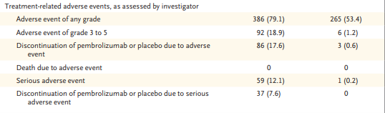
Treatment related adverse events from pembrolizumab
Pembrolizumab
Placebo
Pembrolizumab is not placebo!
Choueiri et al. (2021). NEJM.
Notes:
However, this is not to say that pembro is benign.
adverse event G3-5 occurred in 18.9 percent of pateints with an SAE occurring in 12.1 percent.
While there were Notably no new safety signal compared to prior reports, pembro is not placebo by any means

Slide 17
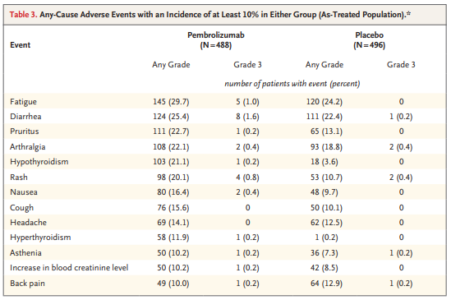
However, Most common adverse events are quite manageable
No single grade 3 AE occurred in > 1.6%
Choueiri et al. (2021). NEJM.
Notes:
However, the most common AEs are quite manageable, with no single grade 3 AE occurring in > 2% of patients

Slide 18
Immune related adverse events were uncommon
irAEs occurred in 36% who received pembrolizumab group and 7% placebo
Most common:
Hypothyroidism (18%)
Hyperthyroidism (12%)
What about the ones that scare us as medical oncologists?
Myocarditis in 1 patient (<1%)
Increased ALT in 4% (2% grade 3); AST in 4% (1% grade 3)
Pneumonitis in 3% (<1% ≥ grade 3)
High-dose steroids (≥ 40 mg per day) used in 8% in pembro group (and 1% in placebo group)
Notes:
And what about IRAEs in particularly? They occurred in 36% of those who received pembro
Most common: hypo/hyper

Slide 19
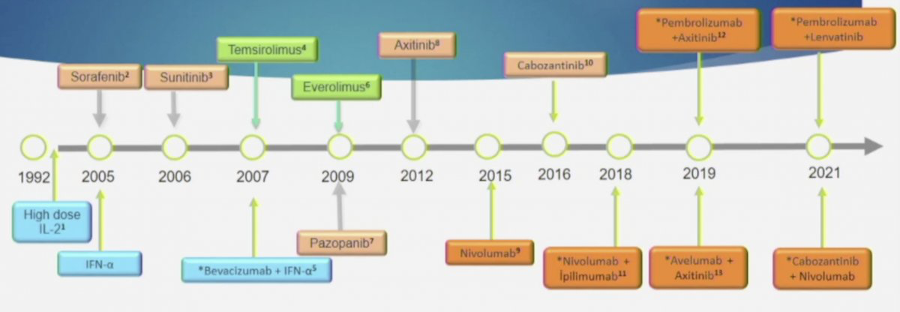
Adjuvant pembrolizumab is new, immunotherapy is not
Effective treatment of the rare, severe immunotherapy-related adverse event requires vigilance from experienced medical oncologists
A high suspicion for detection and a low threshold to treat
Yildiz. Société Internationale D’Urologie (SIU) 2021 annual meeting
Notes:
Also, this group does not need reminding that while adjuvant pembro is new, checkpoint inhibitors are not
Nivo was 1st approved in RCC in 2015. You have been using these drugs for a long time now. Effective treatment of the rare and severe potential IRAEs requires vigilance from experienced medical oncologists. We have to maintain a high suspicion for detection and a low threshold to treat, leading to better outcomes.

Slide 20

Number of immunotherapy-related adverse events Dr. Master has managed in his exceptional career as a surgeon-scientist
Notes:
Now seems like a good time to point out the number of
Which is zero

Slide 21
Patient-centric care
Patient-as-partner model requires informed and in-depth conversations about the potential risks and benefits of adjuvant therapy with the individual patient based on their disease characteristics, underlying comorbidities, and personal values
My discussion with Cara:
  Risk of recurrence with surgery alone somewhere around 60%
  Pembrolizumab may reduce her risk of recurrence by…15%?
  She has no comorbidities or underlying autoimmune disease
  Lives close to Atlanta, doesn’t mind the drive
  Tells me, “I cannot sleep at night unless I know I did everything I could”
  We discuss the risk of an immune-related adverse event
    Some inflammation is good! Just not too much
    Most reversible
    Some not reversible but replaceable (i.e. levothyroxine daily forever)
    Very rare but potentially fatal events like myocarditis
Notes:
Adjuvant pembrolizumab may be easier to tolerate than the sunitinib of S-TRAC, but it is not without risk

Slide 22

Cara opted for 1 year of adjuvant pembrolizumab
Course complicated by grade 1 dermatitis requiring topical triamcinolone
Had mild fatigue, TSH was noted to be elevated to 15 with a low T4 and she was started on levothyroxine which she continues today
2 years after surgery, she is disease free and happy with her decision
I believe that Cara deserved the opportunity to make her decision to pursue adjuvant pembrolizumab.
Do you?

Slide 23

Thank you!
jacqueline.theresa.brown@emory.edu
@jackiebrown_MD

