Slide 1
CAR-T v Bispecifics in Myeloma: The Case for CAR-T
Madhav V. Dhodapkar, MD
Emory University

Slide 2
Disclosure
I am historically poor debater.
Routine lose in debates / arguments with my kids!! ☹
….but please don’t let that impact the strength of the position!!
No other disclosures.

Slide 3
What Are We Debating?
Looking for one&done.
Hates ongoing Rx
Hates bi-specifics..or anything ending with “mab”.
Tumor target negative.
Too frail for either.
Limiting organ dysf.
Poor PS
Marrow failure
Insurance /Costs
Manufact. failure
Rapid prog dz / no bridge options
Hates CART ..or anything ending with “cel”.
CART
Eligibility
Bi-specific
Eligibility

Slide 4
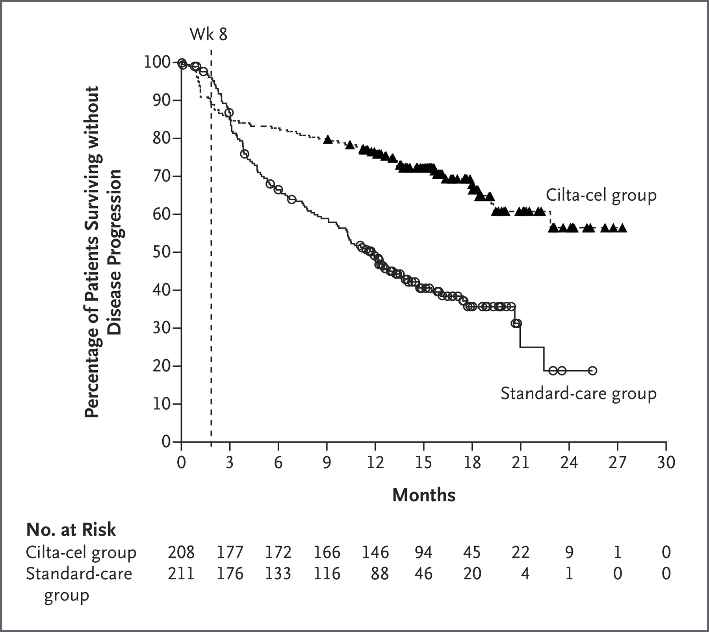
Efficacy
Both are active …..but…show me phase III data
CiltaCel v SOC
 | Bispecific | CAR-T
Efficacy | Yes, Response rates 60-70% | Yes, Response rates 70-100%
Comparison to SOC | Yes, superior to SOC | Pending
Head to head comparison | None | None
San Miguel et al. NEJ Myeloma 2023

Slide 5
Toxicity
Both lead to AEs…..but…
BCMA CARTs
BCMA Bi-specifics
CRS
CRS
Neurotox
Neurotox
Opp Infections
Opp Infections
Risk
Risk
Time (weeks-months)
Time (weeks-months)
OI types similar to that seen with Allo/GVH

Slide 6
Biology
Both lead to “T cell redirection”…..but…
 | Bispecific | CAR-T
Target | Endogenous T cells | Engineered + Endogenous
Overcome impact of endogenous T cell dysfunction | Likely not | Maybe, partially
Lead to chronic / systemic T cell engagement | Likely Yes | Likely not
Emergence of target-variants/mutations in subclones | Seems high (prelim data) | Lower

Slide 7
What if we made the wrong choice initially ?...salvage outcomes
CART after Bi-specific
Bi-specific after CART
Hansen et al. JCO 2023
Van Oekelen et al. Blood 2023

Slide 8
Some Arguments from detractors
Manufacturing time, Access
Improving
Coming----Short manufacturing time (e.g. 1-3d) CARTs.
Coming ---Off the shelf- allo-CART or CAR-NKT.
Not a cure
High CR rates while largely preserving immune function a major step.
Working on it.
Costs too much
Agree— also true for most MM therapies…including bispecifics.
Point of care manufacturing, in vivo CARTs.

Slide 9
How would you rather go from New York to LA ?...By Air or By Train ?
 | By Train (bispecific approach) | By Air (CART approach)
Time | Takes longer (chronic Rx) | Quicker (one and done)
Risk | No risk of airplane crash (but trains can have other problems) Less CRS but more infections | Risk mostly only for a short time and well understood.
Efficacy | Will get you there (similar “response rates”) | Will also get you there….but easier travel
Resources | No need for airport..but does need train station (initial inpt step-up) | Needs airport (manufacturing)
Salvage | Find another airport en route…but harder. CART less effective afer bispecifics | Easy– just take the train only if miss the flight.
Costs | High | High

Slide 10
We are fortunate that we have a range of T cell redirection approaches in myeloma – THAT WORK….
…..but all redirection approaches are NOT EQUAL.
CARTs offer several advantages over bispecifics.
We need to figure our how to best integrate these options in MM therapy.
The person who agrees with you 80 percent of the time is an ally not a 20 percent enemy Ronald Reagan
….Maybe it does not have to be either/or …..but how to use all of the options…..

