Slide 1
CAR T Cells in non-Hodgkin lymphoma (NHL)
Jean Koff, MD, MSc
July 20, 2023

Slide 2
disclosures
Research funding: Oncternal Therapeutics; Viracta Therapeutics; Atara Biotherapeutics
Consulting fees: Janssen / Pharmacyclics; MorphoSys; Gamida Cell; TG Therapeutics; BeiGene
I will be discussing non-FDA approved indications during my presentation.

Slide 3
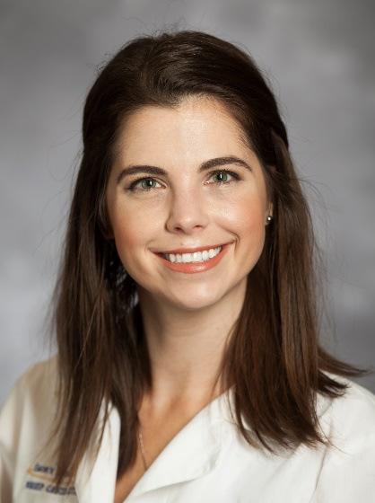
The match-up
Assistant Professor of Hematology and Medical Oncology at Winship
Clinician investigator with expertise in lymphoma and cellular therapy
Assistant Professor of Hematology and Medical Oncology at Winship
Lead, Cellular Therapy Clinical Trials Working Group
Clinical and translational research focus in B-cell lymphoma

Slide 4
The match-up
Assistant Professor of Hematology and Medical Oncology at Winship
Clinician investigator with expertise in lymphoma and cellular therapy
Assistant Professor of Hematology and Medical Oncology at Winship
Lead, Cellular Therapy Clinical Trials Working Group
Clinical and translational research focus in B-cell lymphoma
Still Rick-rolling people in 2023

Slide 5
CAR T cells offer new hope in relapsed / refractory nhl
CAR-T = Cellular Immunotherapy
T cells engineered to express a stripped-down, “Frankenstein” version of the T cell receptor
Extracellular domain binds surface molecules on lymphoma cells (e.g., CD19)
Intracellular domains activate the T cell
Targeted cytotoxic effect is independent of antigen presenting cells and the MHC complex
Created with BioRender.com

Slide 6
CAR T manufacturing and administration
LD chemo
Created with BioRender.com
Notes:
Current commercially available CAR-T products in lymphoma are autologous and CD19-targeted

Slide 7
Pop quiz!
All CAR T products currently FDA-approved for NHL treatment target which molecule?
A. CD19
B. CD20
C. CD79b
D. BCMA

Slide 8
CAR T vs. bispecifics: Administration
CAR T
Manufacture from autologous cells (but off-the-shelf products are under investigation)
“One-and-done” infusion after LD chemo
Key subtypes:
Large B-cell lymphoma (LBCL)
Follicular lymphoma (FL)
Mantle cell lymphoma (MCL)
Bispecifics
Off-the-shelf
Epcoritamab SC: Weekly x 3 months → biweekly x 6 months → monthly infusions indefinitely
Glofitamab IV: Pre-tx Obinutuzumab → weekly x 3 weeks → q3 weeks for 12 cycles
Mosunetuzumab IV: Weekly x 3 weeks → q3 weeks for 8-17 cycles
Key subtypes:
LBCL
FL
8
Notes:
Borne out by RWE analyses

Slide 9
CAR T cell therapy has changed the paradigm for treatment of relapsed/refractory B-cell lymphomas.
Notes:
3 products with a combined 8 indications in 3 major NHL subtypes.

Slide 10
Car t in nhl: large B-cell lymphomas
Trial | Product | Indications | ORR | Landmark OS | Grade 3+ toxicity rates
ZUMA-1 NEJM, 2017 | Axicabtagene ciloleucel | 3+L: DLBCL, PMBL, HGBL, tFL | 83% CRR: 58% | 2-year: 50% mDOR 11.1 mo | CRS: 11% NE: 32%
JULIET NEJM, 2019 | Tisagenlecleucel | 3+L: DLBCL, HGBL, tFL | 52% CRR: 40% | 1-year: 49% | CRS: 22% NE: 12%
TRANSCEND Lancet, 2020 | Lisocaptagene maraleucel | 3+L: DLBCL, PMBL HGBL, tFL, grade 3B FL | 73% CRR: 54% | 1-year: 58% mDOR 23.1 mo | CRS: 2% NE: 10%
Epcoritamab in 3+L DLBCL (n=157)¹: ORR 63%, CR 39%, mDOR 15.5 months.
6-month PFS 44%.
Glofitamab in 3+L DLBCL (n=154)²: ORR 52%, CR 39%, mDOR 18.4 months.
12-month OS 50%.
ORR = overall response rate; OS = overall survival; CRR = complete response rate; CRS = cytokine release syndrome; NE = neurological event
¹Karimi Y et al at ASCO, 2023. ²Dickinson MJ et al at NEJM, 2022.
Notes:
ZUMA-1 mDOR 11.1, mDOCR 62.2
Transcend mDOR 23.1, mDOCR 26.1

Slide 11
Car t in nhl: large B-cell lymphomas
Trial | Product | Indications | ORR | Landmark OS | Grade 3+ toxicity rates
ZUMA-7 NEJM, 2022 | Axi-cel | 2L: LBCL R/R within 12 mos of 1L | 83% CRR: 65% | 2-year: 61% (52% for ASCT) | CRS: 6% NE: 21%
TRANSFORM Lancet, 2022 | Liso-cel | 2L: LBCL R/R within 12 mos of 1L | 79% CRR: 66% | 1-year: 79% (64% for ASCT) | CRS: 1% NE: 4%
PILOT Lancet Oncol, 2022 | Liso-cel | 2L: LBCL not eligible for ASCT | 80% CRR: 54% | mOS not reached | CRS: 2% NE: 5%
No bispecifics approved in 2L DLBCL.

Slide 13
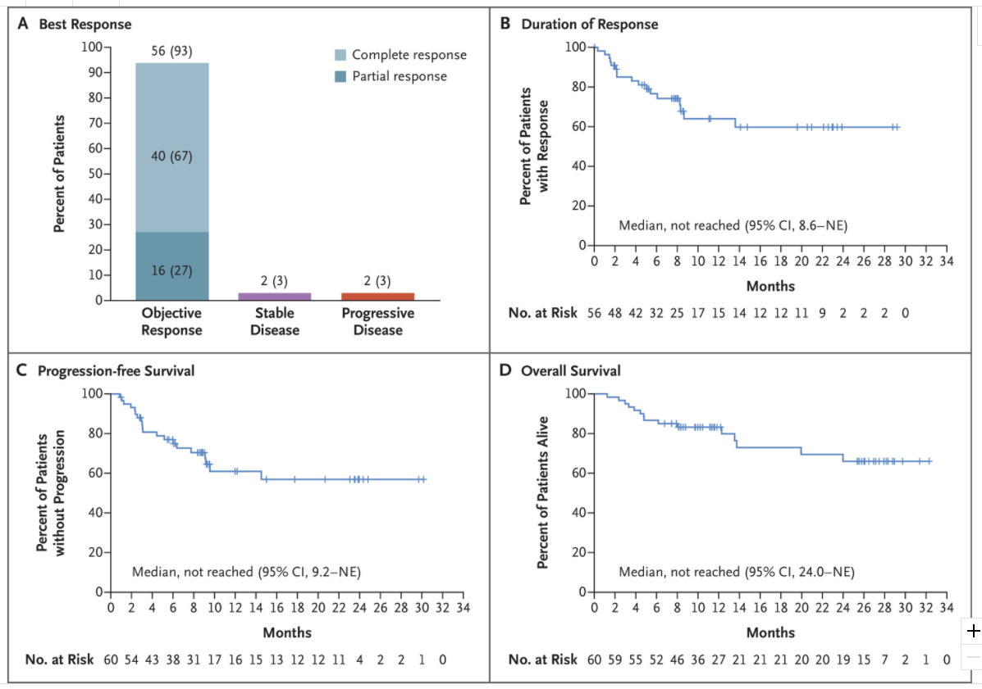
Brexucaptagene autoleucel approved for R/R MCL
Trial | ORR | Landmark OS | Grade 3+ toxicity rates
ZUMA-2 NEJM, 2020 | 85% CRR: 59% | 1-year: 83% | CRS: 15% NE: 31%
Patient population: 74 MCL patients (68 infused)
Median age 65 (38-79)
82% with Ki67 > 30%
17% TP53-mutated
Median # of previous therapies = 3 (1-5)
81% had ≥3 therapies
43% s/p ASCT
100% s/p BTKi (62% refractory)
Median follow-up: 12.3 months (7 to 32.3)
Similar benefit across subgroups
2 Grade 5 infectious events
Notes:
Abstract: Glofit ORR 84%, CR 73% DOR 12.6 months in 29 pts
Odronexatamab – DOR 10.9 months
Supported by RWE in JCO (Wang et al), DOR 17.2 months
Patients with a high content of leukemic blasts in the peripheral blood may have relatively few T cells in the starting material used for the manufacturing of CAR T-cell products, which can lead to manufacturing failure.¹⁵ The preparation of brexucabtagene autoleucel, uses a method of T cell enrichment that decreases the prevalence of CD19-expressing tumor cells in the CAR T cell preparation.
he primary efficacy analysis showed that 93% (95% confidence interval [CI], 84 to 98) of the 60 patients in the primary efficacy analysis had an objective response; 67% (95% CI, 53 to 78) had a complete response. In an intention-to-treat analysis involving all 74 patients, 85% had an objective response; 59% had a complete response.
Indicated after chemoimmunotherapy and BTKi

Slide 14
Brexucaptagene autoleucel approved for R/R MCL
Trial | ORR | Landmark OS | Grade 3+ toxicity rates
ZUMA-2 NEJM, 2020 | 85% CRR: 59% | 1-year: 83% mDOR 28.2 mo | CRS: 15% NE: 31%
No bispecifics approved in MCL
Glofitamab (n=29): ORR 84%, CR 73%, DOR 12.6 months.¹
OS/PFS?
¹Phillips TJ et al at ASH, 2022.
Notes:
Abstract: Glofit ORR 84%, CR 73% DOR 12.6 months in 29 pts
Odronexatamab – DOR 10.9 months
Supported by RWE in JCO (Wang et al), DOR 17.2 months
Patients with a high content of leukemic blasts in the peripheral blood may have relatively few T cells in the starting material used for the manufacturing of CAR T-cell products, which can lead to manufacturing failure.¹⁵ The preparation of brexucabtagene autoleucel, uses a method of T cell enrichment that decreases the prevalence of CD19-expressing tumor cells in the CAR T cell preparation.
he primary efficacy analysis showed that 93% (95% confidence interval [CI], 84 to 98) of the 60 patients in the primary efficacy analysis had an objective response; 67% (95% CI, 53 to 78) had a complete response. In an intention-to-treat analysis involving all 74 patients, 85% had an objective response; 59% had a complete response.
Indicated after chemoimmunotherapy and BTKi

Slide 15
Car t in nhl: Follicular lymphoma
Trial | Product | Subtype | ORR | Landmark OS | Grade 3+ toxicity
ZUMA-5 Lancet Oncol, 2021 | Axi-cel | FL | 94% CRR: 80% | 3-year: 76% mDOR 38.6 mo | CRS: 6% NE: 15%
 |  | MZL | 85% CRR: 60% |  | CRS: 9% NE: 41%
ELARA Nat Medicine, 2021 | Tisa-cel | FL | 96% CRR: 68% | 2-year: 88% | CRS: 0% NE: 3%
Mosunetuzumab in 3+L FL (n=157)¹: ORR 80%, CR 60%, mDOR 22.8 months.
18-month OS 89.6%.
¹Budde LE et al in Lancet Oncol, 2022.
Notes:
ZUMA-5: mDOR 38.6 m
ELARA mDOR NR

Slide 16
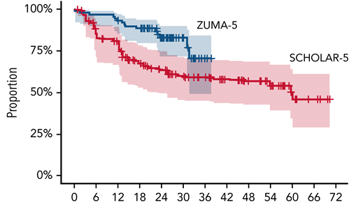
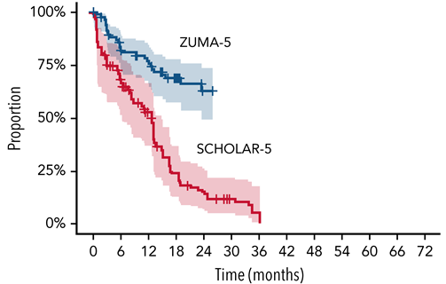
Patient population: 124 FL patients and 22 MZL patients
Median age 61 (34-79)
47% ≥ 3 FLIPI
49% with high tumor bulk per GELF criteria
POD24 55%
Median # of previous therapies = 3 (1-10)
64% had ≥3 therapies
68% refractory to last treatment
Median follow-up: 17.5 months (1.3 – 31.6)
3 Grade-5 AEs: 1 due to CRS
Matched comparison of ZUMA-5 vs. SCHOLAR-5 FL patients²
GELF = Groupe d’Etude des Lymphomes Folliculaire; POD24 = progression <2 years after initial chemotherapy
Notes:
85 patients in S5 after applying propensity score weights along with 86 patients in Z-5. Median follow-up time for Z-5 was 23.3 months and for S-5 was 26.2 months. Variables that were successfully matched (SMD<0.1) included POD24, number of prior LOT, relapsed vs refractory, prior stem cell transplant, size of largest node, response to prior LOT, time since last therapy and age. Despite matching, the S-5 cohort had a higher proportion of ECOG 1 vs 0 (71.0% vs 40.7%) at baseline.
S-5 cohort source data were extracted for r/r FL patients from 7 institutions in 5 countries who initiated a third or higher (3L+) line of therapy (LOT) after July 2014
Hi-grade CRS and neurological toxicity is increased in patients who have high pretreatment inflammatory markers. In FL pts, the pretreatment CRP, ferritin and IL-6 levels are much lower than what they are in DLBCL

Slide 17
CAR T vs. bispecifics: toxicity
Concession: T-cell activation toxicities appear to be more prevalent in CAR T
But…
↓Rates of severe CRS and ICANS with modern mitigation strategies
CAR T is administered at FACT-accredited facilities
Most CRS and ICANS AEs are limited to first 30 days after infusion
17
Notes:
Borne out by RWE analyses
Ability of community centers to safely administer BiTEs is unproven

Slide 18
IEC clinical trials at winship
Allogeneic gamma-delta T cell-Ab conjugate (ACE1831) in R/R NHL (PI: Romancik)
Allo anti-CD19 CAR-T azercabtagene zapreleucel in R/R NHL
Anti-CD19 and –CD20 CAR-T zamtocaptagene autolecleucel in R/R LBCL (PI: Romancik)
Allo anti-CD19 CRISPR-Cas9–Engineered T Cells (CTX110) in R/R LBCL
Allogene allo anti-CD19 CAR-T in R/R LBCL
ZUMA-25: brexu-cel in rare B-cell malignancies (PI: Romancik)
Atara EBV-targeted cytotoxic T cells in EBV+ disorders
Also: Trials of adjuvant or neo-adjuvant therapies to improve commercial CAR-T efficacy

Slide 19
summary
CAR T offers long DOR in R/R FL and MCL, and a curative opportunity in R/R LBCL.
Rates of severe CRS and ICANS after CAR T infusion have decreased with current mitigation strategies.
Currently approved CAR T products represent only the first generation of immune effector cell therapy.
Additional data is needed regarding:
Bispecifics’ ability to produce long DOR (and cure?) in NHL
Optimal duration of bispecific therapy
Comparative outcomes in similar patient populations
Best practices for administration and toxicity monitoring of CAR T and bispecifics
Notes:
Optimizing patient selection to predict response and minimize toxicities
Ultimately, we should think of these modalities as companions rather than competitors

Slide 20
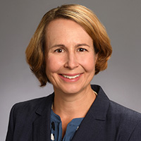
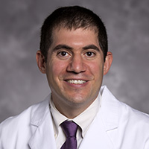
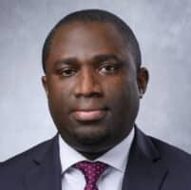
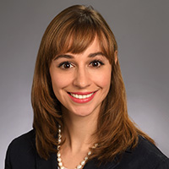
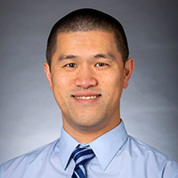
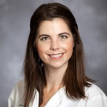
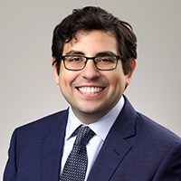
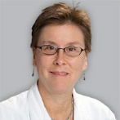
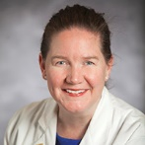
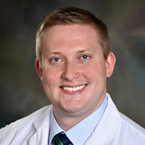
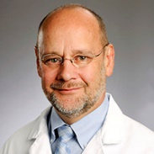
Meet the Lymphoma team at winship
Lymphoma Program
Add photo here
Kristie Blum, MD Co-Director
Add photo here
Jonathon Cohen, MD Co-Director
Add photo here
Owhofasa Agbedia, MD
Add photo here
Pamela Allen, MD
Add photo here
Andres Chang, MD, PhD
Add photo here
Jean Koff, MD
Add photo here
Carlos Lopez, MD
Add photo here
Amelia Langston, MD
Add photo here
Mary Jo Lechowicz, MD
Add photo here
Jason Romancik, MD
Add photo here
Edmund Waller, MD, PhD, FACP

Slide 21
Referrals
bloodcancer@emoryhealthcare.org
404.778.0519

