Slide 1
Diffuse Large B-cell Lymphoma
November 10, 2021

Slide 2
Course Director
John P. Leonard, MD
Senior Associate Dean for Innovation and Initiatives
Executive Vice Chair, Weill Department of Medicine
Richard T. Silver Distinguished Professor of Hematology & Medical Oncology
Weill Cornell Medical College
New York, New York
Presenter
Grzegorz Nowakowski, MD
Professor of Medicine
Division of Hematology
Department of Internal Medicine
Mayo Clinic
Rochester, Minnesota

Slide 3
This activity is supported by independent educational grants from
AstraZeneca,
Bristol-Myers Squibb
and
Epizyme, Inc

Slide 4

This activity is jointly provided by

Slide 5
Continuing Education
In support of improving patient care, this activity has been planned and implemented by University of Nebraska Medical Center and Bio Ascend. University of Nebraska Medical Center is jointly accredited by the Accreditation Council for Continuing Medical Education (ACCME), the Accreditation Council for Pharmacy Education (ACPE), and the American Nurses Credentialing Center (ANCC), to provide continuing education for the healthcare team.
The University of Nebraska Medical Center, Center for Continuing Education designates this live activity for a maximum of 1 AMA PRA Category 1 Credit™. Physicians should claim only the credit commensurate with the extent of their participation in the activity.

Slide 6
Disclosure
As a jointly accredited provider, the University of Nebraska Medical Center (UNMC) ensures accuracy, balance, objectivity, independence, and scientific rigor in its educational activities and is committed to protecting learners from promotion, marketing, and commercial bias. All faculty, planners, and others in a position to control continuing education content participating in an accredited continuing education activity are required to disclose all financial relationships with ineligible companies. Ineligible companies are organizations whose primary business is producing, marketing, selling, re-selling, or distributing healthcare products used by or on patients. The accredited provider is responsible for mitigating all relevant financial relationships in accredited continuing education. Disclosure of these commitments and/or relationships is included in these activity materials so that participants may formulate their own judgments in interpreting its content and evaluating its recommendations.
This activity may include presentations in which faculty may discuss off-label and/or investigational use of pharmaceuticals or instruments not yet FDA-approved. Participants should note that the use of products outside currently FDA-approved labeling should be considered experimental and are advised to consult current prescribing information for FDA-approved indications. All materials are included with the permission of the faculty. The opinions expressed are those of the faculty and are not to be construed as those of UNMC or Bio Ascend.

Slide 7
Disclosures
John P. Leonard, MD
Consulting Fees: ADC Therapeutics, AstraZeneca, Bayer, Bristol-Myers Squibb Company, Epizyme, Kite, a Gilead Company, MEI Pharma, Miltenyi Biotec, Regeneron, Roche/Genentech, Sutro Biopharma
Grzegorz Nowakowski, MD
Consulting Fees: Bantham Pharmaceutical, Blueprint Medicines, Celgene/BMS, Curis, Daiichi Sankyo, Incyte, Karyopharm Therapeutics, Kite Pharma, Kymera Therapeutics, MorphoSys, Roche/Genentech, Ryvu Therapeutics, Seattle Genetics, Selvita, TG Therapeutics, Zai Laboratory
Research Support: Celgene/BMS, Nanostrings, Roche/Genentech
Scientific Advisory Board: Karyopharm Therapeutics, Ryvu Therapeutics
Planning Committee
The following planning committee members have nothing to disclose:
UNMC: Brenda Ram, CMP, CHCP
Bio Ascend: Patti Bunyasaranand, MS; Dru Dace, PhD; Lucja Grajkowska, PhD; Kraig Steubing

Slide 8
Learning Objectives
Evaluate best available evidence regarding treatment for patients with DLBCL
Assess the implications of emerging clinical trial data regarding DLBCL treatment approaches
Develop strategies to address complicated DLBCL cases

Slide 9
Reminders
Please respond to the polling questions as they appear on the webinar screen. All responses are anonymous
You will receive a post-program evaluation link at the end of the webinar. Your response is greatly appreciated
A CME request form is available for download at the end of the online program evaluation
The recording of today’s presentation along with downloadable slides will be available at www.oncologycaseclinic.com in about 2 weeks
Visit www.oncologycaseclinic.com to register for upcoming webinars and view past webinars

Slide 10
Pre-Assessment Question 1
The ROBUST trial examined the addition of what agent to R-CHOP for patients with untreated DLBCL?
Tafasitamab
Lenalidomide
Polatuzumab
Selinexor

Slide 11
Pre-Assessment Question 2
Polatuzumab vedotin is an antibody-drug conjugate that targets which of the following antigens on lymphoma cells?
CD5
CD19
CD20
CD79b

Slide 12
Pre-Assessment Question 3
Which of the following treatment-emergent adverse events (TEAEs) were most common in the LOTIS-2 trial examining loncastuximab tesirine in patients with R/R DLBCL?
Increased gamma-glutamyltransferase (GGT)
Fatigue
Nausea
Cough

Slide 13
Patient 1
22 yo male with several months history of dry cough and night sweats, weight loss of >10 lbs
No significant PMH
No family history of immunodeficiency, lymphoma or cancer
Unremarkable physical examination apart from mass protruding from anterior chest
CXR – large intrathoracic masses
CBC – anemia Hb 9.9, chemistries unremarkable; LDH 550 (ULN 220) HIV-/Hepatitis B-/C-

Slide 14
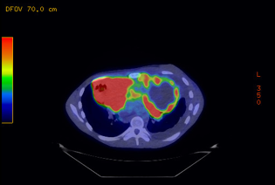
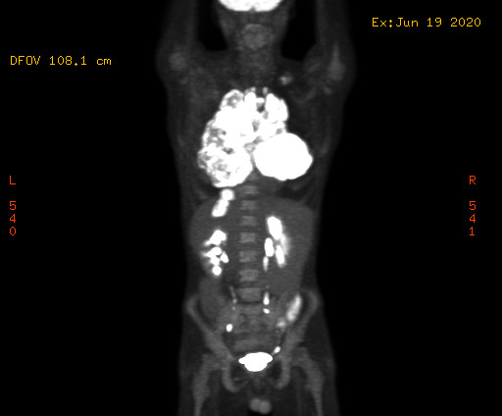
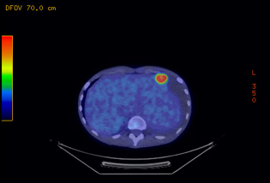
Staging PET Scan

Slide 15
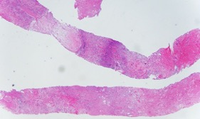
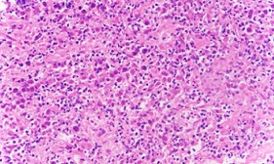
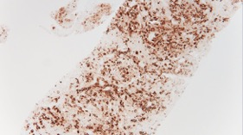
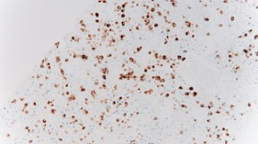
Pathology CT-Guided Core Biopsy
Positive: CD20, PAX5, EBV-LMP1, EBER (in intact viable cells), MUM1 (>30%).
Negative: CD10 (<30%), BCL6 (<30%), BCL2, BCL6 (<50%), and MYC (<40%), CD30.
Non-GCB by Hans
FISH: MYC-/BCL2-
CD20
EBV-LMP1

Slide 16
Pathology CT-Guided Core Biopsy
Positive: CD20, PAX5, EBV-LMP1, EBER (in intact viable cells), MUM1 (>30%).
Negative: CD10 (<30%), BCL6 (<30%), BCL2, BCL6 (<50%), and MYC (<40%), CD30.
Non-GCB by Hans
FISH: MYC-/BCL2-
CD20
EBV-LMP1

Slide 17
Lymph3Cx Assay, Distinction of PMLBCL and Cell-of-Origin for DLBCL, mRNA Gene Expression, NanoString
Molecular classification assay for the distinction of PMBCL from DLBCL subtypes as well as the “cell-of origin” subtypes of DLBCL based on gene expression in formalin-fixed, paraffin-embedded tissue
Utilizes the NanoString Technology and consists of probes for 58 target genes (discriminatory and housekeeping genes)
PMBCL Call is based upon PMBCL probability:
≥ 0.90 is PMBCL
≤ 0.10 is DLBCL
All other DLBCL with unclear gene expression pattern
If DLBCL is called per above, then COO is determined by DLBCL probability:
≤ 0.10 is Germinal Center B-cell (GCB).
≥ 0.90 Activated B-cell (ABC).
All other results are Unclassifiable.
Patient: Non PMBCL - ABC DLBCL
Mottok A et al. Blood. 2018;132(22):2401–2405.

Slide 18
Case Summary
22 yo with ABC DLBCL
Stage IVBE (Extranodal + BM involvement)
IPI 3 (stage, extranodal sites, elevated LDH)
CNS IPI 3 (> 1 extranodal, elevated LDH, stage)
How would you treat this patient?
DA-EPOCH-R
R-CHOP
Ibrutinib-RCHOP
Lenalidomide-RCHOP (R2CHOP)
CODOX-M/IVAC/R

Slide 19
Case Summary
22 yo with ABC DLBCL
Stage IVBE (Extranodal + BM involvement)
IPI 3 (stage, extranodal sites, elevated LDH)
CNS IPI 3 (> 1 extranodal, elevated LDH, stage)
How would you treat this patient?
DA-EPOCH-R
R-CHOP
Ibrutinib-RCHOP
Lenalidomide-RCHOP (R2CHOP)
CODOX-M/IVAC/R

Slide 20
Phase 3 Study of R-CHOP vs DA-EPOCH-R in Patients with Untreated DLBCL
(CALGB/Alliance 50303)
Study schema
Event-free survival
Key eligibility criteria
(N=524)
Age ≥18 years
Stage ≥ II newly diagnosed DLBCL (Stage I PMBCL)
ECOG PS 0–2
Fresh/frozen tumor biopsy (4 cores)
R-CHOP
6 cycles
0.8
R
A
N
D
O
M
I
Z
E
0.6
1:1
Probability event free
0.4
DA-EPOCH-R
6 cycles
0.2
Median follow-up 5.0 years
HR=1.14 (0.82–1.61)
p=0.4386
R-CHOP
+
DA-EPOCH-R
0.0
0
1
2
3
4
5
Years from Study Entry
Bartlett NL, et al. J Clin Oncol. 2019;37:1790-1799.

Slide 21
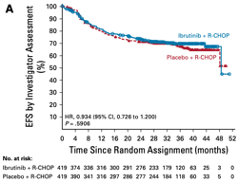
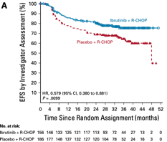
Phoenix Study Ibrutinib RCHOP vs RCHOP
All Patients
Patients < 60
Non GCB DLBCL R-IPI >1
R-CHOP (6-8 cycles*) + placebo
1:1
R-CHOP (6-8 cycles*) +
560 mg ibrutinib
Younes et al J Clin Oncol 37:1285-1295

Slide 22
Molecular Clusters and Outcome with Ibrutinib and RCHOP
Ibrutinib might be of benefit in specific subtypes
Prospective validation needed
Relatively few patients fall into benefit groups
Molecular test not real time
Wilson et al., 2021, Cancer Cell 39, 1–11 December 13, 2021

Slide 23
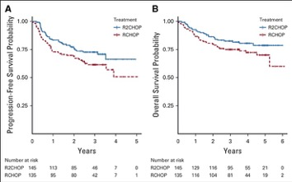
Results of Randomized Studies of Lenalidomide Plus RCHOP (R2CHOP) vs. RCHOP
Nowakowski GS et al. J Clin Oncol. 2021Feb23;JCO2001366.
Nowakowski GS et al. J Clin Oncol. 2021 Feb 8:JCO2001375

Slide 24
Comparison of ROBUST and ECOG-ACRIN 1412
 |  | ROBUST (N = 570) |  | E1412 (N = 280)
Study design |  | Global, Phase 3, Double-blinded w/ placebo |  | US, Phase 2, Open-label
COO by Nanostring |  | ABC Only |  | GCB, ABC, and Unclassified
Len and prednisone dose |  | Len 15 mg days 1-14; Pred 100 mg flat |  | Len 25 mg days 1-10; Pred 100 mg/m²
 |  | R²-CHOP (n = 285) | Placebo/R-CHOP (n = 285) | R²-CHOP (n = 145) | R-CHOP (n = 135)
Median age |  | 65 (21-82) | 65 (28-83) | 67 (24-88) | 66 (37-92)
IPI risk score | 2 | 42% | 42% | 33% | 34%
 | ≥3 | 58% | 58% | 66% | 66%
Disease stage III/IV |  | 87% | 88% | 97% | 96%
ECOG | 0-1 | 82% | 80% | 39% | 35%
 | 2 | 18% | 20% | 61% | 65%
Median time dx to tx, days |  | 31 | 31 | 21 | 19
ORR (CR) |  | 91% (69%) | 91% (65%) | 97% (72%) | 91% (67%)
2-Year PFS |  | 67% | 64% | 76% | 70%
Median follow-up |  | 27.1 mo (range, 0-47) |  | 2.5 years
2-Year OS |  | 79% | 80% | 86% | 80%
Safety |  | Most common grade 3/4 AEs were hematologic: neutropenia, leukopenia, and anemia |  | Grade 3/4 AEs with R²⁻CHOP vs R-CHOP: anemia (30% vs 20%), thrombocytopenia (36% vs 12%)

Slide 25
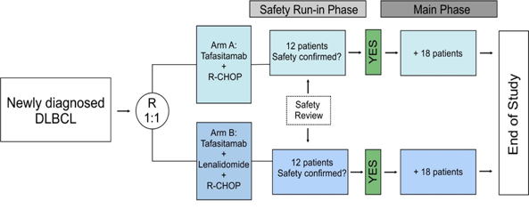
firstMIND Trial – RCHOP/R2CHOP (E1412 Dose) Plus Tafasitamab
Newly diagnosed DLBCL NOS
• Treatment naïve
• Histologically confirmed DLBCL not
otherwise specified
• Intermediate- to high-risk disease
(IPI 2–5)
• No double- or triple-hit lymphoma
• No transformed or composite lymphoma
N=24 (+36 after safety review)
Estimated Study Completion Date: May 2022
Belada D et al. ASH 2020. Abstract 3028.

Slide 26
Future? Pattern of Care in DLBCL
1st Line
2nd Line
3rd+ Line
50%^{c}
50%^{b}
Transplant
eligible
High dose chemo
(eg, RICE, R-DHAP)
CART
50%
R-CHOP or R-CHOP-like
ASCT
Pola-BR
Tafa-Len
CURE
50%
Tafa-Len
Pola-BR
Othter
10-15%^{c}
Selinexor
Non-transplant
eligible
CURE
Lonca-Tesirine
50%-60%^{a,b}
Other chemo…
SCT=stem-cell transplantation.
ª Decisions Resource Group. DLBCL Epidemiology data; ^{b} Sehn LH, Gascoyne RD. Blood. 2015;125:22-32;
^{c} Friedberg JW, et al. Hematology Am Soc Hematol Educ Program. 2011;2011:498-505;
Notes:
However, HDC with ASCT may not be appropriate, especially in patients with comorbidities or older age. This aggressive approach can generally only be offered to a relatively small percentage of patients with relapsed/refractory (R/R) DLBCL. For the remaining patient population, several second line combination therapies are used but with variable success.

Slide 27
Future? Pattern of Care in DLBCL
1st Line
2nd Line
3rd+ Line
50%^{c}
50%^{b}
Transplant
eligible
High dose chemo
(eg, RICE, R-DHAP)
CART
50%
R-CHOP or R-CHOP-like
ASCT
Pola-BR
Tafa-Len
CURE
50%
Tafa-Len
Pola-BR
Othter
10-15%^{c}
Selinexor
Non-transplant
eligible
CURE
Lonca-Tesirine
50%-60%^{a,b}
Other chemo…
SCT=stem-cell transplantation.
ª Decisions Resource Group. DLBCL Epidemiology data; ^{b} Sehn LH, Gascoyne RD. Blood. 2015;125:22-32;
^{c} Friedberg JW, et al. Hematology Am Soc Hematol Educ Program. 2011;2011:498-505;
Notes:
However, HDC with ASCT may not be appropriate, especially in patients with comorbidities or older age. This aggressive approach can generally only be offered to a relatively small percentage of patients with relapsed/refractory (R/R) DLBCL. For the remaining patient population, several second line combination therapies are used but with variable success.

Slide 28
Patient 2
78-year-old female presents for follow up 8 months after completing RCHOP for GCB DLBCL, IPI3
She tolerated therapy poorly with development of peripheral neuropathy and dose reductions due to cytopenia, infections, she has poor appetite and lost 20 lbs
She had diabetes and Cr =2.2 and pedal edema
PET scan at the end of therapy - CR
Now with cervical adenopathy, PET shows PET avid adenopathy below and above the diaphragm
Bx: DLBCL, CD20+, GCB subtype, FISH BCL2+, MYC-
Patient PS - 3

Slide 29
Patient 2
78-year-old female , PS 3, poor appetite with weight loss, residual vincristine induced peripheral neuropathy, pedal edema, with relapse of DLBCL 8 months after RCHOP
How would you treat this patient?
RICE followed by ASCT
Pola-BR
Loncastuximab
Tafa-Len
Selinexor

Slide 30
Patient 2
78-year old female , PS 3, residual vincristine induced peripheral neuropathy, pedal edema, with relapse of DLBCL 8 months after RCHOP
How would you treat this patient:
RICE followed by ASCT
Pola-BR
Lonca
Tafa-Len
Selinexor

Slide 31
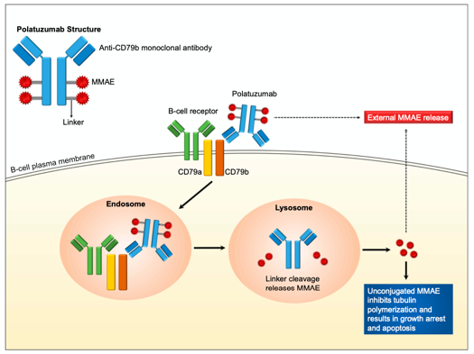
Polatuzumab Vedotin
OncoTargets and Therapy 2020:13 5123–5133; fda.gov

Slide 32
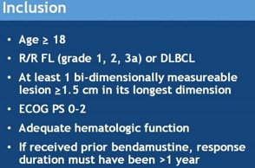
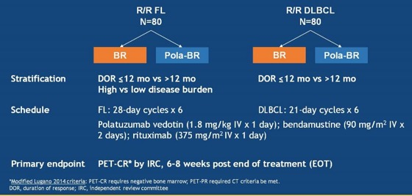
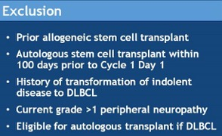
Phase 2 Study of Polatuzumab Vedotin + BR: Design
Age ≥ 18
Biopsy-confirmed R/R DLBCL
≥ 1 prior line of therapy
ECOG PS 0-2
Grade ≤ 1 peripheral neuropathy
Transplant ineligible or treatment failure with prior ASCT
Sehn L, et al. ASCO 2018. Abstract 7507. Sehn L, et al. J Clin Oncol. 2020;38:155-165.
Notes:
Purpose: Patients with transplantation-ineligible relapsed/refractory (R/R) diffuse large B-cell lymphoma (DLBCL) fare poorly, with limited treatment options. The antibody-drug conjugate polatuzumab vedotin targets CD79b, a B-cell receptor component.
Methods: Safety and efficacy of polatuzumab vedotin with bendamustine and obinutuzumab (pola-BG) was evaluated in a single-arm cohort. Polatuzumab vedotin combined with bendamustine and rituximab (pola-BR) was compared with bendamustine and rituximab (BR) in a randomly assigned cohort of patients with transplantation-ineligible R/R DLBCL (primary end point: independent review committee [IRC] assessed complete response [CR] rate at the end of treatment). Duration of response, progression-free survival (PFS), and overall survival (OS) were analyzed using Kaplan-Meier and Cox regression methods.
Results: Pola-BG and pola-BR had a tolerable safety profile. The phase Ib/II pola-BG cohort (n = 27) had a CR rate of 29.6% and a median OS of 10.8 months (median follow-up, 27.0 months). In the randomly assigned cohort (n = 80; 40 per arm), pola-BR patients had a significantly higher IRC-assessed CR rate (40.0% v 17.5%; P = .026) and longer IRC-assessed PFS (median, 9.5 v 3.7 months; hazard ratio [HR], 0.36, 95% CI, 0.21 to 0.63; P < .001) and OS (median, 12.4 v 4.7 months; HR, 0.42; 95% CI, 0.24 to 0.75; P = .002; median follow-up, 22.3 months). Pola-BR patients had higher rates of grade 3-4 neutropenia (46.2% v 33.3%), anemia (28.2% v 17.9%), and thrombocytopenia (41% v 23.1%), but similar grade 3-4 infections (23.1% v 20.5%), versus the BR group. Peripheral neuropathy associated with polatuzumab vedotin (43.6% of patients) was grade 1-2 and resolved in most patients.
Conclusion: Polatuzumab vedotin combined with BR resulted in a significantly higher CR rate and reduced the risk of death by 58% compared with BR in patients with transplantation-ineligible R/R DLBCL.
Trial registration: ClinicalTrials.gov NCT02257567.

Slide 33
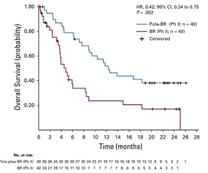
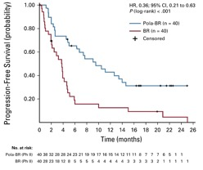
Phase 2 Study of Polatuzumab Vedotin + BR: Efficacy
mPFS
9.5 mo vs 3.7 mo
mOS
12.4 mo vs 4.7 mo
ORR
45%
ORR
17.5%
mDOR by IRC (Pola + BR vs BR): 12.6 mo vs 7.7 mo
Sehn L, et al. J Clin Oncol. 2020;38(2):155-165.
Notes:
Sehn L, et al. J Clin Oncol. 2020;38(2):155-165.

Slide 34
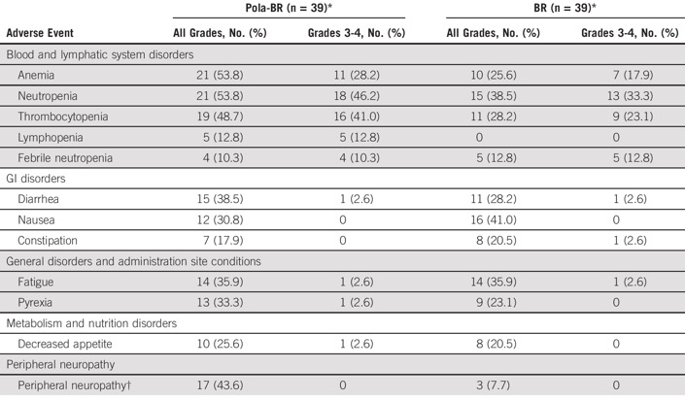
Phase 2 Study of Polatuzumab Vedotin + BR: AEs
Sehn L, et al. J Clin Oncol. 2020;38(2):155-165.
Notes:
All-Grade AES (>= 20%) and Grade 3-4 AES (>= 10%)
*1 patient in each group did not receive study treatment and was excluded from safety evaluable population.
+Includes peripheral motor neuropathy, peripheral sensory neuropathy, decreased vibratory sense, hyopesthesia, paresthesia.

Slide 35
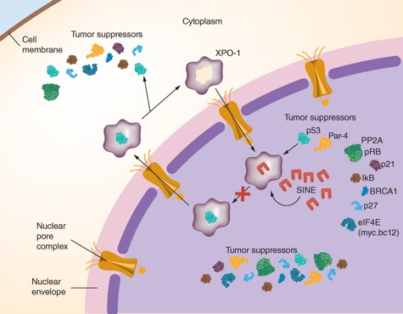
Selinexor
selective inhibitors of nuclear export (SINE) inhibit shuttling of intranuclear TSPs into the cytoplasm
Selinexor binds to XPO1, thereby blocking its function as a nuclear export protein
Int.J.Hematol.Oncol.(2018)7(3),IJH04
Presented by G. S. Nowakowski MD

Slide 36
SADAL: Selinexor in Patients With Relapsed/Refractory DLBCL
Selinexor Against Diffuse Aggressive Lymphoma (SADAL): An Open-label, Phase 2b study
Patient Population
Patients with de novo or trans DLBCL
Relapsed or refractory DLBCL
Not eligible for ASCT or post ASCT
Main Inclusion / Exclusion
2 - 5 prior treatment regimens
Platelet count >75,000/mm³
CrCl <30 ml/min - excluded
Treatment until PD or intolerable toxicity; Response assessed every 8 weeks per Cheson 2014
Oral Selinexor
60 mg twice-weekly Days 1, 3 – 28 day cycle
mITT population for all analysis and safety
Objectives:
  Primary Endpoint: Overall response rate (ORR): Independent Central Radiological Review (ICRR); Lugano Classification (2014)
  Secondary Endpoints: Duration of response (DOR), overall survival (OS), safety
Modified Intent to Treat (mITT) Population: All patients who were randomized to the 60 mg arm
Kalakonda N et al. Lancet Haematol 2020; 7: e511–22

Slide 37
Phase 2 SADAL: Responses
ORR | CR | PR | SD | PD/ND
36/127 (28%) (20·7–37·0) | 15 (12%) (6·8–18·7) | 21 (17%) (10·5–24·2) | 11 (9%) (4·4–15·0) | 80 (63%) (54·0–71·4)
Category | Median DOR (months) | 95% CI
All Responders | 9.2 | (4.8 - 23.0)
CR Patients | 13.5 | (9.3 - 23.0)
PR Patients | 4.8 | (2.0 - NE)
Category | Median OS (months) | 95% CI
All Patients | 9.0 | (6.2 - 13.7)
Median follow-up: 11.1 months.
Kalakonda N, et al. Lancet Haematol. 2020;7: e511–22.
Notes:
Data are n/N (%; 95% CI). Responses were adjudicated according to central imaging assessment. GCB=germinal centre B cell. See results section in main text for one-sided 97·5% CI.
Kalakonda N, et al. Lancet Haematol. 2020;7: e511–22.

Slide 38
Phase 2b SADAL: TEAE (≥ 20%)
 | Grade 1–2 | Grade 3 | Grade 4
Thrombocytopenia | 20 (16%) | 39 (31%) | 19 (15%)
Nausea | 66 (52%) | 8 (6%) | 0
Fatigue | 46 (36%) | 14 (11%) | 0
Anemia | 26 (21%) | 27 (21%) | 1 (1%)
Decreased appetite | 42 (33%) | 5 (4%) | 0
Diarrhea | 41 (32%) | 4 (3%) | 0
Constipation | 39 (31%) | 0 | 0
Neutropenia | 7 (6%) | 20 (16%) | 11 (9%)
Weight loss | 38 (30%) | 0 | 0
Vomiting | 35 (28%) | 2 (2%) | 0
Pyrexia | 23 (18%) | 5 (4%) | 0
Asthenia | 21 (17%) | 6 (5%) | 0
Event | % (N)
TEAE-related discontinuations | 17% (22)
Dose modification due to TEAE | 57% (73)
Serious AEs | 48% (61)
Death due to TEAEª | (5)
a None of the deaths in the study were considered related to selinexor by the investigator.
Kalakonda N, et al. Lancet Haematol. 2020;7: e511–22.
Notes:
22 (17%) patients discontinued treatment due to a treatment-emergent adverse events.
Treatment-emergent adverse events leading to dose modification (reduction or interruption) occurred in 89 (70%) patients, with the majority (73 [57%]) of patients having modifications in the first two cycles (appendix p 7).
The majority of patients who required a dose reduction due to adverse events received selinexor 40 mg twice weekly, which, with appropriate supportive care, was shown to be effective for resolution of the events. Supportive care included additional anti-nausea drugs (eg, oral olanzapine 2·5 mg to 5 mg once daily), appropriate fluid and caloric intake, appetite stimulants, psychostimulants, moderate to high doses of thrombopoietin-receptor agonists (n=21), and granulocyte colony stimulating factors (n=31). These drugs usually reduced the intensity or duration of adverse events, or both.
Serious adverse events occurred in 61 (48%) patients (appendix p 8)
The most common serious adverse events (≥3%) were pyrexia (n=9, 7%), pneumonia (n=6, 5%), fatigue (n=5, 4%), anaemia (n=4, 3%), cardiac failure (n=4, 3%), febrile neutropenia (n=4, 3%), and sepsis (n=6, 5%; appendix p 8).
Three of the five deaths due to treatment-emergent AE were in patients >= 70 years
None of the deaths in the study were considered related to selinexor by the investigator.

Slide 39
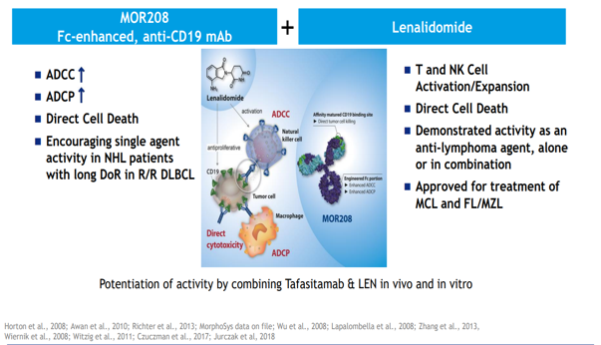
Combination Tafasitamab and Lenalidomide
1. ICML 2019 #124. Salles G, et al. L-MIND. June 22, 2019.
Notes:
ICML 2019 #124. Salles G, et al. L-MIND. June 22, 2019.
https://www.morphosys.de/sites/default/files/phone-conferences/downloads/190622_morphosys_icml_2019_presentation.pdf
Tafasitamab-cxix is an Fc-modified monoclonal antibody that binds to CD19 antigen expressed on the surface of pre-B and mature B lymphocytes and on several B-cell malignancies, including diffuse large B-cell lymphoma (DLBCL). Upon binding to CD19, tafasitamab-cxix mediates B-cell lysis through apoptosis and immune effector mechanisms, including antibody-dependent cellular cytotoxicity (ADCC) and antibody-dependent cellular phagocytosis (ADCP). In studies conducted in vitro in DLBCL tumor cells, tafasitamab-cxix in combination with lenalidomide resulted in increased ADCC activity compared to tafasitamab-cxix or lenalidomide alone.

Slide 40
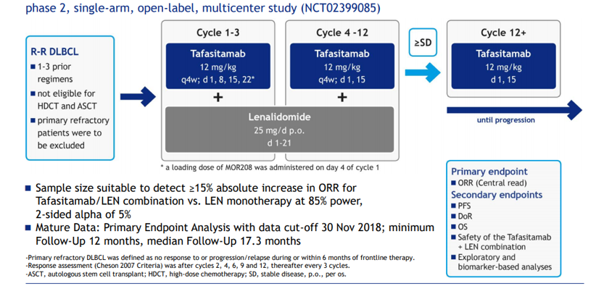
Phase 2 L-MIND Study of Tafasitamab + Lenalidomide: Design
1. ICML 2019 #124. Salles G, et al. L-MIND. June 22, 2019.
2.Salles G, et al. Lancet Oncol. 2020;21(7):978-988.
Notes:
Salles G, et al. Lancet Oncol. 2020 June 5. https://doi.org/10.1016/S1470-2045(20)30225-4. (NCT02399085)
https://www.morphosys.de/sites/default/files/phone-conferences/downloads/190622_morphosys_icml_2019_presentation.pdf
Key inclusion criteria were adequate organ function, ≤3 prior lines of therapy, including ≥1 anti-CD20 therapy, and ineligibility for stem cell transplantation. Treatment comprised up to 12, 28-day (d) cycles (C) of MOR208, 12 mg/kg IV, q1w C1–3 (loading dose on d4 of C1), and q2w C4–12 + LEN 25 mg PO d1–21, C1–12. Pts progression-free after 12 C received MOR208 q2w until progression. The primary endpoint was independent review committee (IRC)-assessed ORR as per Cheson 2007 criteria.
The median age of enrolled patients was 72 years (IQR 62–76) and all patients received R-CHOP (rituximab, cyclophosphamide, doxorubicin, vincristine, and prednisone or prednisolone) or equivalent anthracycline-containing immunochemotherapy before study entry (table 1).
The median follow-up was 13·2 months

Slide 41
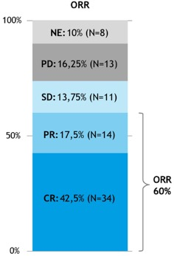
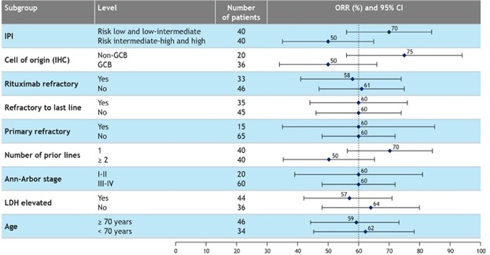
Primary Endpoint: Overall Response Rate (ORR) by IRC
Salles G, et al. Lancet Oncol. 2020;10.1016/S1470-2045(20)30275-8

Slide 42
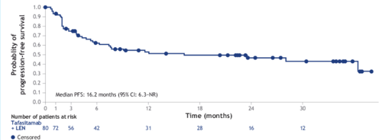
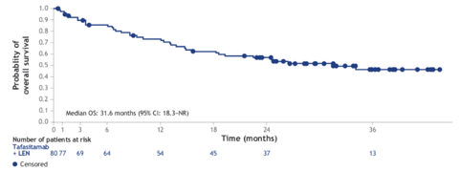
Phase 2 L-MIND: PFS and OS at ≥ 2 Years of Follow Up
PFS
Median PFS: 16.2 moª
Median OS: 31.6 mo^{b}
OS
a Median follow up, 22.6 months. B Median follow up 31.8 months.
Salles G, et al. EHA 2020. EP1201.
Notes:
Median OS was 31.6 months (95% CI: 18.3–NR) with a median follow-up of 31.8 months (95% CI: 27.2–35.9), and IRC-assessed median PFS was 16.2 months (95% CI: 6.3–NR) with a median follow-up of 22.6 months (95% CI: 22.2–27.4).

Slide 43
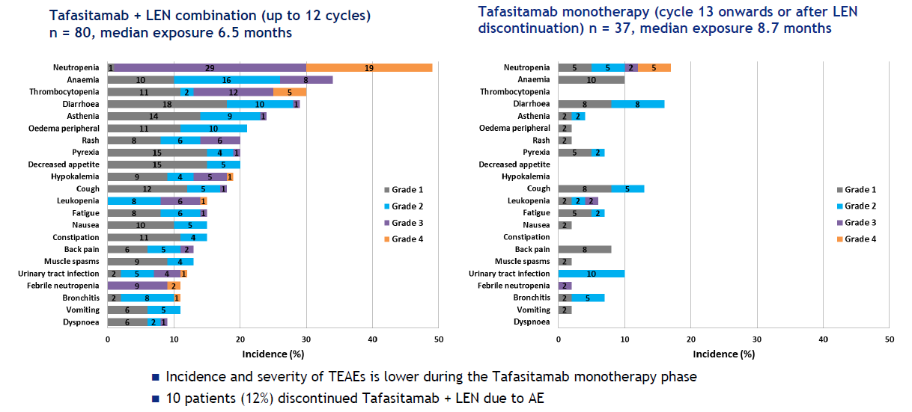
Phase 2 L-MIND: Safety by Treatment Phase
AE collection period included 30 days after end of treatment.
1. ICML 2019 #124. Salles G, et al. L-MIND. June 22, 2019.

Slide 44
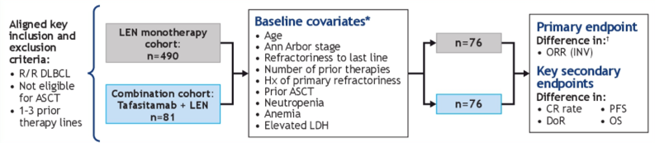
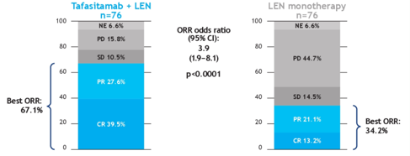
RE-MIND: Propensity Score-Based 1:1 Matched Comparison of Tafasitamab + Len Vs Len—Real-World Data in Transplant-Ineligible Patients With R/R DLBCL
Significantly better ORR, CR and OS w/ tafa + len combination in ASCT-ineligible R/R DLBCL.
Nowakowski G, et al. ASCO 2020. Abstract 8020.
Notes:
https://meetinglibrary.asco.org/record/187014/abstract
Background:Patients with R/R DLBCL ineligible for autologous stem cell transplant (ASCT) have a poor prognosis. In these patients, tafasitamab (anti-CD19 antibody) plus lenalidomide (LEN) has shown encouraging results in the open-label, single-arm, phase II L-MIND study (n = 81; NCT02399085). To evaluate the contribution of tafasitamab to the activity of this doublet, we conducted a global, real-world study of patients treated with LEN monotherapy (RE-MIND; NCT04150328). Here we present the primary analysis of a 1:1 patient-level matched comparison between the L-MIND and RE-MIND cohorts.Methods:Patients treated with LEN monotherapy for R/R DLBCL were enrolled in the observational, retrospective RE-MIND cohort. As in L-MIND, patients had 1–3 prior systemic therapies, including ≥1 CD20-targeting regimen; were aged ≥18 years; and were not eligible for ASCT. A 1:1 estimated propensity score (ePS) matching methodology ensured balancing of nine pre-specified baseline covariates. The primary analysis set, Matched Analysis Set 25 (MAS25), included patients who received a LEN starting dose of 25 mg/day. The primary endpoint was investigator-assessed best objective response rate (ORR). Key secondary endpoints included overall survival (OS) and complete response (CR) rate.Results:490 patients were enrolled in RE-MIND across 58 centers in the US and Europe, of which 140 fulfilled the ePS matching criteria. The MAS25 included 76 patients each from the two cohorts. Baseline characteristics between cohorts were comparable. The primary endpoint was met with a significantly better ORR of 67.1% (95% CI: 55.4–77.5) for the L-MIND cohort versus 34.2% (95% CI: 23.7–46.0) for the RE-MIND cohort (odds ratio 3.89; 95% CI: 1.90–8.14; p < 0.0001). The CR rate was 39.5% (95% CI: 28.4–51.4) in the L-MIND cohort and 13.2% (95% CI: 6.5–22.9) in the RE-MIND cohort. A significant difference in OS favored the L-MIND cohort (HR = 0.499; 95% CI: 0.317–0.785). ORR and CR outcomes in the RE-MIND cohort were similar to the published literature for LEN monotherapy in R/R DLBCL.Conclusions:Significantly better ORR, CR and OS indicate potential synergistic effects of the tafasitamab + LEN combination in ASCT-ineligible R/R DLBCL. ePS-based 1:1 matching allows robust estimation of the treatment effect of tafasitamab when added to LEN. RE-MIND demonstrates the utility of real-world data in interpreting non-randomized trials. Clinical trial information: NCT04150328.

Slide 45
Loncastuximab Tesirine for R/R
humanized anti-CD19 antibody, stochastically conjugated through a cathepsin-cleavable valine-alanine linker to a pyrrolobenzodiazepine (PBD) dimer toxin causing DNA crosslinking
fda.gov, adctherapeutics.com/

Slide 46
Single-Arm, Phase 2 LOTIS-2 Study of Loncastuximab Tesirine for R/R DLBCL: Design
Eligibility: Adults with R/R DLBCL after 2 or more lines of systemic therapy, CD19+ biopsy if prior anti-CD19 therapy received, ECOG PS 0-2, ASCT 30+ days prior or alloSCT 60+ days prior permitted
30-minute infusion of Lonca Q3W for up to 1 year
Q12W for up to 3 years
150 µg/kg
75 µg/kg
Follow-up
First 2 cycles
After 2 cycles
Baseline Characteristics
87.6% DLBCL
10.3% Double/triple hit
13.8% Double/triple expressor
20% Transformed disease
77.2% Stage III-IV
Median number prior tx, 3 (2-7)
Primary endpoint: ORR
Secondary endpoints: DOR, CR, RFS, PFS, OS, Safety, PK/PD, HRQoL
Carlo-Stella C, et al. EHA Congress 2020. Abstract S233.
46
Notes:
CAR T-cell therapy review article: Levin A, Shah NN. Am J Hematol 2019;94:S18–S23
RR DLBCL outcomes after ASCT in rituximab era: . Nagle SJ, et al. Am J Hematol 2013;88(10):890–4
Preclinical lonca data: Zammarchi F, et al. Blood 2018;131(10):1094–105

Slide 47
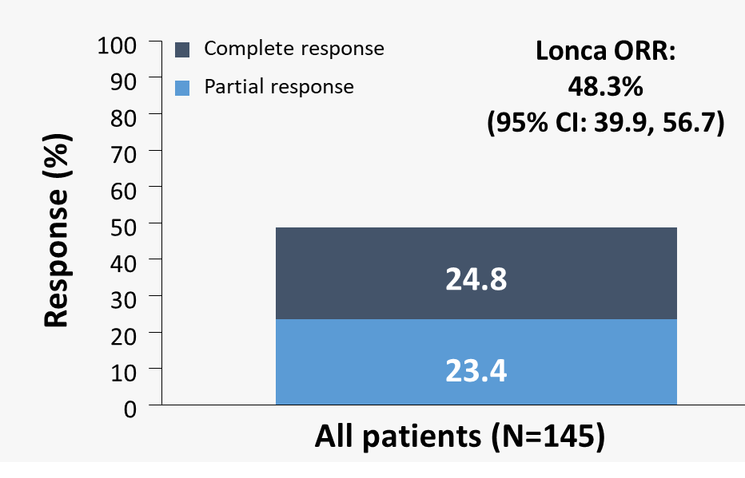
LOTIS-2 Trial: Efficacy Results
mDoR for the 70 responders:
12.58 months
(95% CI: 6.87, - )
Median PFS:
5.09 mo
(95% CI, 2.89-8.31)
mDoR for patients
with a CR:
13.37 months
(95% CI: 12.58, - )
Median OS:
9.53 mo
(95% CI, 6.93-11.24)
ORRs seen in high-risk subgroups (eg, double/triple hit, transformed disease)
Most responders had response after 2 cycles; median time to first response was 41.0 days (range: 35–247)
Mean lonca cycles: 4.5 (Std: ± 3.89) (Min, max: 1, 18)*
Subsequent treatment
  15 pts received CD19-directed CAR-T therapy with an INV-assessed ORR of 46.7% (6 CR; 1 PR)
  9 patients proceeded to SCT as consolidation after response to lonca
ORR was assessed by independent reviewer. Data cut-off: 06 Aug 2020.
*4 patients had treatment ongoing at data cut-off.
Caimi PF, et al. ASH 2020l. Abstract 1183.
Notes:
ASH 2020 - updated results including analysis of response in subgroups with high risk for poor prognosis Pre-specified analyses of ORR and DoR by demographic and clinical characteristics were performed
mDoR was comparable to the whole study population in subgroups at high-risk of poor prognosis
Patients continue to be followed for DoR. DoR was defined as the time from earliest date of first response until the first date of either disease progression or death due to any cause. *mDoR for patients with a PR: 5.68 months (95% CI: 1.64, 6.87). Data cut-off: 06 Aug, 2020
Caimi PF, et al. ASH 2020l. Abstract 1183.

Slide 48
LOTIS-2 Trial: Safety Results
TEAEs in ≥20% of the all-treated population
Most common (≥10%) grade ≥3 TEAEs were:
Neutropenia (38 patients; 26.2%)
Thrombocytopenia (26 patients; 17.9%)
GGT increased (25 patients; 17.2%)
Anemia (15 patients; 10.3%)
 | Patients n (%)
Preferred term | <65 years (N=65) | ≥65 (N=80) | Total (N=145)
Patients with any TEAE | 65 (100) | 78 (97.5) | 143 (98.6)
GGT increased | 33 (50.8) | 27 (33.8) | 60 (41.4)
Neutropenia | 34 (52.3) | 24 (30.0) | 58 (40.0)
Thrombocytopenia | 28 (43.1) | 20 (25.0) | 48 (33.1)
Fatigue | 21 (32.3) | 19 (23.8) | 40 (27.6)
Anemia | 23 (35.4) | 15 (18.8) | 38 (26.2)
Nausea | 17 (26.2) | 17 (21.3) | 34 (23.4)
Cough | 19 (29.2) | 13 (16.3) | 32 (22.1)
Alkaline phosphatase increased | 18 (27.7) | 11 (13.8) | 29 (20.0)
Peripheral edema | 11 (16.9) | 18 (22.5) | 29 (20.0)
Treatment-related TEAEs leading to treatment discontinuation occurred in 26 (17.9%) patients, most commonly (≥2%):
GGT increased (16 patients; 11.0%)
Peripheral edema (4 patients; 2.8%)
Localized edema (3 patients; 2.1%)
No increase in toxicity was seen in patients aged ≥65 years compared with younger patients
TEAEs were reported for the all-treated population. Data cut-off: 06 Aug, 2020.
GGT, gamma-glutamyltransferase; TEAE, treatment-emergent adverse event.

Slide 49
Patient 3
50-year-old male, h/o RCHOP; RICE/ASCT presents 4 weeks after CART therapy with rapidly progressive adenopathy
PET scan – bulky abdominal disease, PET avid adenopathy above and below diaphragm; bx: DLBCL, CD20+, CD19+, non GCB subtype, FISH BCL2-, MYC-, BCL2 pos and MYC pos by IHC
Patient has good PS
Hb 7, PLT 12, ANC 0.4; organ function preserved

Slide 50
Patient 3
50-year-old male with rapidly progressive disease 4 weeks after CART
How would you treat this patient?
Clinical trial
Lenalidomide
Loncastuximab
Selinexor
Pola BR

Slide 51
Future? Pattern of Care in DLBCL
1st Line
2nd Line
3rd+ Line
50%^{c}
50%^{b}
Transplant
eligible
High dose chemo
(eg, RICE, R-DHAP)
CART
50%
R-CHOP or R-CHOP-like
ASCT
Pola-BR
Tafa-Len
CURE
50%
Tafa-Len
Pola-BR
Othter
10-15%^{c}
Selinexor
Non-transplant
eligible
CURE
Lonca-Tesirine
50%-60%^{a,b}
Other chemo…
SCT=stem-cell transplantation.
ª Decisions Resource Group. DLBCL Epidemiology data; ^{b} Sehn LH, Gascoyne RD. Blood. 2015;125:22-32;
^{c} Friedberg JW, et al. Hematology Am Soc Hematol Educ Program. 2011;2011:498-505;
Notes:
However, HDC with ASCT may not be appropriate, especially in patients with comorbidities or older age. This aggressive approach can generally only be offered to a relatively small percentage of patients with relapsed/refractory (R/R) DLBCL. For the remaining patient population, several second line combination therapies are used but with variable success.

Slide 52
Future Pattern of Care in DLBCL
1st Line
2nd Line
3rd+ Line
50%^{c}
50%^{b}
Transplant
eligible
High dose chemo
(eg, RICE, R-DHAP)
CART
50%
R-CHOP or R-CHOP-like
Management of Post CART relapse moves center stage
ASCT
Pola-BR
Tafa-Len
CURE
50%
Tafa-Len
Pola-BR
Othter
10-15%^{c}
Selinexor
Non-transplant
eligible
CURE
Lonca-Tesirine
50%-60%^{a,b}
Other chemo…
SCT=stem-cell transplantation.
ª Decisions Resource Group. DLBCL Epidemiology data; ^{b} Sehn LH, Gascoyne RD. Blood. 2015;125:22-32;
^{c} Friedberg JW, et al. Hematology Am Soc Hematol Educ Program. 2011;2011:498-505;
Notes:
However, HDC with ASCT may not be appropriate, especially in patients with comorbidities or older age. This aggressive approach can generally only be offered to a relatively small percentage of patients with relapsed/refractory (R/R) DLBCL. For the remaining patient population, several second line combination therapies are used but with variable success.

Slide 53
CART T-cell for DLBCL Extended Follow Up
60% will relapse

Slide 54
Outcomes of Patients with Post CART Progression
30 days
Chow et al. Am J Hematology 2019

Slide 55
Outcomes of Patients with Post CART Progression
30 days
Presented by G. S. Nowakowski MD

Slide 56
What is the best treatment option for patients with DLBCL post CART relapse?

Slide 57
What is the best treatment option for patients with DLBCL post CART relapse?
11 out of 11 lymphoma KOL* says “participation in clinical trial”
*Google and Twitter search

Slide 58
Prolonged cytopenias is a major barrier to enrollment in clinical trials of patients with aggressive B-cell lymphoma progressing after CART19
2021 Pan Pacific Lymphoma Conference Poster Session
N = 53 (100%)
Clinical trial | Eligibility criteria |  |  | Total excluded
 | Hb | ANC | Plt
Selinexor¹ | < 10 | < 1,000 | < 75K | 30 (56%)
N excluded (%) | 25 (48%) | 13 (25%) | 19 (37%)
Polatuzumab Bendamustine Rituximab² | < 9.0 | < 1,500 | <75K | 33 (62%)
N excluded (%) | 15 (29%) | 21 (40%) | 19 (37%)
Tafasitamab Lenalidomide³ | N/A | < 1,500 | < 90K | 32 (60%)
N excluded (%) | 0 | 21 (40%) | 21 (40%)
Loncastuximab⁴ | N/A | < 1,000 | < 75K | 28 (53%)
N excluded (%) | 0 | 13 (25%) | 19 (37%)
Excluded all N (%) | 0 | 13 (25%) | 19 (37%) | 25 (47%)
Other exclusion criteria would be less often a barrier:
ECOG > 2: 3 (6%)
CNS disease: 0 – 7 (14%)
Renal function: 2 (4%) – 8 (15%)
Liver function: 3 (6%)
¹Kalakonda et al. Lancet Haematol, 2020.
²Sehn et al. JCO, 2020.
³Salles et al. Lancet Oncol, 2020.
⁴Caimi PF et al. Lancet Oncol, 2021.
Time from CART19 to disease progression was shorter in patients ineligible to trials compared to eligible patients:
median 1.1 months (0.5 – 4.7) vs. 3.0 (0.9 – 2.7), p = 0.004

Slide 59
Prolonged cytopenias is a major barrier to enrollment in clinical trials of patients with aggressive B-cell lymphoma progressing after CART19
N = 53 (100%)
Clinical trial | Eligibility criteria |  |  | Total excluded
 | Hb | ANC | Plt
Selinexor¹ | < 10 | < 1,000 | < 75K | 30 (56%)
N excluded (%) | 25 (48%) | 13 (25%) | 19 (37%)
Polatuzumab Bendamustine Rituximab² | < 9.0 | < 1,500 | <75K | 33 (62%)
N excluded (%) | 15 (29%) | 21 (40%) | 19 (37%)
Tafasitamab Lenalidomide³ | N/A | < 1,500 | < 90K | 32 (60%)
N excluded (%) | 0 | 21 (40%) | 21 (40%)
Loncastuximab⁴ | N/A | < 1,000 | < 75K | 28 (53%)
N excluded (%) | 0 | 13 (25%) | 19 (37%)
Excluded all N (%) | 0 | 13 (25%) | 19 (37%) | 25 (47%)
Other exclusion criteria would be less often a barrier:
ECOG > 2: 3 (6%)
CNS disease: 0 – 7 (14%)
Renal function: 2 (4%) – 8 (15%)
Liver function: 3 (6%)
Only ~ 50% patents will be CT candidates
¹Kalakonda et al. Lancet Haematol, 2020.
²Sehn et al. JCO, 2020.
³Salles et al. Lancet Oncol, 2020.
⁴Caimi PF et al. Lancet Oncol, 2021.
Time from CART19 to disease progression was shorter in patients ineligible to trials compared to eligible patients:
median 1.1 months (0.5 – 4.7) vs. 3.0 (0.9 – 2.7), p = 0.004

Slide 60
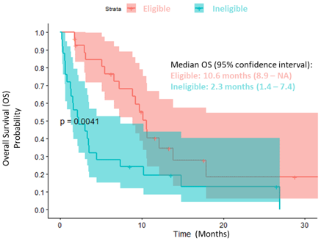
Patients potentially excluded from trials have poor prognosis and unmet need for new therapies
Approximately half of the pts (47%) would be excluded from landmark clinical trials
The current hematologic exclusion criteria are a major barrier
Adjustment of hematologic exclusion criteria to increase trial participation, especially for primary refractory disease

Slide 61
How do we develop studies and treat in patients relapsing post CART ?
Need for studies not excluding patents with cytopenias
Non- myelosuppressive strategies preferred
  Immune mediated
  Targeted therapy

Slide 62
Lenalidomide Post-CART
Progression after Tisa-cel (n=33) of Axi-cel (n=26) infusion
16 (27%) of the failures occurred before day 15, 27 (45.8%) during the <1 mo and 45 (76.3%) during the first-3 months after infusion
41 Patients treated with lenalidomide with (n=30) or without (n= 10) rituximab (R) or Obinutuzumab (O) (n=1);
ORR 27.1% (CR in 9 patents)
Median PFS was 101 days, and the median OS 225 days
11 patients who started LEN+/-R or O before D15 post-CAR T-cell infusion (group ≤D15) experienced a higher ORR (7/11, 63.6% vs 9/48, 18.8%, p=0.006), and a higher CR rate (4/11, 36.4% vs 5/48, 10.4%, p=0.05)
Thieblemont C et al ASH 2020

Slide 63
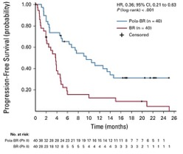
Polatuzumab Vedotin + BR in R/R DLBCL and Post-CART
mPFS
9.5 mo vs 3.7 mo
Multicenter retrospective study of pola +/- BR in r/r DLBCL/HGBCL
12 patients had failed CAR T-cell therapy before receiving pola as bridging treatment to alloHCT or as palliative treatment
7 of 12 patients responded to pola (+/-BR)
Duration of benefit was limited
ORR
45%
ORR
17.5%
mDOR by IRC (Pola + BR vs BR): 12.6 mo vs 7.7 mo
Sehn L, et al. J Clin Oncol. 2020;38(2):155-165; Liebers N et al. Blood Adv (2021) 5 (13): 2707–2716.
Notes:
Sehn L, et al. J Clin Oncol. 2020;38(2):155-165.

Slide 64
LOTIS-2 Trial: Efficacy Results
mDoR for the 70 responders:
12.58 months
(95% CI: 6.87, - )
Median PFS:
5.09 mo
(95% CI, 2.89-8.31)
mDoR for patients
with a CR:
13.37 months
(95% CI: 12.58, - )
Median OS:
9.53 mo
(95% CI, 6.93-11.24)
*CD19 expression required post CD19 targeting rx
N* ORR 95% CI
.
Caimi PF, et al. ASH 2020. Abstract 1183.
Notes:
ASH 2020 - updated results including analysis of response in subgroups with high risk for poor prognosis Pre-specified analyses of ORR and DoR by demographic and clinical characteristics were performed
mDoR was comparable to the whole study population in subgroups at high-risk of poor prognosis
Patients continue to be followed for DoR. DoR was defined as the time from earliest date of first response until the first date of either disease progression or death due to any cause. *mDoR for patients with a PR: 5.68 months (95% CI: 1.64, 6.87). Data cut-off: 06 Aug, 2020
Caimi PF, et al. ASH 2020l. Abstract 1183.

Slide 65
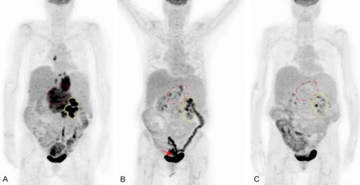
Selinexor in R/R DLBCL
ORR | CR | PR | SD | PD/ND
36/127 (28%) (20·7–37·0) | 15 (12%) (6·8–18·7) | 21 (17%) (10·5–24·2) | 11 (9%) (4·4–15·0) | 80 (63%) (54·0–71·4)
Patient with post CART progression treated (A) with Selinexor (B) as bridge to all SCT (C)
 | Grade 1–2 | Grade 3 | Grade 4
Thrombocytopenia | 20 (16%) | 39 (31%) | 19 (15%)
Neutropenia | 7 (6%) | 20 (16%) | 11 (9%)
Kalakonda N, et al. Lancet Haematol. 2020;7: e511–22.; Horesh N et al. Am J Blood Res. 2021; 11(1): 111–117.
Notes:
Data are n/N (%; 95% CI). Responses were adjudicated according to central imaging assessment. GCB=germinal centre B cell. See results section in main text for one-sided 97·5% CI.
Kalakonda N, et al. Lancet Haematol. 2020;7: e511–22.

Slide 66
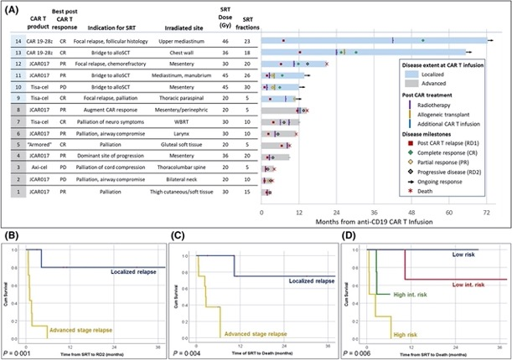
Radiation Therapy Post CART relapse

Slide 67

Conclusions
RCHOP remains standard in frontline DLBCL regardless of molecular subtype
  Pending Polarix study results
New options in R/R DLBCL
Elderly patient with multiple comorbidities with relapsed DLBCL 8 months after RCHOP – not BTM/CART candidate, has neuropathy after RCHOP
  Tafa/len, others
Elderly patient with some medical problems, relapsed DLBCL, not BMT candidate “but who knows if CART candidate”, getting symptomatic
  Pola-(B) R, others, ? avoid use of CD19 targeting
Good PS patient with DLBCL progression after CART (with some cytopenias)
  Lonca (if CD19 +), tafa/len (if CD19 +), Pola-R (B) if CD19 neg unknown or CD19 neg, Selinexor
  RT if localized relapse

Slide 68
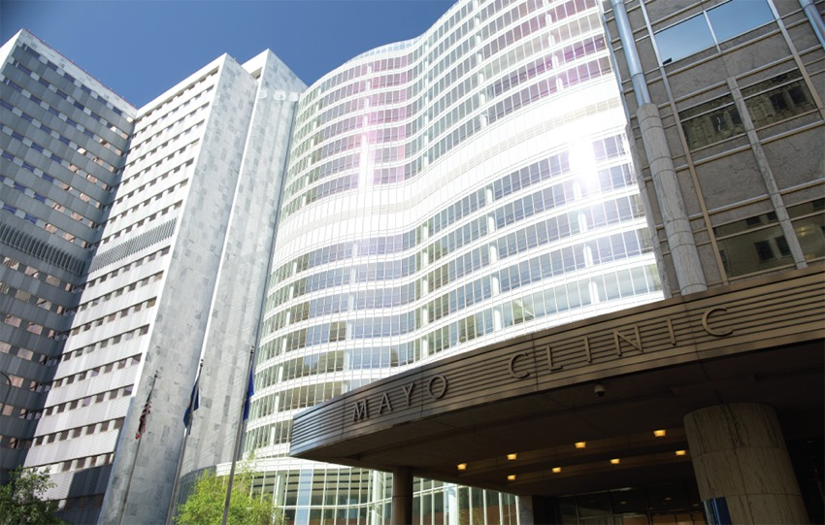
Thank You nowakowski.grzegorz@mayo.edu

Slide 69
Post-Assessment Question 1
The ROBUST trial examined the addition of what agent to R-CHOP for patients with untreated DLBCL?
Tafasitamab
Lenalidomide
Polatuzumab
Selinexor

Slide 70
Post-Assessment Question 2
Polatuzumab vedotin is an antibody-drug conjugate that targets which of the following antigens on lymphoma cells?
CD5
CD19
CD20
CD79b

Slide 71
Post-Assessment Question 3
Which of the following treatment-emergent adverse events (TEAEs) were most common in the LOTIS-2 trial examining loncastuximab tesirine in patients with R/R DLBCL?
Increased gamma-glutamyltransferase (GGT)
Fatigue
Nausea
Cough

Slide 72
Q&A
Type your questions into the Question tab
of your webinar control panel

Slide 73
Thank You!
Please complete the post-webinar evaluation at
(This link will pop-up on your screen after the webinar ends)
https://cvent.me/2KeNyn
A CME request form is available for download
at the end of the online evaluation.
Visit OncologyCaseClinic.com to register for
upcoming webinars.
A recording of today’s webinar with downloadable slides
will be available at OncologyCaseClinic.com in about 2 weeks.
Next presentation: Wednesday, December 8
Marginal Zone Lymphoma
Leo Gordon, MD, FACP

