Slide 1
Marginal Zone Lymphoma
December 8, 2021

Slide 2
Course Director
John P. Leonard, MD
Senior Associate Dean for Innovation and Initiatives
Executive Vice Chair, Weill Department of Medicine
Richard T. Silver Distinguished Professor of Hematology & Medical Oncology
Weill Cornell Medical College
New York, New York
Presenter
Leo I. Gordon, MD
Abby and John Friend Professor of Oncology Research
Professor of Medicine
Division of Hematology and Oncology
Northwestern University
Chicago, Illinois

Slide 3
This activity is supported by independent educational grants from
AstraZeneca,
Bristol-Myers Squibb
and
Epizyme, Inc

Slide 4
This activity is jointly provided by

Slide 5
Continuing Education
In support of improving patient care, this activity has been planned and implemented by University of Nebraska Medical Center and Bio Ascend. University of Nebraska Medical Center is jointly accredited by the Accreditation Council for Continuing Medical Education (ACCME), the Accreditation Council for Pharmacy Education (ACPE), and the American Nurses Credentialing Center (ANCC), to provide continuing education for the healthcare team.
The University of Nebraska Medical Center, Center for Continuing Education designates this live activity for a maximum of 1 AMA PRA Category 1 Credit™. Physicians should claim only the credit commensurate with the extent of their participation in the activity.

Slide 6
Disclosure
As a jointly accredited provider, the University of Nebraska Medical Center (UNMC) ensures accuracy, balance, objectivity, independence, and scientific rigor in its educational activities and is committed to protecting learners from promotion, marketing, and commercial bias. All faculty, planners, and others in a position to control continuing education content participating in an accredited continuing education activity are required to disclose all financial relationships with ineligible companies. Ineligible companies are organizations whose primary business is producing, marketing, selling, re-selling, or distributing healthcare products used by or on patients. The accredited provider is responsible for mitigating all relevant financial relationships in accredited continuing education. Disclosure of these commitments and/or relationships is included in these activity materials so that participants may formulate their own judgments in interpreting its content and evaluating its recommendations.
This activity may include presentations in which faculty may discuss off-label and/or investigational use of pharmaceuticals or instruments not yet FDA-approved. Participants should note that the use of products outside currently FDA-approved labeling should be considered experimental and are advised to consult current prescribing information for FDA-approved indications. All materials are included with the permission of the faculty. The opinions expressed are those of the faculty and are not to be construed as those of UNMC or Bio Ascend.

Slide 7
Disclosures
John P. Leonard, MD
Consulting Fees: ADC Therapeutics, AstraZeneca, Bayer, Bristol-Myers Squibb Company, Epizyme, Kite, a Gilead Company, MEI Pharma, Miltenyi Biotec, Regeneron, Roche/Genentech, Sutro Biopharma
Leo I. Gordon, MD
Consulting Fees: AstraZeneca, Bristol-Myers Squibb Company, Kite, a Gilead Company, Nordic Nanovector, Novartis
Patent: Gold nanoparticles for lymphoma
Planning Committee
The following planning committee members have nothing to disclose: UNMC: Brenda Ram, CMP, CHCP
Bio Ascend: Patti Bunyasaranand, MS; Dru Dace, PhD; Kraig Steubing

Slide 8
Learning Objectives
Evaluate best available evidence regarding treatment for patients with MZL
Assess the implications of emerging clinical trial data regarding MZL treatment approaches
Develop strategies to address complicated MZL cases

Slide 9
Reminders
Please respond to the polling questions as they appear on the webinar screen. All responses are anonymous
You will receive a post-program evaluation link at the end of the webinar. Your response is greatly appreciated
A CME request form is available for download at the end of the online program evaluation
The recording of today’s presentation along with downloadable slides will be available at www.oncologycaseclinic.com in about 2 weeks
Visit www.oncologycaseclinic.com to register for upcoming webinars and view past webinars

Slide 10
Pre-Assessment Question 1
Which form of marginal zone lymphoma (MZL) is most common?
Nodal MZL
Extra-modal MZL (MALT lymphoma)
Splenic MZL

Slide 11
Pre-Assessment Question 2
In the AUGMENT study of lenalidomide plus rituximab (R²) vs rituximab plus placebo in patients with relapsed/refractory indolent NHL, what was the overall response rate (ORR) observed with R²?
~98%
~78%
~58%
~38%

Slide 12
Pre-Assessment Question 3
Which of the following PI3K inhibitors is FDA approved for patients with MZL?
Idelalisib
Duvelisib
Umbralisib
Alpelisib

Slide 13
Marginal Zone Lymphoma
Leo I Gordon, MD
Abby and John Friend Professor of Cancer Research Professor in Medicine Co-Director Hematologic Malignancies Program Division of Hematology/Oncology Northwestern University Feinberg School of Medicine Robert H. Lurie Comprehensive Cancer Center of Northwestern University Medical Director of the John and Lillian Matthews Center for Cellular Therapy

Slide 14
Marginal Zone Lymphoma
Leo I Gordon, MD
Northwestern University Feinberg School of Medicine and the Robert H. Lurie Comprehensive Cancer Center

Slide 15
MZL: Take Home Messages
MZL are linked and overlap
Antigen driven
Infection associated
t(11;18) (q21;q21), t(1;14)(p22;q32), BCL10 and common path to NF-kB
Treat HCV in SMZL
Splenectomy vs. rituximab in SMZL
Nodal and some Extra-nodal MZL could be treated like FL
PI3k inhibitors: Umbralisib FDA approved 2/5/2021
CAR T therapy ZUMA 5

Slide 16
Diagnosis

Slide 17
MZL: a group of related clinical entities
Treatment and outcome of nodal NZL
SWOG retrospective survey of low-grade NHL patients uniformly treated with CHOP
Nodal MZL Extranodal MZL (MALT lymphoma)
10-year survival 53% 21%
All nodal MZL patients were given full-dose CHOP, and showed a survival pattern superimposable on that of advanced FL, but how they would behave with other treatment strategies frequently employed in low-grade lymphomas (such as watchful waiting, single alkylating agents, or new purine analogues, rituximab) is still to be ascertained.
International survey for the validation of the REAL classification,
5-year survival, overall 57% 74%
5-year survival, overall 57% 74%
Comparisons of patients with International Prognostic Index scores of 0 to 3 showed that those with nodal MZL had lower 5-year overall survival (52% v 88%; P =.025) and failure-free survival (30% v 75%; P =.007) rates than those with extranodal MZL. This discrepancy with the SWOG study might be at least partially due to the higher incidence of advanced disease in the nodal MZBCL group (82%, versus 44% in the extranodal MALT-type group) 173,178. In a French series of non-MALT type MZL from Lyon 156, 4 clinical subtypes were identified, splenic , nodal, disseminated (splenic and nodal), and leukemic (not splenic nor nodal). The nodal cases comprised 30% of patients and showed a more aggressive behaviour. Nodal and disseminated subtypes had shorter median time-to progression (about 1 year.) in comparison with the splenic and leukemic subtypes (median time to progression longer than 5 years). The cases with disseminated disease more often presented with poor prognosis parameters (high LDH and beta 2 microglobulin, poor performance status, bulky disease) and might represent the end-stage of the other subtypes 124,156. However, in all subsets, even if the median time-to progression was short, a prolonged survival was observed (splenic , 9 years; nodal, 5.5 years; disseminated 15 years; , and leukemic 7 years). About half of the nodal and one forth of the disseminated cases presented with more than 50% of large cells or sheets of large B-cells. These patients cases may be considered as having a "transformed" lymphoma at diagnosis or a composite lymphoma with MZL aspect and features of DLBCL. Large cell rich cases were definitely less common in the splenic subsets. This finding may at least partially explain the observed differences in the outcome of different subsets.
The retrospective nature of this study precludes any conclusion on the therapeutic aspects, but conservative treatments seem recommended for leukemic and splenic subtypes whilst in nodal and disseminated subtypes front-line chemotherapy may be considered. Treatment options may include single agent chlorambucil or fludarabine or combination chemotherapy regimens (such as the CVP or CHOP). Rituximab may also have some efficacy 179. Autologous transplantation has been used in younger patients with adverse prognostic factors and high number of large cells subtypes 156. However, no prospective studies have been conducted so far and treatment decision should be based on the histological and clinical features of the individual patien
Leukemic MZL
Bone marrow and
Blood involvement
Nodal MZL
Peripheral LN
Disseminated
MZL
Spleen involvement
+ Peripheral LN
+ Bone marrow + Blood +/- Other extranodal sites
Splenic MZL
Spleen involvement
+/- Bone marrow +/- Blood
+/- Hilar splenic LN
+/- Liver
Extranodal MZL (MALT type)
Extranodal sites
Thieblemont, Lancet Oncology 2004

Slide 18
Marginal Zone B-Cell Lymphomas (MZLs)
WHO CLASSIFICATION
Splenic MZL ~ 1% of all NHLs
Nodal MZL ~ 2% of all NHLs
Extra-nodal MZL (MALT Lymphoma) ~ 8% of all NHLs

Slide 19
Can be Confused with Waldenstrom’s Macroglobulinemia
Both low grade
Both can be CD5 negative
Both can have MyD88 mutation
95% in WM and 5% in MZL
Both can have IgM paraprotein
Higher in WM and lower in MZL

Slide 20
Diagnosis—Immunophenotypic Markers Distinguishing FL from other NHLs
Neoplasm | CD5 | CD10 | Bcl-2 | IgD | Bcl-6 | CD43 | Cyclin D1 | CD23
MCL | + | - | + | + | - | + | + | -/+
CLL/SLL | + | - | + | + | - | + | -/+ | +
Follicular lymphoma | - | + | + | -/+ | +* | - | - | -/+
MALT | - | - | + | - | - | +/- | - | -
MZL – nodal | - | - | + | +/- | -/+ | +/- | - | -
MZL – splenic | - | - | + | + | - | - | - | -
LPL/Waldenstrom’s macroglobulinemia | - | -/+ | + | - | - | -/+ | - | -/+
Hairy cell leukemia | - | -/+ | + | - | - | NT | + | -/+
CD5 to distinguish from MCL, CD10 to distinguish from MZL
December 8, 2021
- indicates < 5%; -/+ indicates 5–25%; +/- indicates 25–50%; + indicates > 50%; NT indicates not tested.
Notes:
Key Point
The absence of CD5 expression is used to distinguish FL from MCL or CLL/SLL, whereas presence of CD10 expression is used to distinguish FL from MZL.
Background
FL biopsies show expression of CD10, bcl-2 and -6, and may or may not show IgD, or CD23 expression.
FL biopsies are negative for CD5, CD43, and cyclin D1.
Bcl-6 expression in FL biopsies is associated with transformation to a more aggressive subtype.
Reference
Vitolo et al. Crit Rev Oncol Hematol. 2008;66:248-61.

Slide 22
Extra Nodal (MALT) Marginal Zone Lymphoma

Slide 23
EN Marginal Zone Lymphoma
Stomach (MALT)
Mid and lower GI tract
Lung (BALT)
Thyroid
Lung
Breast
Skin
Ocular adnexal
December 8, 2021

Slide 24
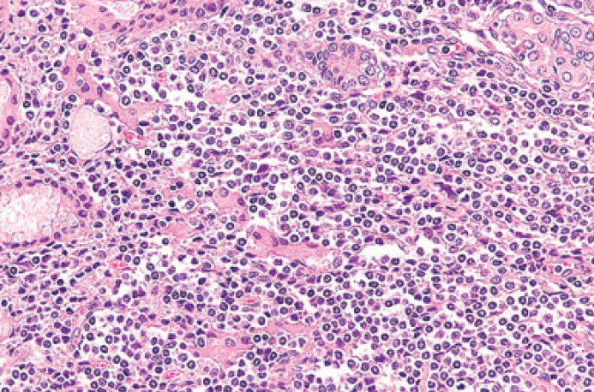
Diagnosis of MALT lymphoma
HISTOLOGICAL FEATURES
centrocyte-like cells (usually)
lymphoepithelial lesions
plasma cell differentiation
scattered transformed blasts
admixed reactive T-cell
follicular colonisation
IMMUNOPHENOTYPE
CD5, CD10, CD23, cyclin-D1, IgD negative
CD20, CD21, CD35, IgM positive
But up to 25% may be CD5+
December 8, 2021
Isaacson et al. in WHO Classification of Tumours of Haematopoietic &Lymphoid Tissues. IARC, Lyon 2008; pp. 214-7

Slide 25
Antigen-driven lymphoma development
Helicobacter pylori in gastric MZL
Borrelia burgdorferi in cutaneous MZL
Chlamydophila psittaci in some OALs
Campylobacter jejuni in IPSID
HCV association with some non-MALT MZL
Achromobacter (Alcaligenes) Xylosoxidans in BALT-Lymphoma?
December 8, 2021

Slide 26
Evidence linking specific microorganisms to MALT lymphoma at different sites
Koch’s postulates (1882) | H. pylori & Gastric MZL | C. jejuni & IPSID | B. burgdorferi & Cutaneous MZL | C. psittaci & Ocular adnexal MZL
Organism found in the lesion. | most cases | some cases | variable | variable
Organism can be isolated and grown in vitro. | yes | not yet | not yet | yes
Organism inoculation causes lesions in animals | yes | unknown | unknown | unknown
Organism can be recovered from the experimental animal | yes | unknown | unknown | unknown
Lymphoma regression after bacteria eradication | yes | yes | yes | yes
Modified from: MQ Du, J Clin Exp Hematopathol 2007

Slide 27
Antigen-driven lymphoma development
Helicobacter pylori in gastric MZL
Borrelia burgdorferi in cutaneous MZL
Chlamydophila psittaci in some OALs
Campylobacter jejuni in IPSID
HCV association with some non-MALT MZL
Achromobacter (Alcaligenes) Xylosoxidans in BALT-Lymphoma?
December 8, 2021

Slide 28
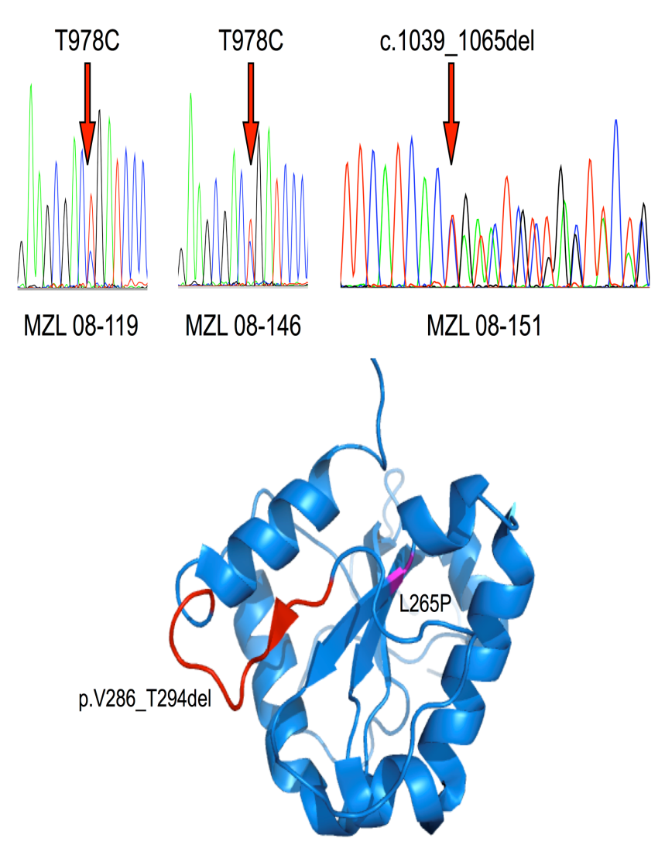
MALT lymphoma: MYD88 mutations in 6%
Mutations in 3 of 54 EMZL
2 cases with T978C mutation causing the reported L265P substitution. Both with OAMZL involvement and no additional genomic lesions
One case of salivary gland MALT lymphoma, with trisomy's 3 and 18, with novel interstitial 27bp deletion (c.1039_1065del)
loss of nine amino acids (p.V286_T294del, which precede an internal inhibitory domain which could become disrupted and allow an increased binding of MYD88 to IRAK1/IRAK4)
Li et al BJH, 2012

Slide 29
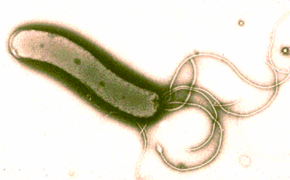
Helicobacter Pylori
December 8, 2021

Slide 30
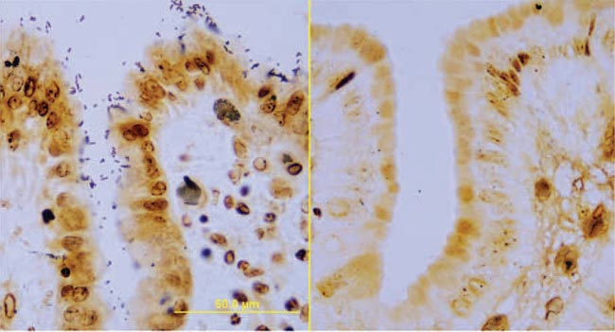
H Pylori in Gastric Biopsy
December 8, 2021

Slide 31
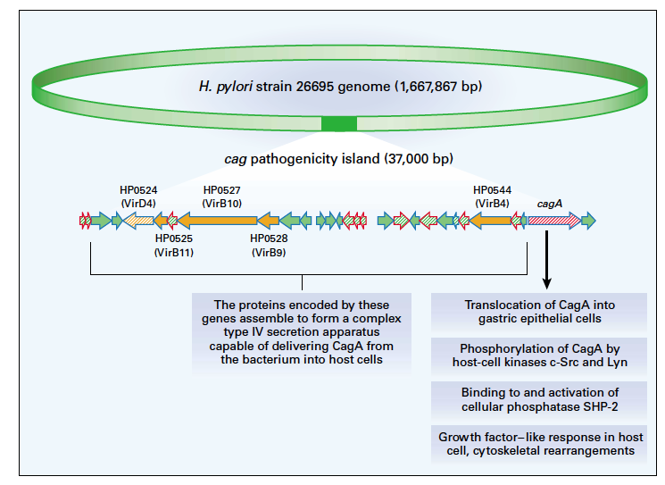
The Cag Pathogenicity Island of H.Pylori

Slide 32
H. pylori and MALT lymphoma: a Model of Tumor Progression
CagA+ strains
H. pylori chronic gastritis
B
neutrophils activations with release of
genotoxic
free radicals
B
strain-specific stimulation
B
B
B
B
B
B
B
B
B
contact-dependent B-cell stimulation
T
B
genetic alterations
T
B
B
B
B
T
T
antigen selection autoimmunity
T
B
H. pylori-dependent MALT lymphoma
mucosal
T-cell proliferation
B-cell proliferation
BCL10 and MALT1 translocations
H. pylori-independent MALT lymphoma
additional genetic damages
DLBCL
Ferrucci & Zucca, BJH 2007

Slide 33
“Radicals” accused of causing MALT Lymphoma¹
3 early genomic events
²Trisomy 3
³t(11;18)(q21;q21)
^{4,5}t(1;14)(p22;q32)
t(11;18)(q21;q21) and t(1;14)(p22;q32)may converge on NF kB pathway
¹Barth and Moller Blood (2003)102:777
²Wotherspoon et al BLOOD (1995) 85:2000
³Ott et al Cancer Res (1997) 57:3944
⁴Willis et al Cell (1999) 96:35
⁵Zhang et al Nat Genet (199) 22:63
December 8, 2021

Slide 34
“Radicals” Accused of Causing MALT Lymphoma
¹association of t(11;18)(q21;q21), gastric MALT and Cag A strains of h pylori
Most in lung and stomach (38% and 24%), vs. 1% in salivary gland
Chromosomal damage cause by PMN leading to oxidative stress
²glutathione S-transferase GST T1 null and IL-2 RN2/2 associated with gastric MALT, so implicating defense against oxidative stress
December 8, 2021
Yee et al BLOOD (2003) 102:1012
Rollinson et al BLOOD (2003) 102:107

Slide 35
Case 1
65-year-old man
Belching and GERD symptoms
EGD shows ulcers
Biopsy shows…
December 8, 2021

Slide 36
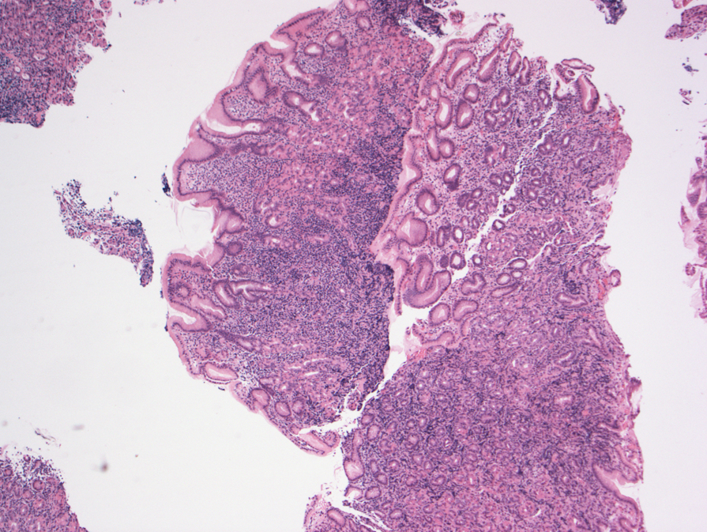
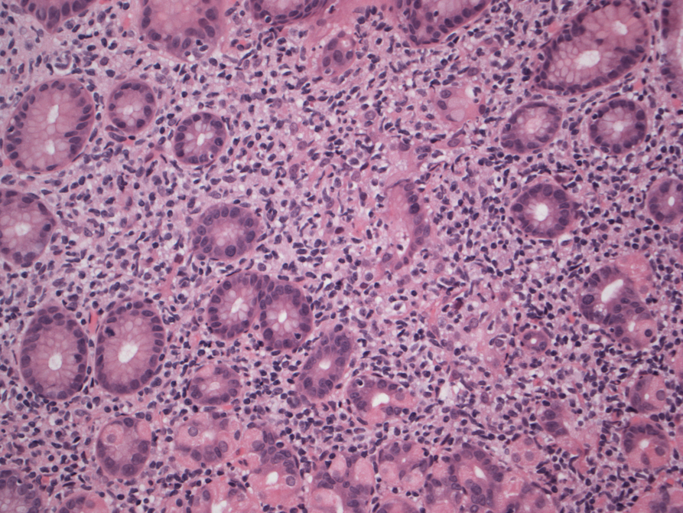
Gastric Biopsy Case 1
H pylori negative
t (11;18) negative

Slide 37
What Next?
Bone Marrow
CT scan/PET scan
Peripheral Blood Flow
Breath Test
H pylori antibodies
December 8, 2021

Slide 38
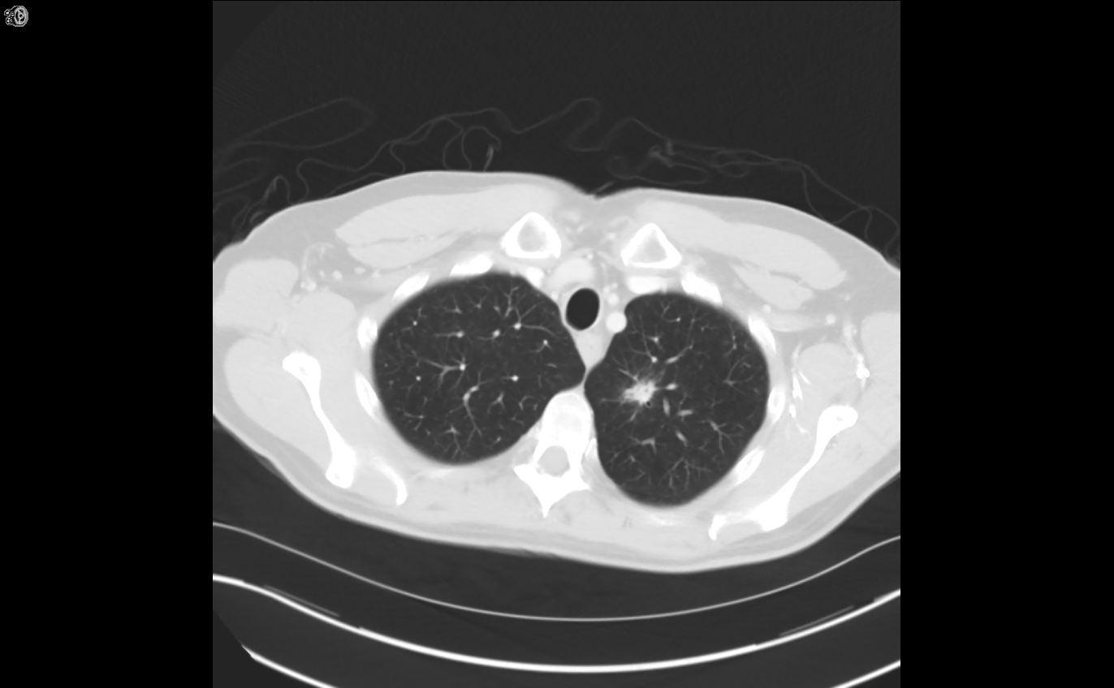
Staging CT Scan

Slide 39
Diagnostics: Would you do a PET-CT scan?
Yes
No
December 8, 2021

Slide 40
PET-CT
We did
Shows FDG hyper-metabolism in the lung lesion
SUV=8.5
December 8, 2021

Slide 41
What is the Next Step?
Antibiotics
Radiation to stomach
Wedge resection lung lesion
Observation
Rituximab
December 8, 2021
Notes:
Note from NCCN: changed ‘Rituxan’ to ‘rituximab’.

Slide 42
What might excision of lung mass show?
Hamartoma
Primary lung cancer
MALT lymphoma
DLBCL
Histoplasmosis
December 8, 2021
Notes:
Note from NCCN: Query for Dr Gordon – for the purpose of story flow, should the next slide be shown BEFORE the present slide?
LG: I wanted audience to guess at answer

Slide 43
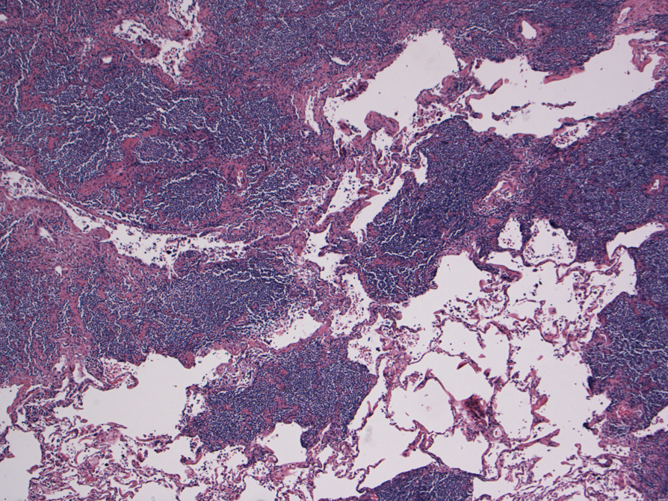
Excision of Lung mass
Notes:
Note from NCCN: Query for Dr Gordon – for the purpose of story flow, should this be shown BEFORE the previous slide?
LG: I wanted audience to try to guess what the biopsy would show, since lymphoma was a bit if a surprise here

Slide 44
What Treatment ?
Radiation to stomach
Rituximab +/- radiation to the stomach
Antibiotics
Chlorambucil and rituximab
Y90-ibritumomab tiuxetan
December 8, 2021
Notes:
Note from NCCN: changed brand names to generic drug names, ie, ‘Rituxan’ to ‘rituximab’ and ‘Zevalin’ to ‘ibritumomab tiuxetan’.

Slide 45
EN Marginal Zone Lymphomas
Observation (skin, lung, breast)
Local therapy (surgery, radiation)
Antibiotics (for H pylori or rarely chlamydia)
Systemic therapy

Slide 46
Splenic Marginal Zone Lymphoma

Slide 47
Case 2
60-year-old with pancytopenia
Early satiety
Exam: splenomegaly
WBC=3.3, ANC=1.2, platelets=95k
Smear shows…
December 8, 2021

Slide 48
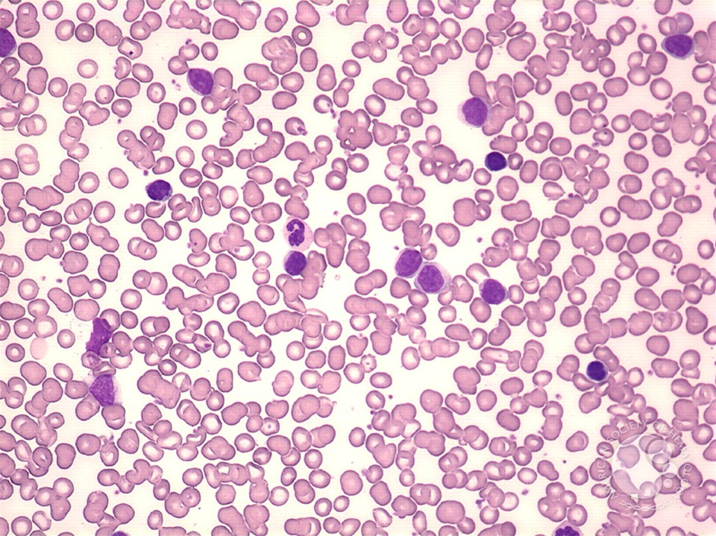
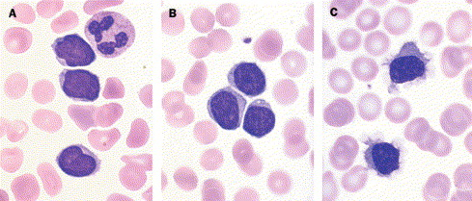
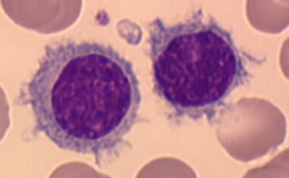
Blood Smear Case 2

Slide 49
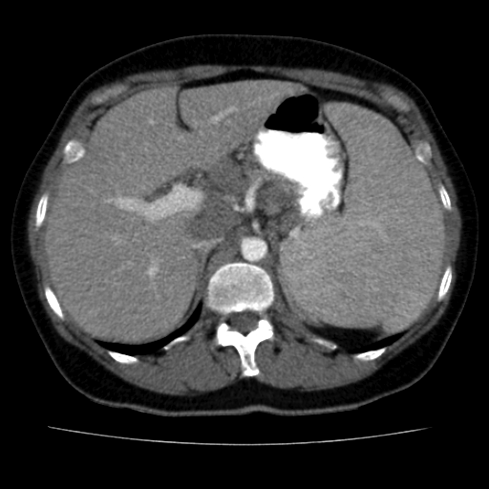
Enlarged Spleen

Slide 50
What next ?
Bone Marrow
Peripheral Blood Flow
Splenectomy
Liver biopsy
Right SCV node biopsy
December 8, 2021

Slide 51
Case 2 Peripheral Blood Flow
CD20++
CD5 negative
CD10 negative
Cyclin D1 negative
Hepatitis C negative
Diagnosis : SMZL
December 8, 2021

Slide 52
Case 2 What Treatment?
Observation
Chlorambucil
Chlorambucil and rituximab
Rituximab
Splenectomy
December 8, 2021
Notes:
Note from NCCN: corrected spelling to ‘chlorambucil’; also changed brand name ‘Rituxan’ to ‘rituximab’.

Slide 53
Lymphoma Presenting in Spleen
Primary in Spleen
SMZL
HCL and Variants
B-PLL
T-LGL
Hepatosplenic T-cell
Primary Splenic Presentation of Nodal Lymphoma
MCL
FL
DLBCL
T-cell/histiocyte rich DLBCL
Iannitto and Tripodo. Blood 2011; 117: 2585

Slide 54
SMZL and Hepatitis C
Hepatitis C has been associated with SMZL (Silvestri et al Ann Oncol 1998;9:499
Treatment of Hep C (IFN, ribavirin) may impact response in SMZL (Hermine et al NEJM 2002;11:89)
Treated 9 patients with IFN and ribavirin
5 no prior therapy, 2 splenectomy, 1 chemotherapy
6/9 had cryoglobulinemia (purpura, neuropathy, arthralgia)
December 8, 2021

Slide 55
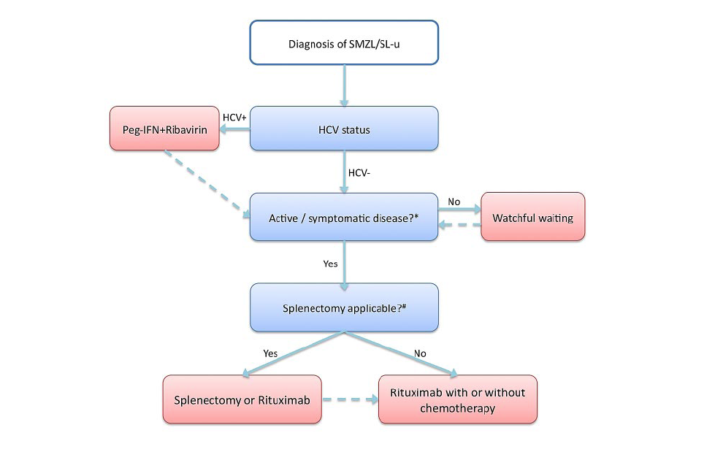
Treatment Options in SMZL
December 8, 2021

Slide 56
Nodal Marginal Zone Lymphoma

Slide 57
Case #3
60-year-old man with adenopathy
SPEP shows clonal IgM=300 mg/dL
Bx shows small lymphocytes with plasmacytic differentiation, MyD88+
CT shows disease above and below the diaphragm
Marrow shows interstitial lymphoid infiltrate with plasmacytic differentiation and MyD88+
What is the diagnosis?

Slide 58
Case #3
MZL
Waldenstrom's macroglobulinemia

Slide 59
Case #3
Observation
Rituximab-based therapy (monotherapy, BR, R-CHOP, R²)
Ibrutinib
Zanubrutinib
Copanlisib

Slide 60
Case #3
Two years later he has progression and symptoms and AIHA
Re-biopsy shows the same morphology
Now what?

Slide 61
Case #3
Observation
Rituximab-based therapy (monotherapy, BR, R-CHOP, R²)
Ibrutinib
Zanubrutinib
Copanlisib

Slide 62
Case #3
He is treated with BR and has complete response
Should he get maintenance rituximab?
In 2019 ?
In 2021 ?

Slide 63
Case #3
3 years later he relapses with symptoms
Options ?

Slide 64
Case #3
Observation
Rituximab-based therapy (monotherapy, BR, R-CHOP, R²)
Ibrutinib
Zanubrutinib
Copanlisib

Slide 65
Nodal Marginal Zone Lymphoma
Present like FL
Multiple nodal sites
May be observed
Most usually not very FDG avid
Treatment historically has been like FL

Slide 66
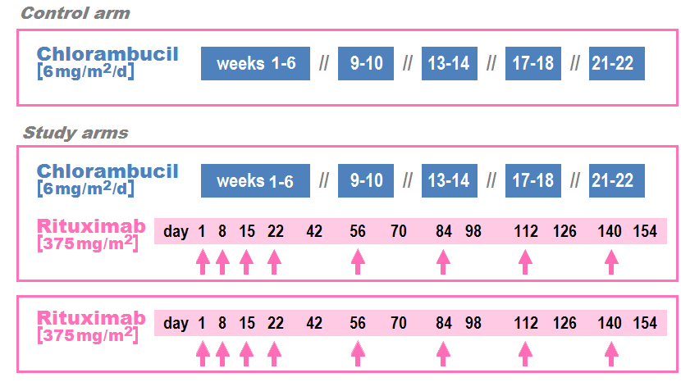
Systemic treatment of Marginal Zone Lymphoma
Zuca et al ICML 2013

Slide 67
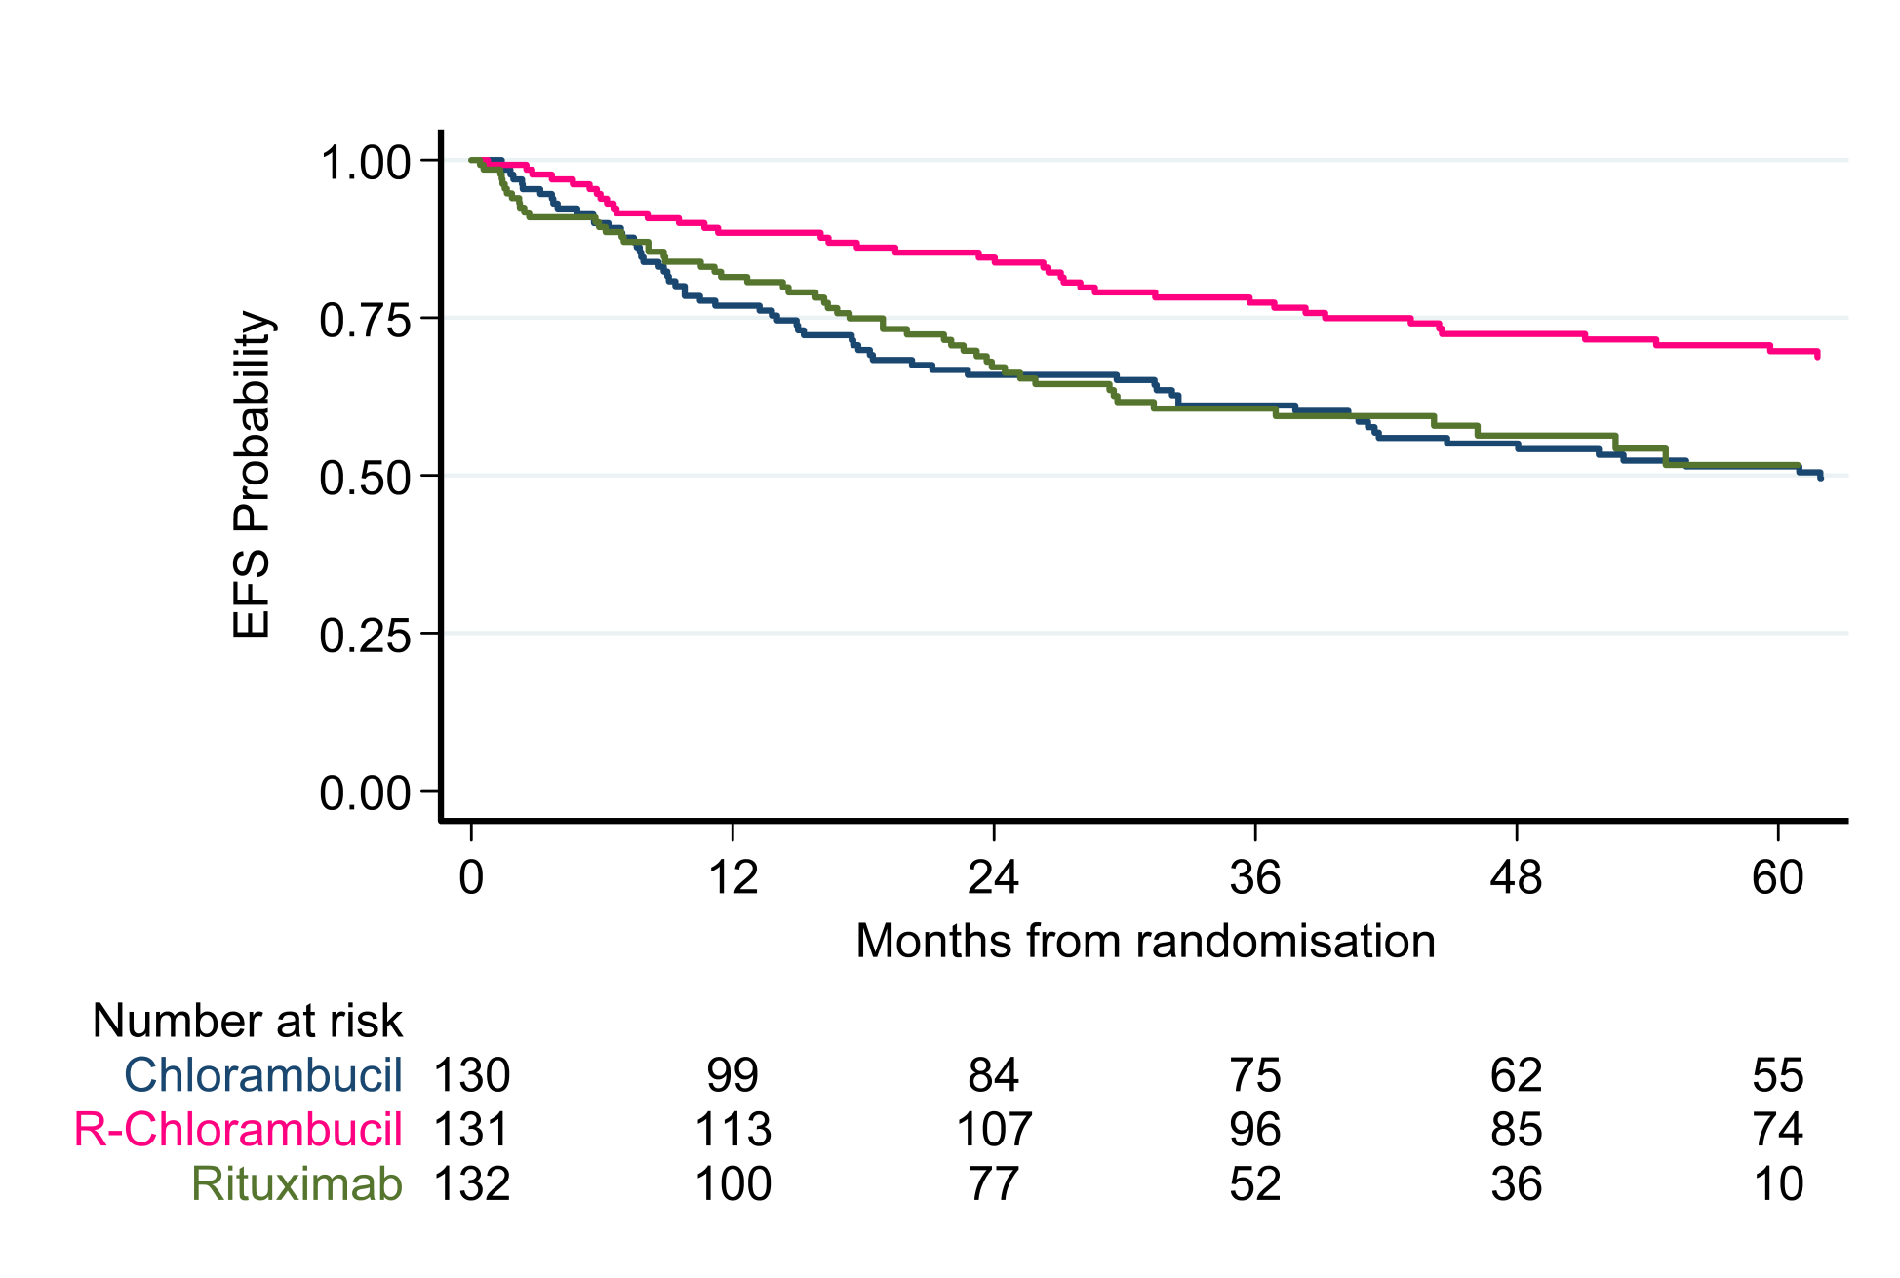
Systemic treatment of Marginal Zone Lymphoma
December 8, 2021
Zuca et al ICML 2013

Slide 68
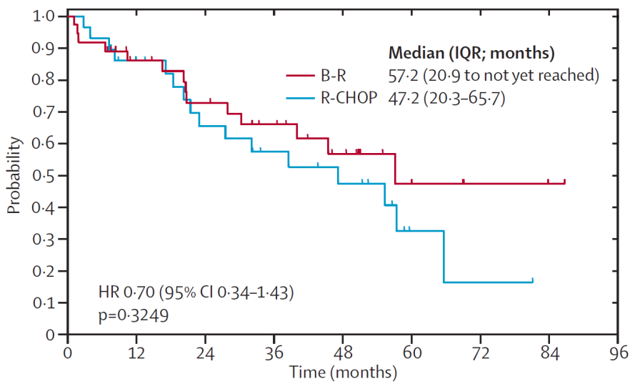
Systemic treatment of Marginal Zone Lymphoma: “StiL Trial” BR vs R-CHOP
Rummel et al Lancet 2013; 381(9873):1203

Slide 69
AUGMENT: A Phase III Randomized Study of Lenalidomide Plus Rituximab (R²) vs Rituximab/Placebo in Patients With Relapsed/Refractory Indolent Non-Hodgkin Lymphoma
John P. Leonard,¹ Marek Trneny,² Koji Izutsu,³ Nathan H. Fowler,⁴ Xiaonan Hong,⁵ Jun Zhu,⁶ Huilai Zhang⁷ Fritz Offner,⁸ Adriana Scheliga,⁹ Grzegorz Nowakowski,¹⁰ Antonio Pinto,¹¹ Francesca Re,¹² Laura Maria Fogliatto,¹³ Phillip Scheinberg,¹⁴ Ian Flinn,¹⁵ Claudia Moreira,¹⁶ David Liu,¹⁷ Stacey Kalambakas,¹⁷ Chengqing Wu,¹⁷ Pierre Fustier,¹⁸ and John G Gribben,¹⁹ on behalf of the AUGMENT study investigators
¹Meyer Cancer Center, Weill Cornell Medicine and New York Presbyterian Hospital, New York, NY; ²Charles University Hospital, Prague, Czech Republic ; ³National Cancer Center Hospital, Tokyo, Japan; ⁴The University of Texas MD Anderson Cancer Center, Houston, TX; ⁵Fudan University Shanghai Cancer Center, Shanghai, China; ⁶Beijing Cancer Hospital, Beijing, China; ⁷Tianjin Medical University Cancer Institute and Hospital, Tianjin, China; ⁸UZ Gent, Gent, Belgium; ⁹INCA Instituto Nacional De Câncer, Rio de Janeiro, Brazil; ¹⁰Mayo Clinic, Rochester, MN; ¹¹Istituto Nazionale Per Lo Studio E La Cura Dei Tumori Fondazione Giovanni Pascale, Napoli, Italy; ¹²Azienda Ospedaliero-Universitaria di Parma, Parma, Italy; ¹³Hospital de Clinicas de Porto Alegre, Porto Alegre, Brazil; ¹⁴ Division of Hematology, Hospital A Beneficência Portuguesa, São Paulo, Brazil; ¹⁵SCRI Tennessee Oncology Nashville, Nashville, TN; ¹⁶Instituto Português de Oncologia Do Porto Francisco Gentil Epe, Porto, Portugal; ¹⁷Celgene Corporation, Summit, NJ; ¹⁸Celgene Corporation, Boudry, Switzerland; ¹⁹Centre for Haemato-Oncology, Barts Cancer Institute, London, United Kingdom
Notes:
ASH 2018 Presentation Information
Title: AUGMENT: A Phase III Randomized Study of Lenalidomide Plus Rituximab (R2) vs Rituximab/Placebo in Patients with Relapsed/Refractory Indolent Non-Hodgkin Lymphoma
Session Name: 623. Mantle Cell, Follicular, and Other Indolent B-Cell Lymphoma—Clinical Studies: Antibodies, Immunomodulators, and BTK Inhibitors in Indolent NHL
Session Date: Sunday, December 2, 2018
Session Time: 4:30 PM - 6:00 PM
Presentation Time: 4:30 PM
Room: San Diego Convention Center, Hall AB
Presentations are projected and formatted here in 16:9 format

Slide 70
Study design: Randomized double blind phase III trial
≤ 12 cycles or until PD, relapse, or intolerability
R-lenalidomide (R²)
Rituximab: 375 mg/m² d1, 8, 15, 22 of cycle 1; d1 of cycles 2-5
Lenalidomide: 20 mg/d*, d1-21/28 (12 cycles)
5-year follow-up for OS, SPMs, subsequent treatment, and histological transformations
Relapsed/refractory FL and MZL
(N = 358)
1:1
*10 mg if CrCl between 30 to 59 mL/min.
R-placebo
Rituximab: 375 mg/m² d1, 8, 15, 22 of cycle 1; d1 of cycles 2-5
Placebo: matched capsules (12 cycles)
Stratification
Prior rituximab (yes vs no)
Time since last therapy (≤ 2 vs > 2 y)
Histology (FL vs MZL)
Key eligibility criteria
MZL or FL (grades 1-3a) in need of treatment
≥ 1 prior chemotherapy, immunotherapy or chemoimmunotherapy
Not rituximab refractory
Prophylactic anticoagulation / antiplatelet Rx recommended for at risk patients
Growth factor use was allowed per ASCO/ESMO guidelines^{1,2}
Primary endpoint: PFS by IRC (2007 IWG criteria w/o PET)
NCT01938001
1. Crawford et al. Ann Oncol. 2010;21 Suppl 5:248-251. 2. Smith et al. J Clin Oncol. 2015;33:3199-3212.

Slide 71
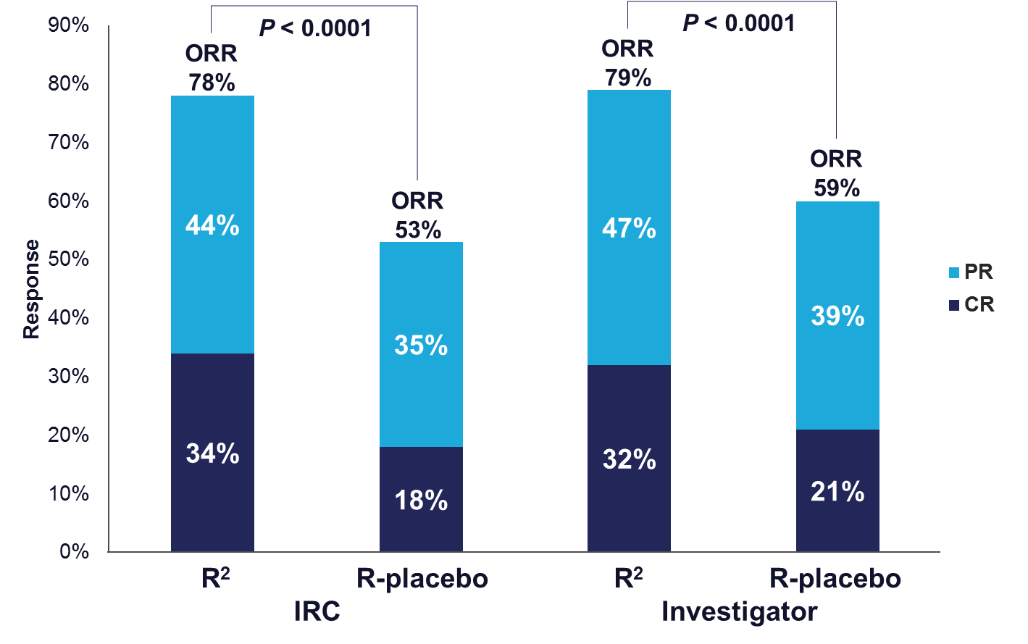
Response (ITT)
Median DOR was 36.6 mo (95% CI, 22.9-NR) for R² vs 21.7 mo (95% CI, 12.8-27.6) for R-placebo, HR 0.53 (95% CI, 0.36-0.79), P = 0.0015

Slide 72
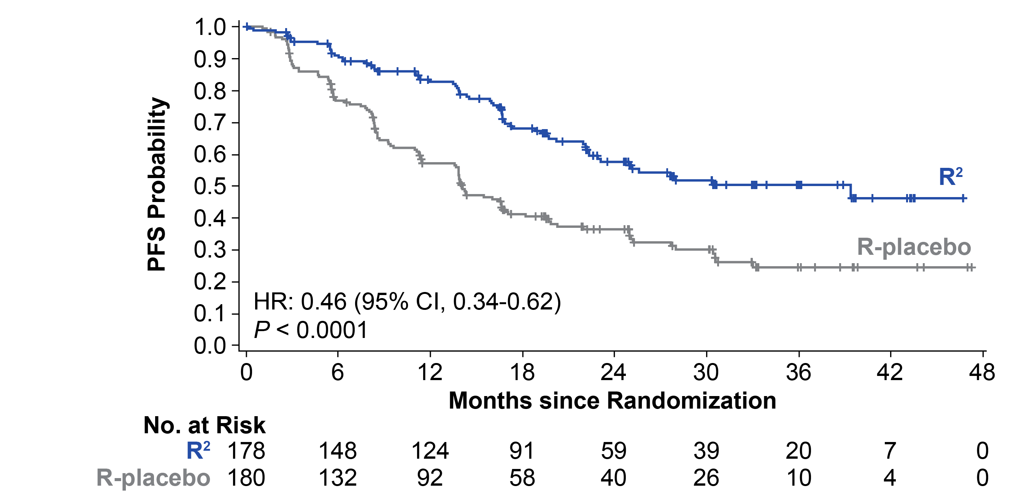
Primary endpoint: progression-free survival (ITT, IRC)
PFS by IRC*
Median follow up: 28.3 months
Median PFS | R² (n = 178) | R-placebo (n = 180) | HR (95% CI) | P Value
By IRC, mo (95% CI) | 39.4 (22.9-NE) | 14.1 (11.4-16.7) | 0.46 (0.34-0.62) | < 0.0001
By investigator, mo (95% CI) | 25.3 (21.2-NE) | 14.3 (12.4-17.7) | 0.51 (0.38-0.69) | < 0.0001

Slide 73
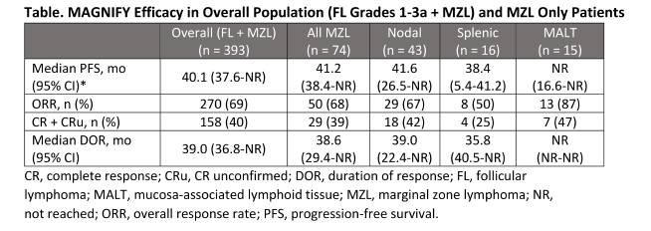
Magnify Trial (for MZL): Induction R² followed my maintenance R
Coleman et al ASH 2020 Abstract 1123

Slide 74
Magnify Trial (for MZL): Induction R² followed by maintenance R
 | Overall (FL + MZL) (n=393) | All MZL (n-74) | Nodal (n=43) | Splenic (n=16) | MALT (n=15)
Median PFS (range) | 40mos (38-NR) | 41 mos (38-NR) | 42 mos (26-NR) | 38 mos (5-41) | NR (17-NR)
ORR (%) | 270 (69) | 50 (68%) | 29 (67%) | 8 (50%) | 13 (87)
CR + Cru (%) | 158 (40) | 29 (39%) | 18 (42%) | 4 (25%) | 7 (47%)
Median DOR | 39 (37-NR) | 39 (29-NR) | 39 (22-NR) | 36 (40-NR) | NR (NR-NR)
Coleman et al ASH 2020 Abstract 1123

Slide 75
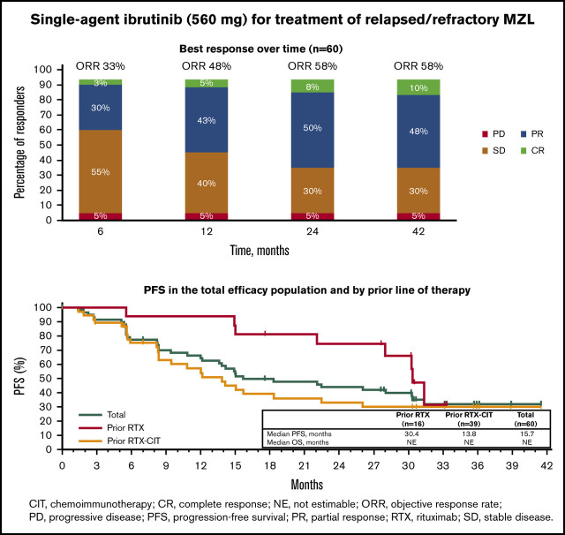
Ibrutinib in Marginal Zone Lymphoma: PCYC 1121
n=63
ibrutinib 560
Prior R or R-chemotherapy
ORR 58%
DOR 28 m
ORR was
63% EN
47% Nodal
62% Splenic
Noy et al BLOOD 2017; 129 (16):2224
Noy et al Blood Adv 2020 4(22):57873

Slide 76
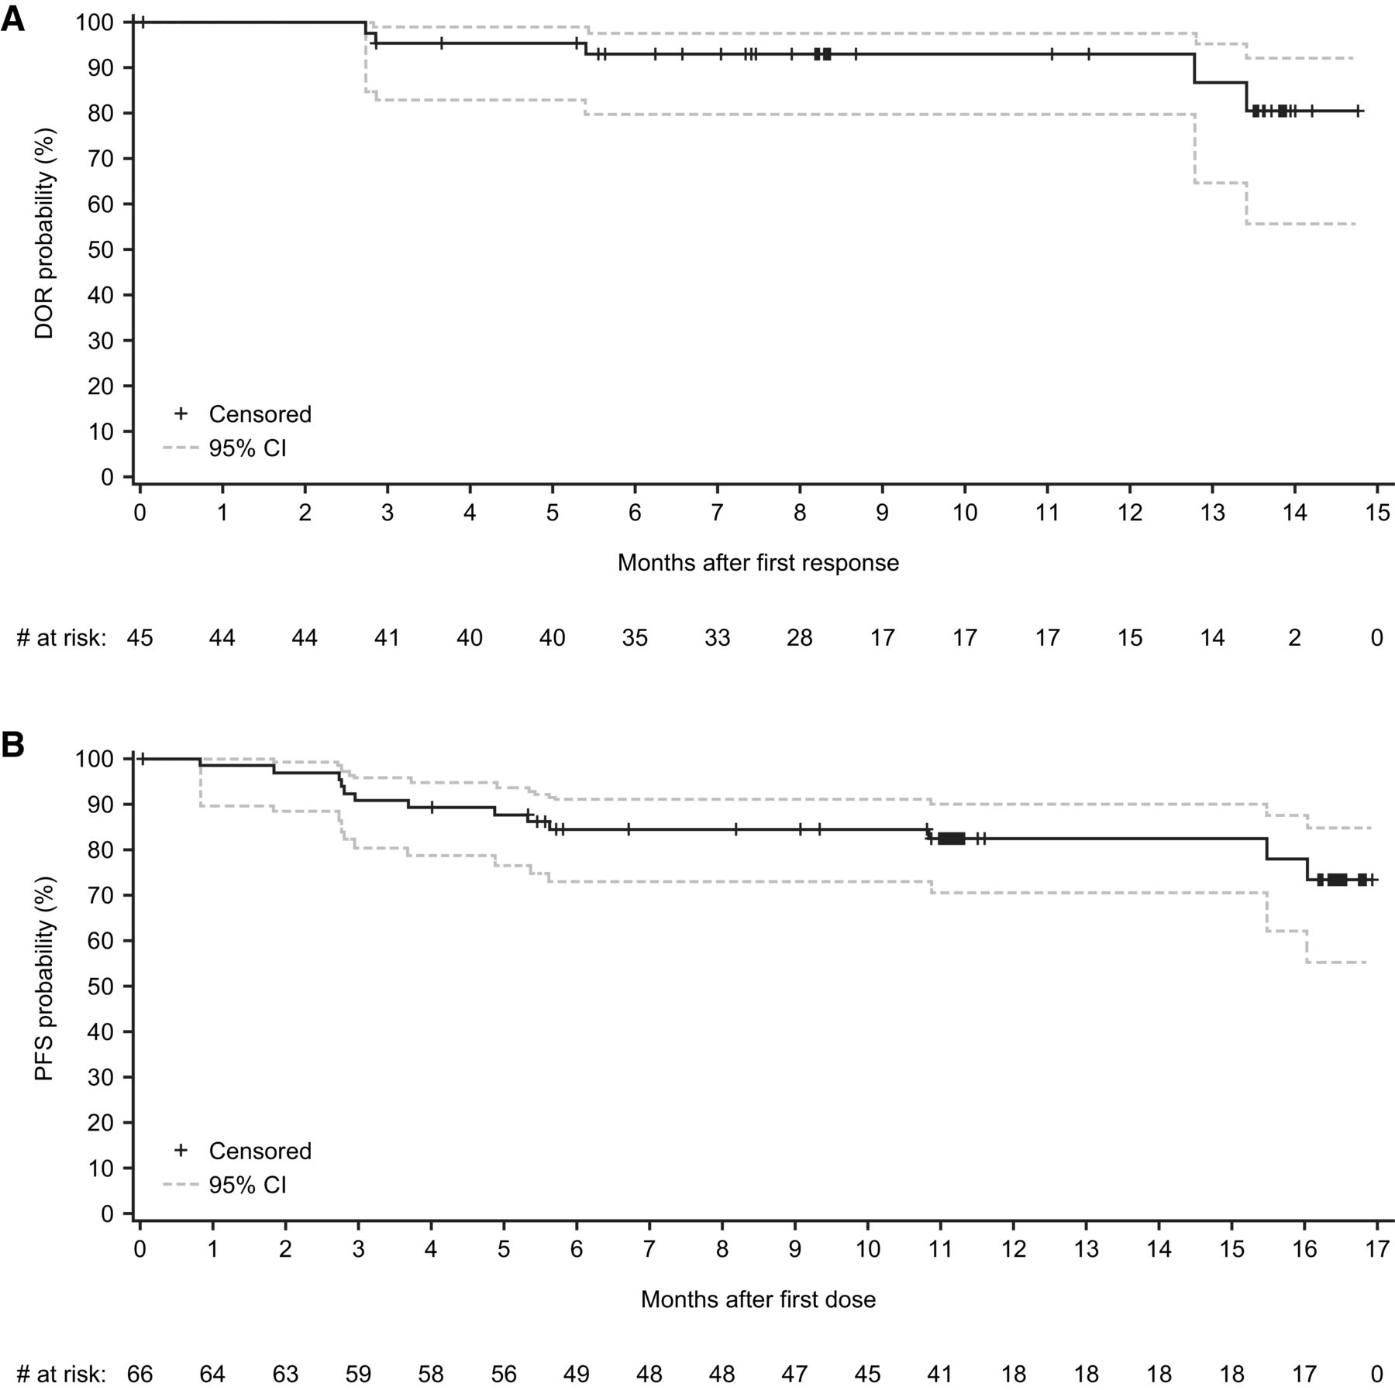
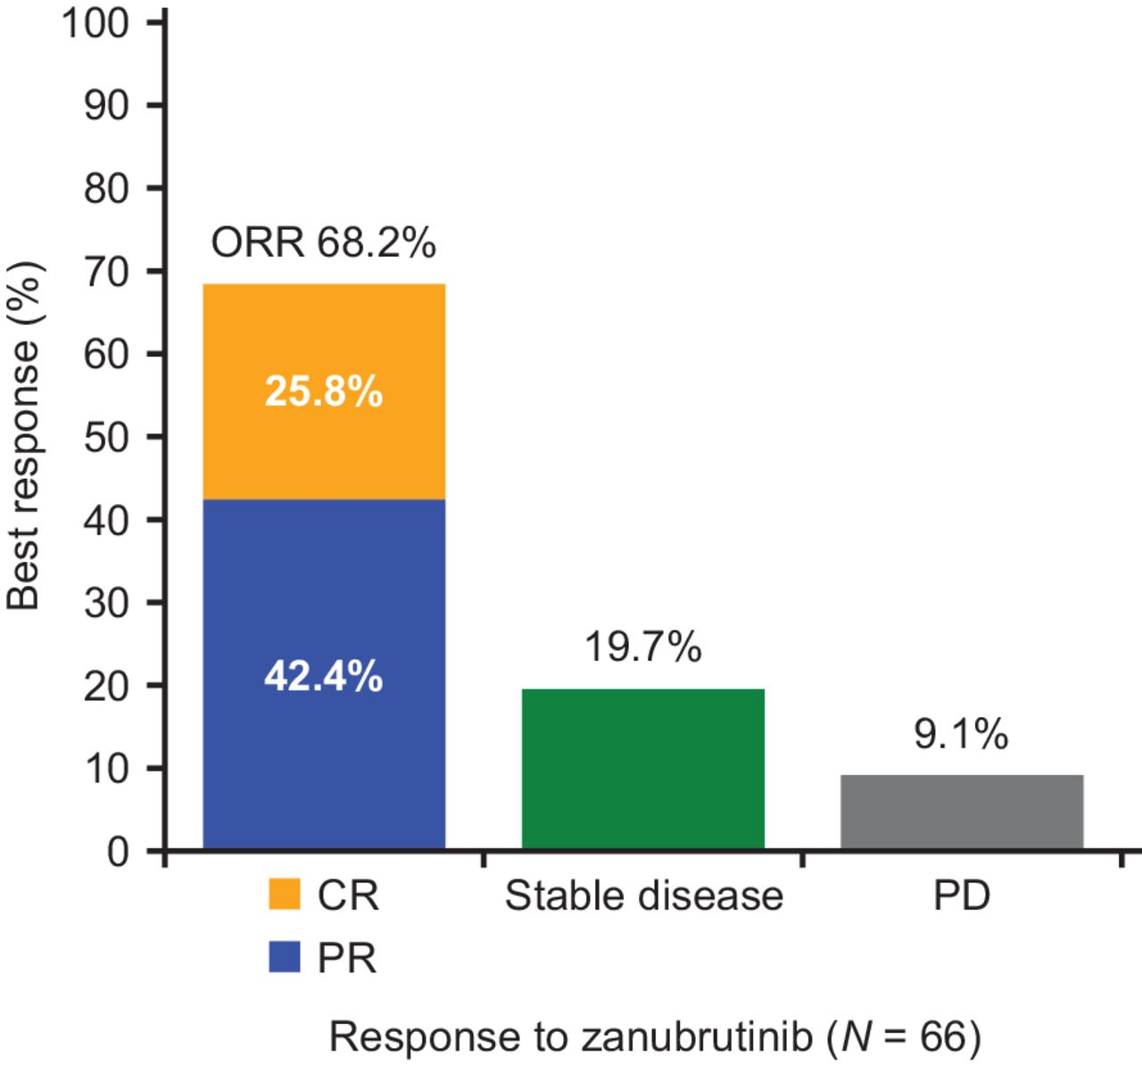
The MAGNOLIA Trial: Zanubrutinib in R/R Marginal Zone Lymphoma
Phase II
1 prior line or >
31 sites, 9 countries
n=68
Zanubrutinib 320
PET response
Opat et al Clin Cancer Res 20221; 27:6323

Slide 77
Novel Treatments
PI3K Inhibitors: Idelalisib, duvelisib, Copanlisib Umbralisib
CAR T

Slide 78
FDA grants accelerated approval to umbralisib for marginal zone lymphoma and follicular lymphoma
February 5, 2021
UTX-TGR-205 (NCT02793583)

Slide 79
PI3K Inhibitors
1st generation PI3K δ inhibitor:
Idelalisib
2nd generation PI3K δ inhibitors:
Umbralisib (TGR-1202)
INCB050465
Dual PI3K inhibitor (δ and γ):
Duvelisib (IPI-145)

Slide 80
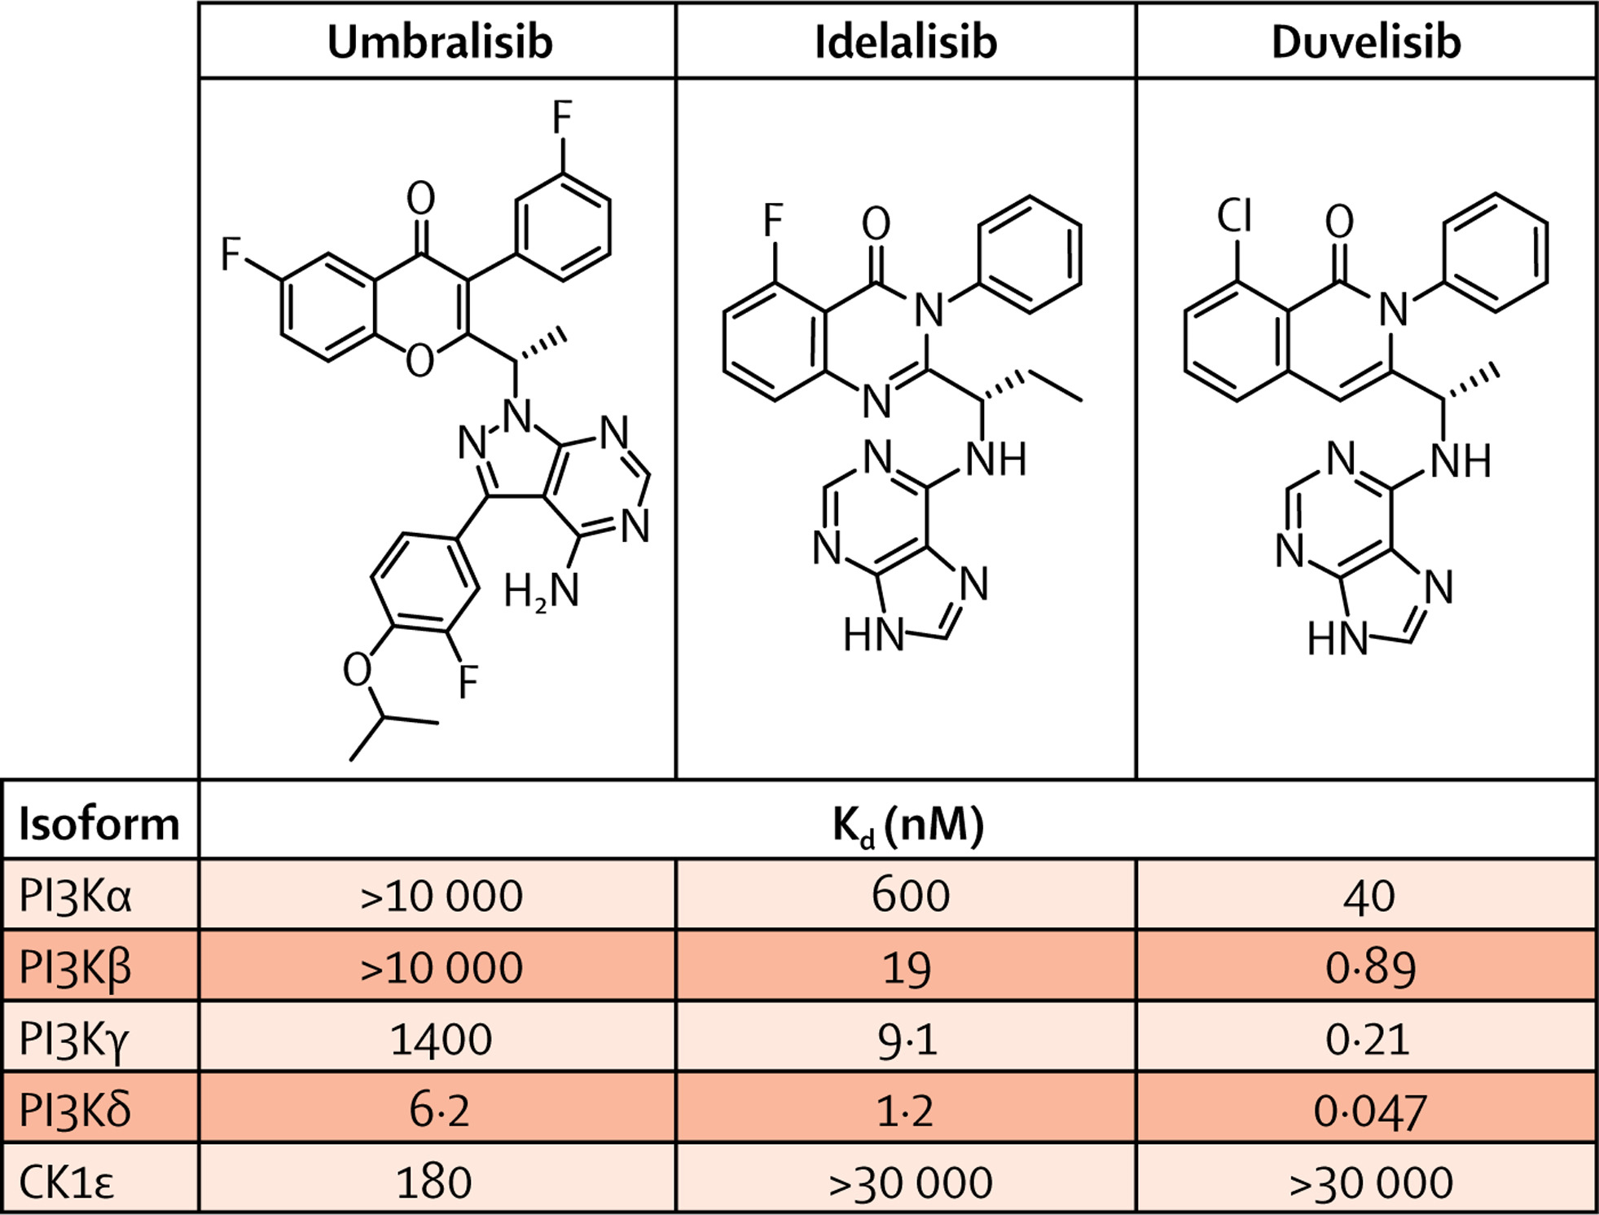
Umbralisib: Inhibitor of PI3Kδ and Casein Kinase-1ε
Umbralisib is an inhibitor of PI3K isoform p110δ:
structurally distinct from idelalisib and duvelisib
Has demonstrated improved isoform selectivity
Limited inhibition of CYP450
PK profile that allows once-daily oral dosing
The impact of differences in the mechanism of action is unknown, and these findings do not enable safety or efficacy comparisons between these compounds
Burris HA, et al. Lancet Oncol. 2018 Feb 20

Slide 81
Relapsed or Refractory CLL and other NHL: An Open-Label, Phase 1, Dose-Escalation, First-in-Human Study
Study Schema
Relapsed≥ 1and or refractory Lymphoma, CLL cHL or T cell
>1 prior regimen prior treatment regimen
Umbralisib 50 – 1800 mg*# PO QD Days 1 – 28
OR Umbralisib (micronized) 200 – 1800 mg*# PO QD Days 1 – 28
Until PD, unacceptable toxicity, or withdrawal of consent
*Intra-patient dose escalation permitted for patients in earlier cohorts following establishment of safety at higher doses.
Response assessments were performed every two cycles until cycle 12, and then at least every six cycles
Pneumocystis jiroveci pneumonia prophylaxis was permitted but not mandated during the study
Burris HA, et al. Lancet Oncol. 2018 Feb 20

Slide 82
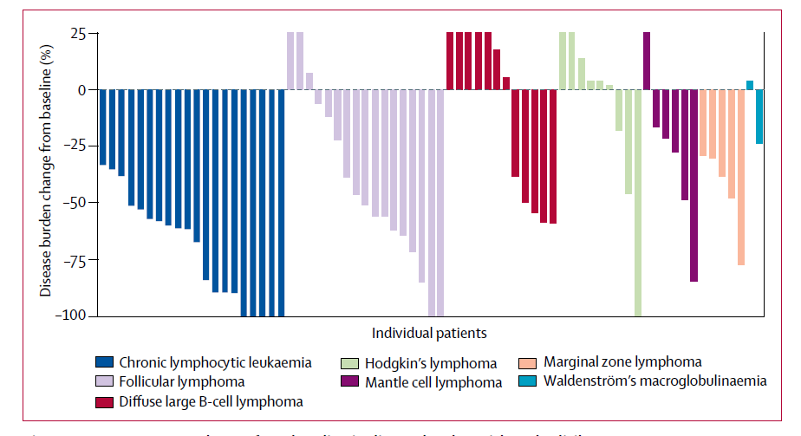
Umbralisib Monotherapy Phase I Trial Relapsed/Refractory CLL and Lymphoma - Clinical Activity*
CLL
FL
MZL
*Best percentage change from baseline in disease burden with umbralisib treatment
Burris HA, et al. Lancet Oncol. 2018 Feb 20

Slide 83
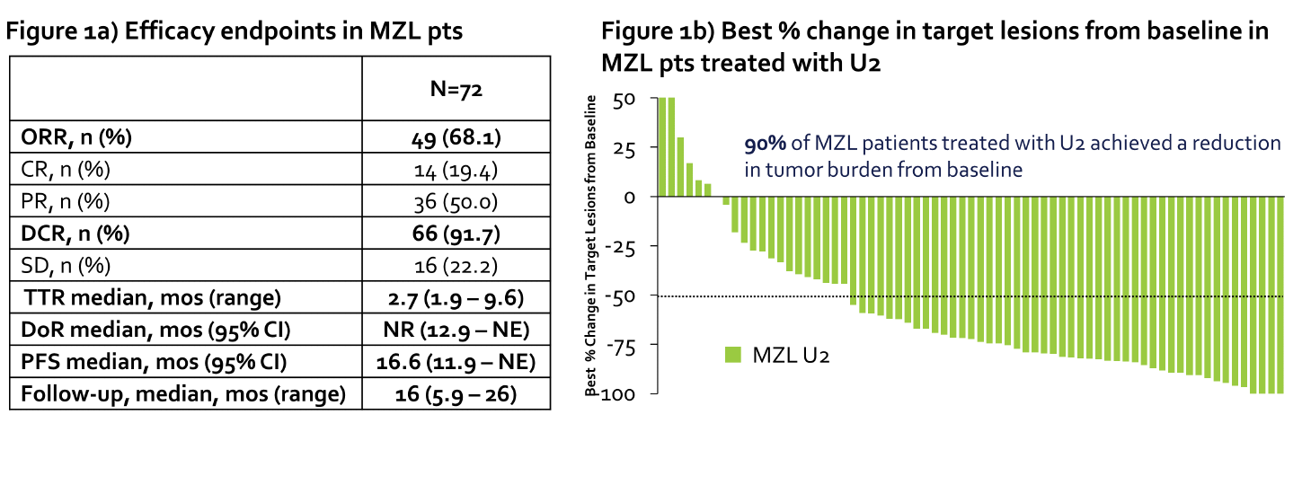
More PI3K inhibitors: Unity Trial: Ubralisib and Ublituximab (U2)
Regimen
Umbralisib 800 mg QD till PD
Ublituximab IV day 1, 8,15 (C-1) then
Monthly C 2-6 then q3 months x 2 years
Toxicity
49% diarrhea
30% nausea
Chavez et al ASH 2021 Abstract 45 Session 623

Slide 84
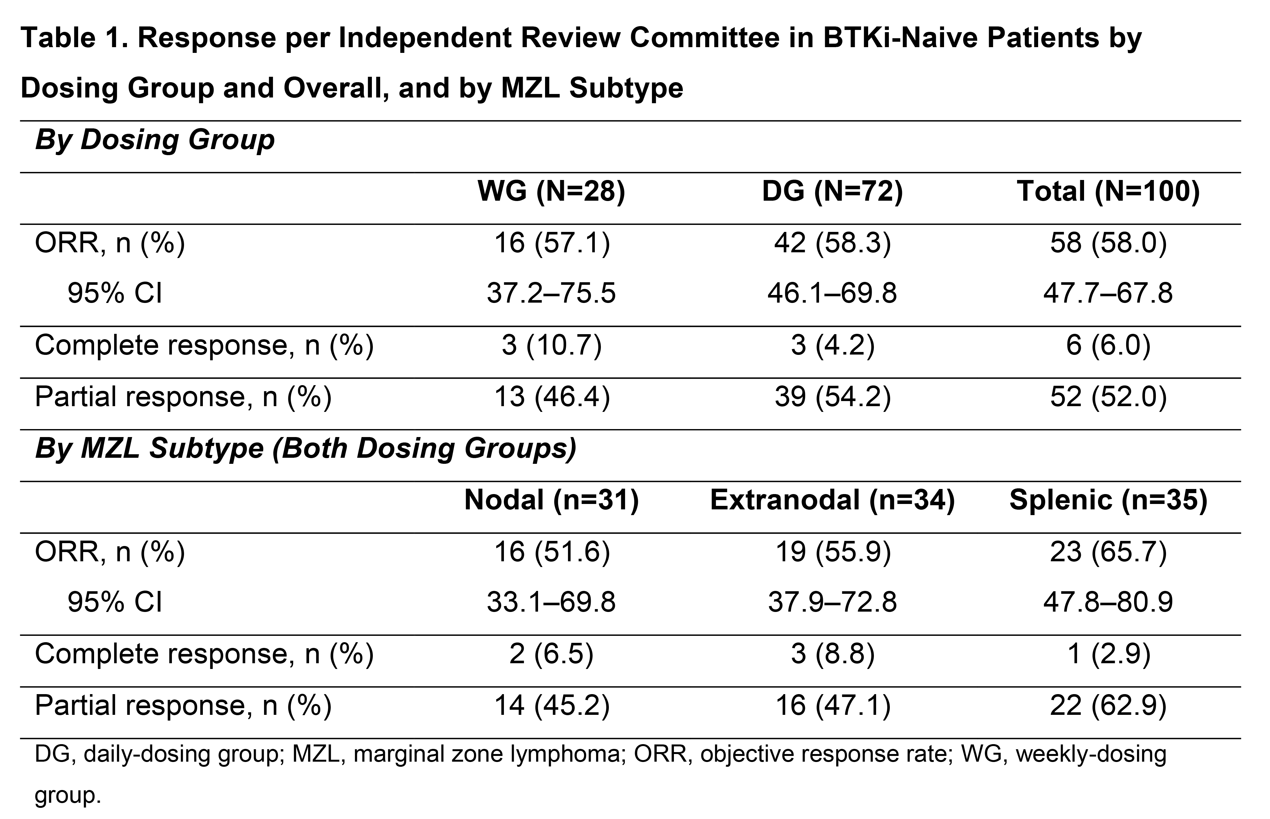
More PI3K inhibitors: Parsaclisib
n=100
Parsaclisib 20 mg QD x 8 weeks then 20 mg weekly or 2.5 mg QD
Primary end point ORR and secondary end points DOR, CRR, PFS
Median age = 71
Phillips et al ASH 2021 Abstract 44 Session 623

Slide 85
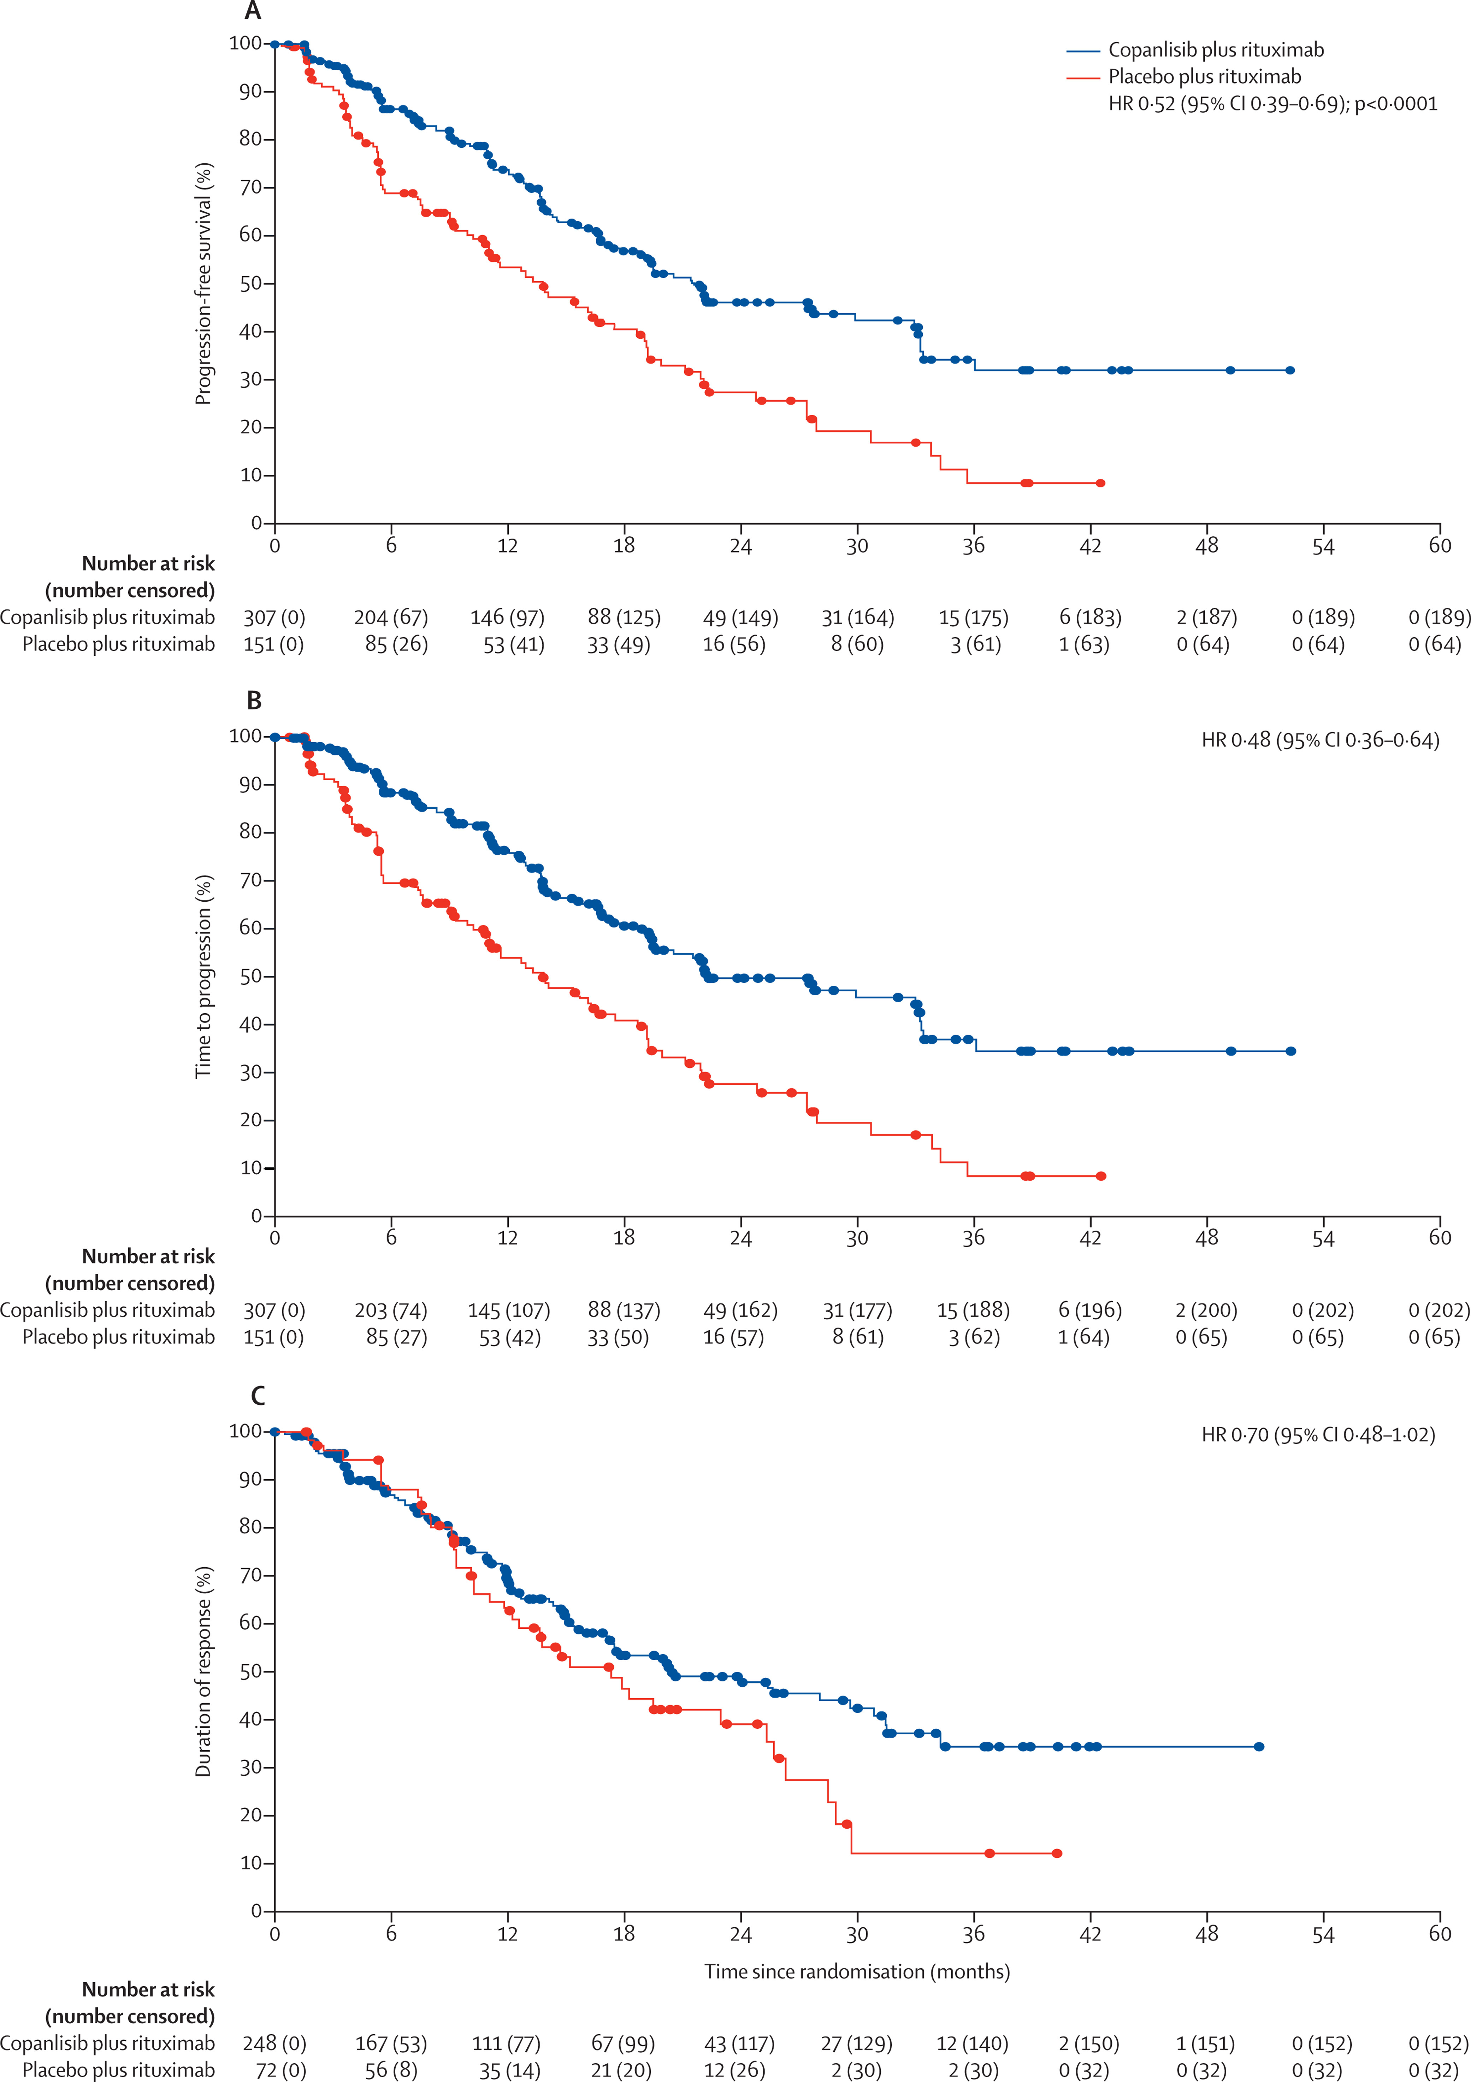
Chronos 3: Copanlisib for Indolent Lymphoma
Copanlisib: Pan class PI3K inhibitor
n=458 randomized C + R or Placebo +R
Median f/u 19 months, 205 events
PFS 21.5 m vs 13.8 m
Hyperglycemia in 57%
Hypertension in 40%
PFS
Time to Progression
DOR
Matasar et al Lancet Oncol 2021; 22:678

Slide 86
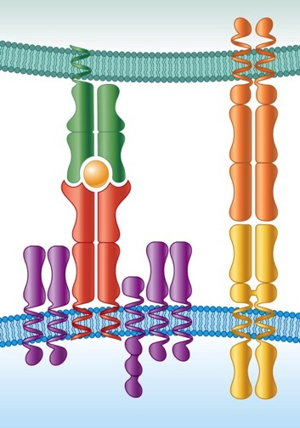
CAR Design: Critical Elements
CAR T cells are genetically altered to express CAR on the cell surface.
T Cell Receptor
Chimeric Antigen Receptor
APC
scFv: recognize tumor surface proteins
Costimulatory Signal 2: CD28 or 4-1BB or OX40
Essential Signal 1:
CD3ζ
pMHC
CD28L
TCR
CD28
T Cell
CD3ζ
Activation Independent of MHC
Limited to cell surface proteins

Slide 87
ZUMA-5 (cont.)
Overall ORR by IRRC assessment was 93% (95% CI, 86-97), and CR rate was 80% (95% CI, 71-88)
The median time to first response was 1 month (range, 0.8-3.1)
Of the 80 patients with FL, 10 (13%) had an initial response of PR at Week 4 and later converted to CR
Jacobson et al 2020

Slide 88
ZUMA-5 (cont.)
Progression-Free Survival and Overall Survival
With a median follow-up of 15.3 months, median PFS was 23.5 months (95% CI, 22.8-NE) in all patients, and the median OS was not reached
The 12-month OS rate was 94.3% (95% CI, 86.8-97.6) for all patients
Jacobson et al, 2020.

Slide 89
Therapy for MZL: NCCN 2021
First Line
BR
R-CHOP
R-CVP
R
Ibrutinib
R²
First Line Extended
Rituximab x 2 years
Second Line and Subsequent
Obinutuzumab + CHOP
+CVP
+Bendamustine
+Lenalidomide
BTK inhibitors (ibrutinib, Acalabrutinib, Zanubrutinib)
R²
PI3K inhibitors (Copanlisib, Duvelisib, Idelalisib, Umbralisib all 3rd or 4th line)
NCCN 2021

Slide 90
Therapy for MZL: NCCN 2021
Second Line Consolidation and Extended Dosing
Rituximab
Transplant in selected patients
Histologic Transformation
Anthracycline based if not given
Transplant
Lisocabtagene maraleucel
Loncastuximab teserine
NCCN 2021

Slide 91
MZL: Take Home Messages
MZL are linked and overlap
Antigen driven
Infection associated
t(11;18) (q21;q21), t(1;14)(p22;q32), BCL10 and common path to NF-kB
Treat HCV in SMZL
Splenectomy vs. rituximab in SMZL
Nodal and some Extra-nodal MZL could be treated like FL
PI3k inhibitors: Umbralisib FDA approved 2/5/2021
CAR T therapy ZUMA 5

Slide 92
Post-Assessment Question 1
Which form of marginal zone lymphoma (MZL) is most common?
Nodal MZL
Extra-modal MZL (MALT lymphoma)
Splenic MZL

Slide 93
Post-Assessment Question 2
In the AUGMENT study of lenalidomide plus rituximab (R²) vs rituximab plus placebo in patients with relapsed/refractory indolent NHL, what was the overall response rate (ORR) observed with R²?
~98%
~78%
~58%
~38%

Slide 94
Post-Assessment Question 3
Which of the following PI3K inhibitors is FDA approved for patients with MZL?
Idelalisib
Duvelisib
Umbralisib
Alpelisib

Slide 95
Q&A
Type your questions into the Question tab
of your webinar control panel

Slide 96
Thank You!
Please complete the post-webinar evaluation at
(This link will pop-up on your screen after the webinar ends)
https://cvent.me/8w42LA
A CME request form is available for download at the end of the online evaluation.
Visit OncologyCaseClinic.com to register for
upcoming webinars.
A recording of today’s webinar with downloadable slides
will be available at OncologyCaseClinic.com in about 2 weeks.
Next presentation: Wednesday, January 12
Updates from ASH
Sonali Smith, MD, FASCO

